Slide 1
CDC/IDSA COVID-19 Clinician Call
January 30, 2021
52nd in a series of weekly calls, initiated by CDC as a forum for information sharing among frontline clinicians caring for patients with COVID-19
The views and opinions expressed here are those of the presenters and do not necessarily reflect the official policy or position of the CDC or IDSA. Involvement of CDC and IDSA should not be viewed as endorsement of any entity or individual involved.
This webinar is being recorded and can be found online at www.idsociety.org/cliniciancalls.
Welcome & Introductions
  Dana Wollins, DrPH, MGC
  Vice President, Clinical Affairs & Guidelines IDSA

Slide 2
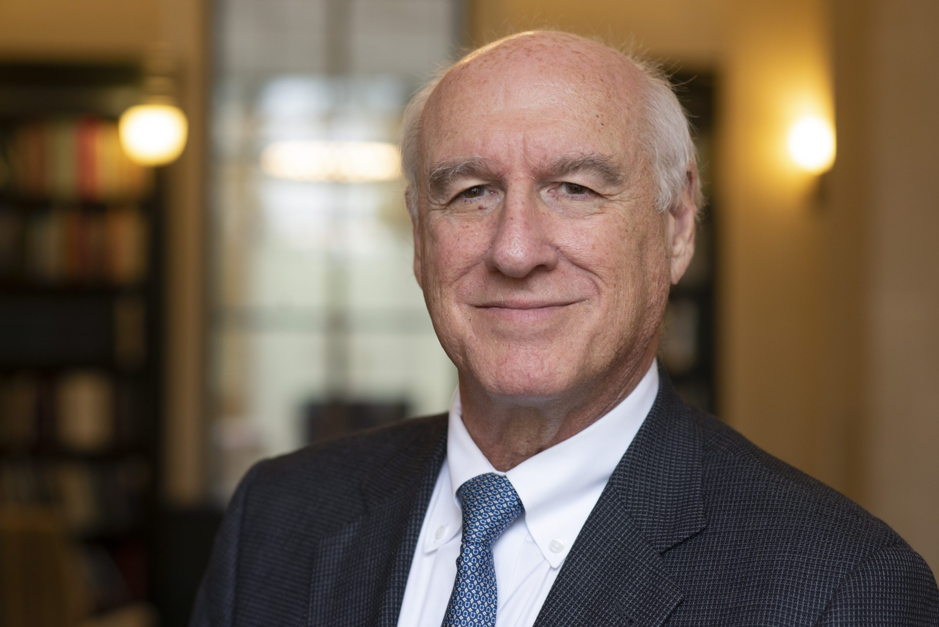


Today’s Topics and Featured Experts:
Monoclonal Antibodies Update & More on COVID-19 Vaccines
Monoclonal Antibodies Update
Myron Cohen, MD
Yeargan-Bate Distinguished Professor of Medicine, Microbiology and Immunology, and Epidemiology
Associate Vice Chancellor for Global Health and Medical Affairs
UNC School of Medicine
Rajesh Gandhi, MD, FIDSA
Director, HIV Clinical Services and Education
Massachusetts General Hospital
Professor of Medicine, Harvard Medical School
COVID-19 Vaccine Update
Kathleen Dooling, MD, MPH​
Co-Lead, COVID-19 Work Group
Advisory Committee on Immunization Practices (ACIP)​
Centers for Disease Control and Prevention

Slide 3

Question?
Use the “Q&A” Button
Comment?
Use the “Chat” Button

Slide 4

Monoclonal Antibodies for Treatment and Prevention of COVID-19
Rajesh T. Gandhi, MD
Massachusetts General Hospital
Boston, MA
Myron S. Cohen, MD
University of North Carolina
Chapel Hill, NC
RG: scientific advisory board for Merck (>1 yr ago) and Gilead (>2 yr ago)
MSC: Co-PI on behalf of NIH CoVPN focused on mAb development with industry

Slide 5
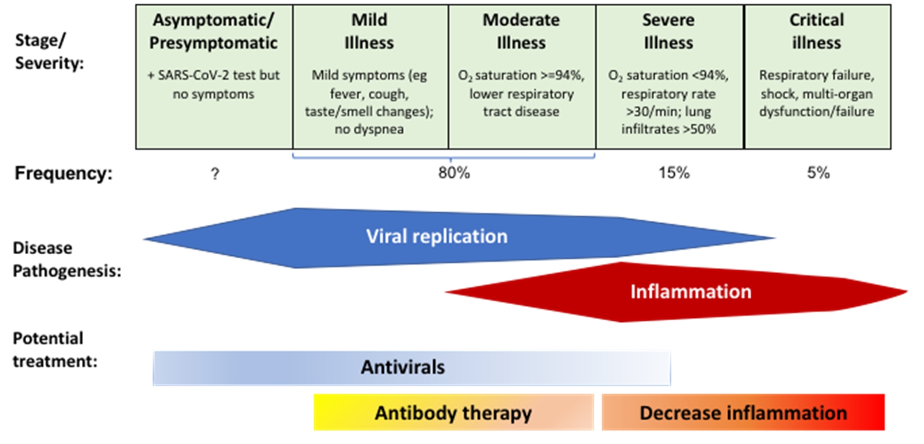
Management Across the COVID-19 Spectrum
Gandhi RT, CID, 2020; Gandhi RT, Lynch J, del Rio C. NEJM 2020

Slide 6

Monoclonal Antibodies
Boost immune responses
Monoclonal antibodies (mAbs) against SARS-CoV-2 spike protein being studied for treatment and prevention
Emergency Use Authorizations (EUAs) for treatment of ambulatory patients with mild to moderate COVID-19 at high risk of progression and within 10 days of symptom onset:
  Bamlanivimab (700 mg)
  Casirivimab + Imdevimab (2400 mg)
EUA criteria: https://www.fda.gov/media/143603/download https://www.fda.gov/media/143892/download

Slide 7
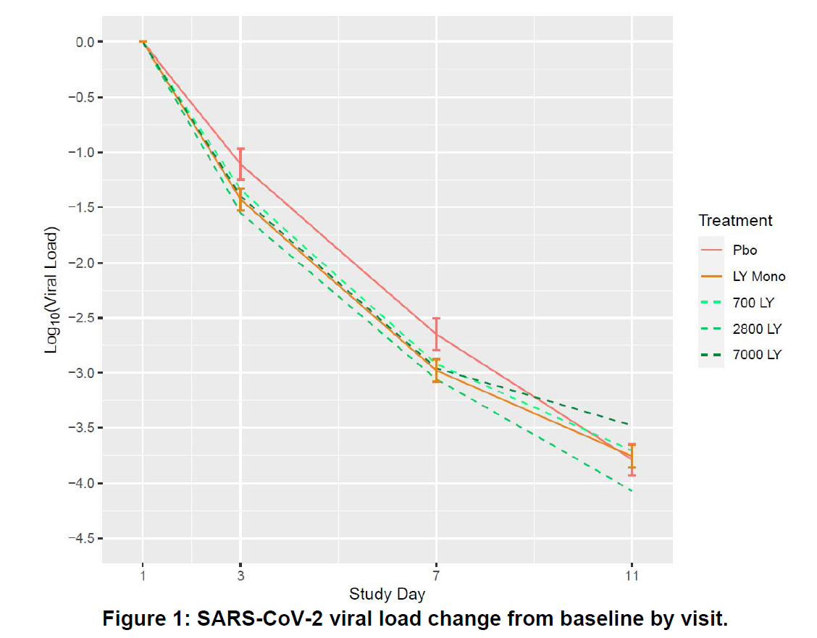
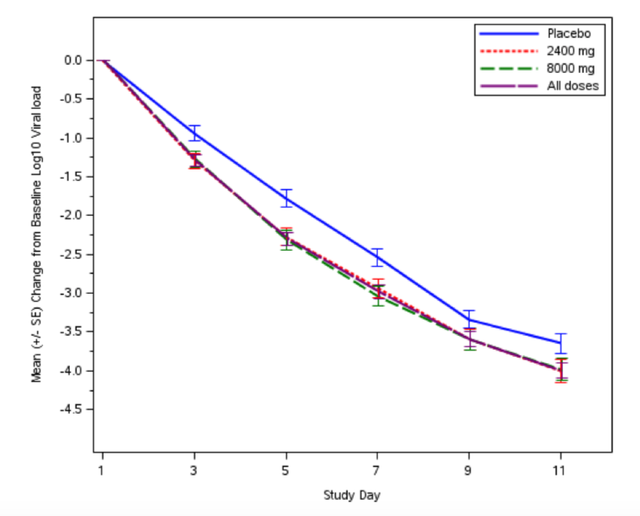
Antiviral Effect of Monoclonal Antibodies
In outpatients with mild to moderate COVID-19, bamlanivimab and casirivimab + imdevimab appeared to accelerate decline in SARS CoV-2 level compared to placebo
Bamlanivimab vs placebo
Casirivimab/imdevimab vs placebo
  Largest reduction in viral load in participants seronegative at baseline
Chen P et al, NEJM, 2020; http://pi.lilly.com/eua/bamlanivimab-eua-factsheet-hcp.pdf;
https://www.regeneron.com/sites/default/files/treatment-covid19-eua-fda-letter.pdf; Weinreich DM et al. N Engl J Med 2020 Dec 17

Slide 8
Bamlanivimab
In outpatients with mild to moderate disease (n=452) enrolled within 3 days of positive SARS-CoV-2 test, lower rate of ED visits/hospitalization in those who received bamlanivimab vs. placebo, particularly among high-risk patients
Hospitalization/ED Visit: All Participants
Treatment | N | Events | Proportion
Placebo | 156 | 9 | 6%
700 mg | 101 | 1 | 1%
2800 mg | 107 | 2 | 2%
7000 mg | 101 | 2 | 2%
Pooled antibody | 309 | 5 | 2%
Hospitalization/ED Visit: Participants at Higher Risk of Hospitalization
Treatment | N | Events | Proportion
Placebo | 69 | 7 | 10%
700 mg | 46 | 1 | 2%
2800 mg | 46 | 1 | 2%
7000 mg | 44 | 2 | 5%
Pooled antibody | 136 | 4 | 3%
Chen P et al, NEJM, 2020; http://pi.lilly.com/eua/bamlanivimab-eua-factsheet-hcp.pdf

Slide 9
Casirivimab/Imdevimab (C/I)
In outpatients with mild to moderate disease (n=799) enrolled within 3 days of positive SARS-CoV-2 test, lower rate of hospitalization/ED visit in those who received casirivimab/imdevimab vs. placebo, particularly among high-risk patients
Safety of antibodies and placebo similar
  1 anaphylactic reaction, 4 infusion reactions (8000 mg group)
Hospitalization/ED Visit: All Participants
Treatment | N | Events | Proportion
Placebo | 231 | 10 | 4%
C/I 2400 mg | 215 | 4 | 2%
C/I 8000 mg | 219 | 4 | 2%
Pooled antibody | 434 | 8 | 2%
Hospitalization/ED Visit: Participants at Higher Risk of Hospitalization
Treatment | N | Events | Proportion
Placebo | 78 | 7 | 9%
C/I 2400 mg | 70 | 2 | 3%
C/I 8000 mg | 81 | 2 | 2%
Pooled antibody | 151 | 4 | 3%
https://www.regeneron.com/sites/default/files/treatment-covid19-eua-fda-letter.pdf; Weinreich DM et al. N Engl J Med 2020 Dec 17
Notes:
Event = hospitalization or ER Visit

Slide 10
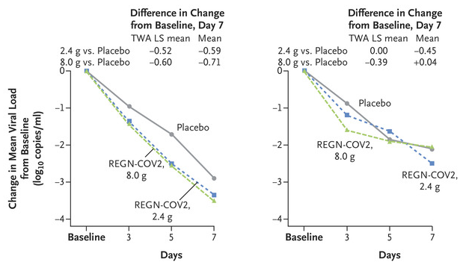
Casirivimab/Imdevimab
Boost immune responses
SARS-CoV-2 Ab negative at baseline (41%):
  Viral load change greater in antibody than in placebo recipients (difference, -0.56 log₁₀ copies/mL)
  6% of antibody recipients and 15% of placebo recipients had medically attended visit.
Viral load over time
Serum Ab negative
Serum Ab positive
Weinreich DM et al. N Engl J Med 2020 Dec 17
Notes:
Event = hospitalization or ER Visit

Slide 11
New Data Since the EUA
(some unpublished; some data not yet peer-reviewed)

Slide 12
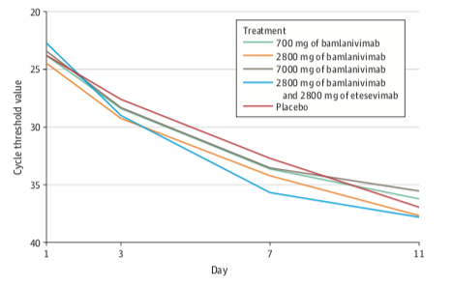
Bamlanivimab with or without Etesevimab vs. Placebo
Final data set for bamlanivimab monotherapy doses in initial portion of trial and data on bamlanivimab/etesevimab (a 2nd mAb against SARS CoV-2 spike)
Compared with placebo, differences in change in viral level at day 11 not statistically significant for bamlanivimab monotherapy
Significantly greater change in viral level in those who received bamlanivimab/etesevimab
Hospitalization/ED visits: placebo: 5.8% (9 events); bam 700 mg 1% (1 event); bam 2800 mg 1.9% (2 events); bam 7000 mg 2% (2 events); bam/etesevimab 0.9% (1 event)
Gottlieb RL et al, JAMA, 2021

Slide 13
Bamlanivimab/Etesevimab Phase 3 Trial (BLAZE-1)
  n=1035 high risk outpatients within 3 days of a positive SARS-CoV-2 test
  Randomized to receive bamlanivimab/etesevimab (2800/2800 mg) or placebo
  Study population:
    65 years or older: 30-32%; mean BMI: 33-34
    Duration of symptoms: mean 4.1-4.2 days
COVID-19 Hospitalization/Death by Any Cause (day 29)
Treatment | N | Events | Rate | p
Placebo | 517 | 36 | 7.0% | -
Bam + Ete | 518 | 11 | 2.1% | 0.0004
Death (day 29)
Events | Proportion
10 | 1.9%
0 | 0%
https://investor.lilly.com/news-releases/news-release-details/new-data-show-treatment-lillys-neutralizing-antibodies

Slide 14
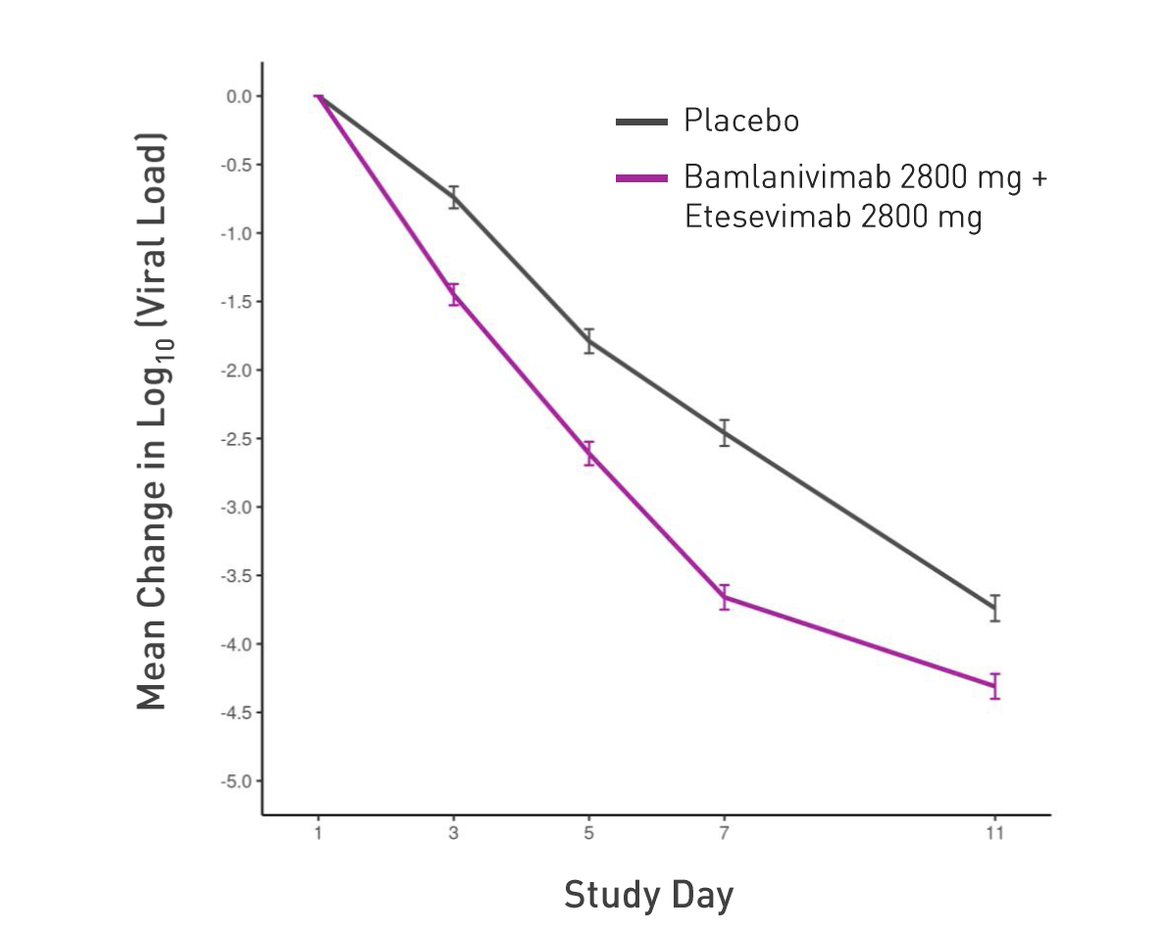
Bamlanivimab/Etesevimab: Virus Levels
SARS CoV-2 Viral Load: Change from Baseline
Mean Viral Load
Day | Placebo | Bam./Ete. | p=
1 | 6.52 | 6.51 | -
3 | 5.74 | 5.04 | <0.000001
5 | 4.68 | 3.85 | <0.000001
7 | 4.05 | 2.87 | <0.000001
11 | 2.69 | 2.21 | 0.000011
https://investor.lilly.com/news-releases/news-release-details/new-data-show-treatment-lillys-neutralizing-antibodies

Slide 15
Bamlanivimab/Etesevimab
  Treatment-emergent adverse events:
    Placebo 11.6%, antibodies 13.3%
  Serious adverse events
    Placebo: 1.0%; antibodies: 1.4%
  Ongoing trial of bamlanivimab/etesevimab (700 mg/1400 mg) (n=500) vs. placebo (n=250) in high-risk patients
https://investor.lilly.com/news-releases/news-release-details/new-data-show-treatment-lillys-neutralizing-antibodies

Slide 16
What about patients hospitalized due to COVID-19?

Slide 17
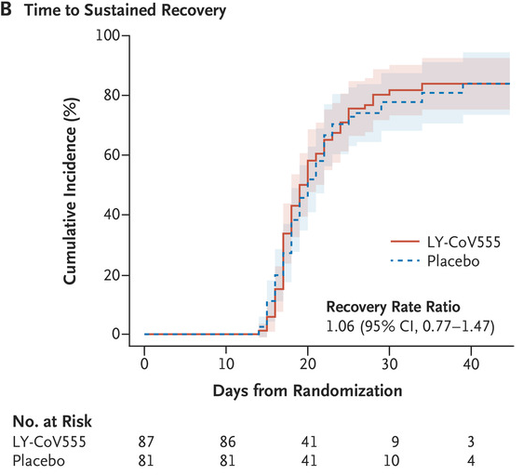
Bamlanivimab in Hospitalized Patients
Hospitalized patients with COVID-19 and without end organ failure randomized 1:1 to receive bamlanivimab or placebo (ACTIV-3)
Stopped for futility after 314 participants enrolled: no evidence for efficacy of the antibody
NIAID Office of Communications, NIH-Sponsored ACTIV-3 Trial Closes LY-CoV555 Sub-Study, 2020; ACTIV-3/TICO LY-CoV555 Study Group, NEJM 2020

Slide 18
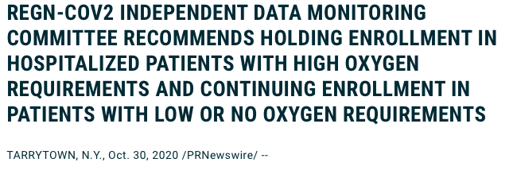
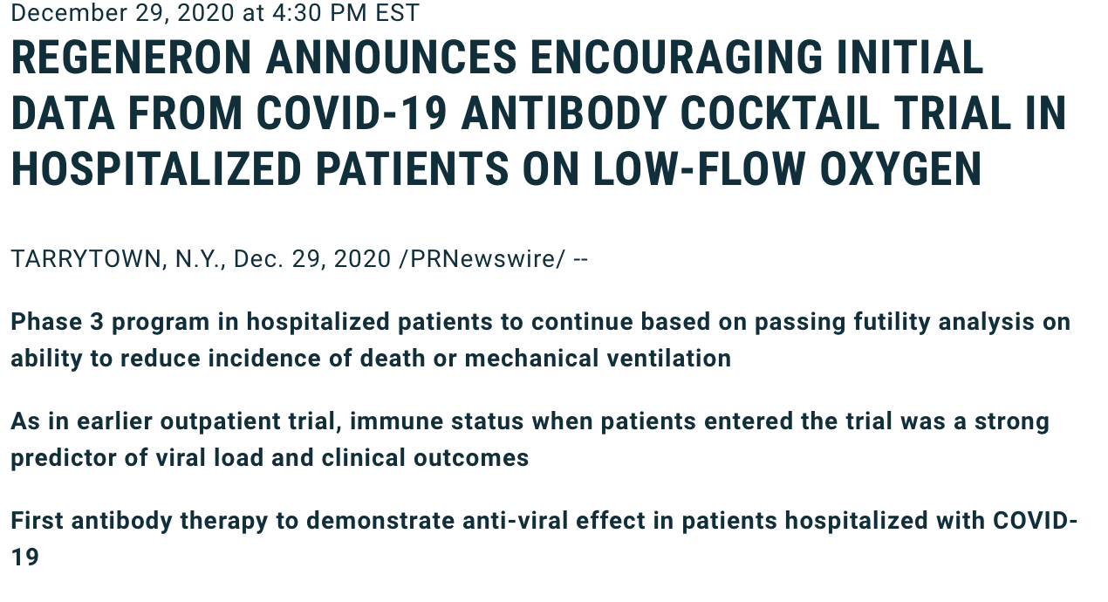
Casirivimab/Imdevimab in Hospitalized Patients
Casirivimab/Imdevimab still being evaluated in hospitalized patients in the RECOVERY trial and in ongoing trial in people on low flow oxygen

Slide 19
Monoclonal Antibodies for Treatment: My Take
Abs show promise for treatment of high-risk outpatients with mild-moderate COVID
For high-risk patients not eligible/interested in trials (or if trial not available), discuss potential benefits/risks of mAbs through EUAs (shared decision making)
No comparative data to determine whether there are differences in efficacy or safety between bamlanivimab vs. casirivimab + imdevimab
Data needed: relationship between change in virus level and outcomes; effect of endogeneous Ab; optimal timing and dose; approach to patient with COVID after 1 dose of vaccine; effect of SARS CoV-2 variants
mAbs not authorized for use in people hospitalized due to COVID; may be used in people hospitalized for reasons other than COVID (see FDA FAQ)
Development of antibodies with shorter infusion times, subcutaneous administration needed to help with logistical challenges

Slide 20
COVID-19 mAb for Prevention
Monoclonal Abs (mAbs):
Offer immediate protection for those exposed or unvaccinated in high risk settings
Can be provided to people unlikely to respond to a vaccine, or allergic
They could stop viral replication and block progression of disease
Can help predict requirements for a vaccine by identifying required titers of neutralizing antibodies
Target Populations for mAbs:
Nursing homes, both residents and attendants
High incidence workplaces (e.g. meat packing plants)
Index case contacts (e.g. household contacts)

Slide 21
Bamlanivimab for Prevention
(BLAZE-2)
  Phase 3 trial: bamlanivimab (4200 mg) vs. placebo
  Staff and residents in long term care facilities with at least one confirmed case of SARS-CoV-2 <= 7 days prior to randomization
  Prevention: 965 participants who tested negative for SARS-CoV-2 (299 residents, 666 staff)
  Treatment: 132 participants who tested positive for SARS-CoV-2 (41 residents, 91 staff) and had risk factor for severe COVID-19
https://investor.lilly.com/news-releases/news-release-details/lillys-neutralizing-antibody-bamlanivimab-ly-cov555-prevented

Slide 22
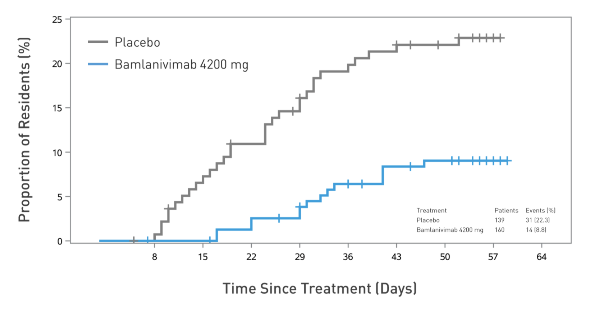
Bamlanivimab for Prevention
(BLAZE-2)
  Among all participants, lower frequency of symptomatic COVID-19 with bamlanivimab (OR 0.43, p=0.00021)
  For nursing home residents, lower frequency of symptomatic COVID-19 with bamlanivimab (OR 0.2, p=0.00026)
    4 deaths, all in placebo group
Residents with symptomatic COVID-19 (prevention population)
https://investor.lilly.com/news-releases/news-release-details/lillys-neutralizing-antibody-bamlanivimab-ly-cov555-prevented

Slide 23
Casirivimab/Imdevimab for Prevention
  Ongoing phase 3 trial in household contacts (n=>3000)
  Cohort A is PrEP/PEP; Cohort B are PCR+ at baseline (n=235)
  The full study explores prevention and early treatment (SubQ)
  Exploratory analysis on approximately 400 participants
  Participants randomized to casirivimab/imdevimab (1200 mg,SubQ, 4 injections) or placebo
  Note the potential importance of SubQ administration
https://newsroom.regeneron.com/press-releases

Slide 24
Casirivimab/Imdevimab for Prevention
  Symptomatic infection: 8/223 placebo, 0/186 mAbs (100% prevention)
  Symptomatic + asymptomatic infection: 23/223 placebo, 10/186 mAbs (approximately 50% reduction)
  Decreased peak virus levels and duration of viral shedding
    Placebo group on average: >100-fold higher peak viral load
    -note similar results seen in Bamlanivimab study
    Viral shedding: C/I: < 1 week; placebo: about 40% lasted 3-4 weeks
    Virus level >10,000 copies/mL: placebo: 13/21 (62%); C/I: 0/9 (0%)
  One death, 1 hospitalization in placebo group; none in antibody group
https://newsroom.regeneron.com/press-releases

Slide 25

Lilly, Vir Biotechnology and GSK announce first patient dosed in expanded BLAZE-4 trial evaluating bamlanivimab (LY-CoV555) with VIR-7831 (GSK4182136) for COVID-19
January 27, 2021
INDIANAPOLIS and SAN FRANCISCO and LONDON, Jan. 27, 2021 /PRNewswire/ -- Eli Lilly and Company (NYSE: LLY), Vir Biotechnology, Inc. (NASDAQ: VIR) and GlaxoSmithKline plc (LSE/NYSE: GSK) today announced a collaboration to evaluate a combination of two COVID-19 therapies in low-risk patients with mild to moderate COVID-19. Lilly has expanded its ongoing BLAZE-4 trial to evaluate the administration of bamlanivimab (LY-CoV555) 700mg with VIR-7831 (also known as GSK4182136) 500mg, two neutralizing antibodies that bind to different epitopes of the SARS-CoV-2 spike protein. This unique collaboration marks the first time that monoclonal antibodies from separate companies will be brought together to explore potential outcomes.

Slide 26
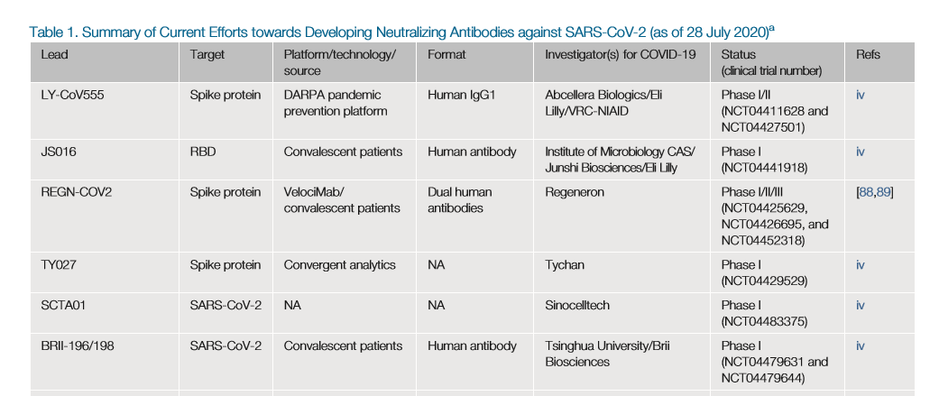
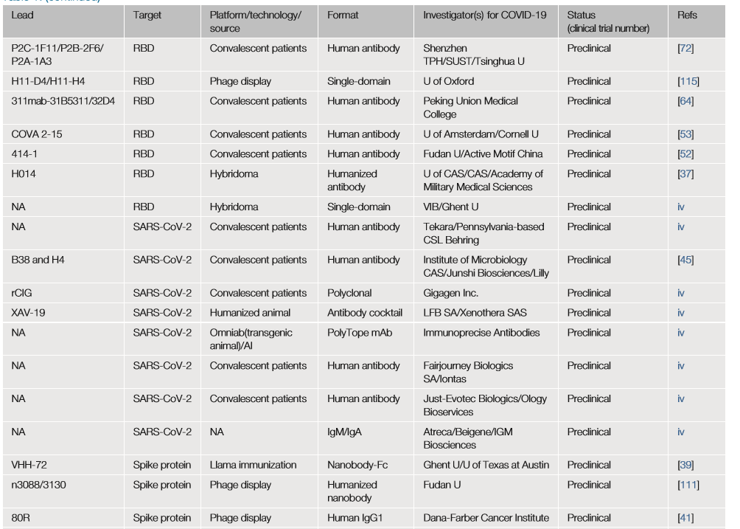
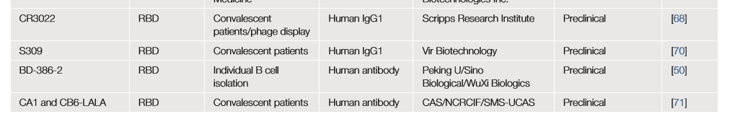
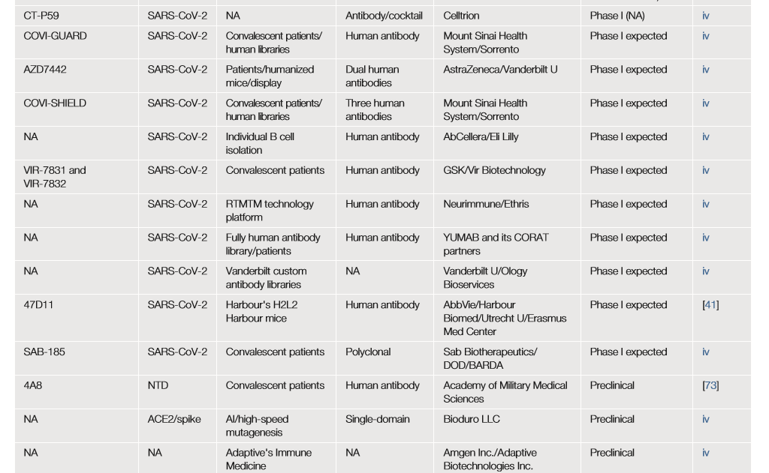
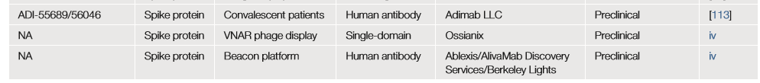
Trends Pharmacol Sci. 2020 Jul 31;S0165-6147(20)30166-8.

Slide 27
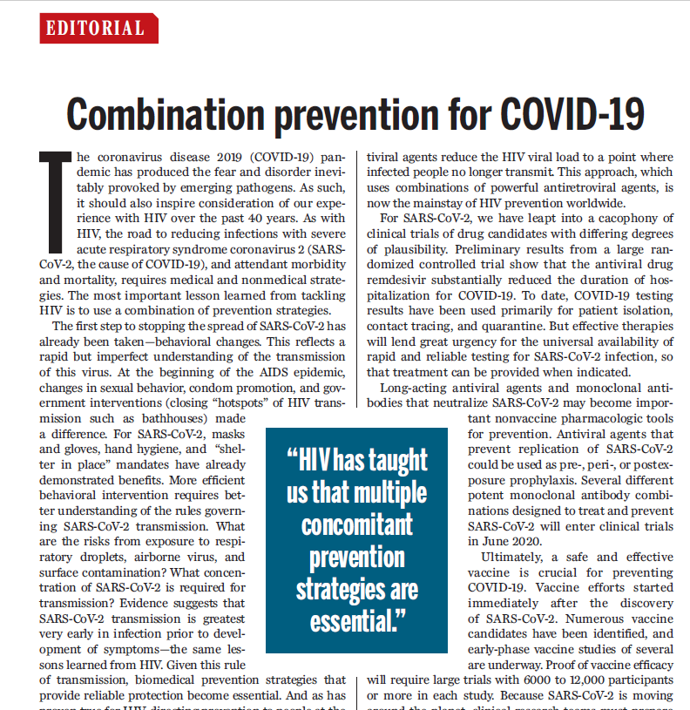

Myron S. Cohen & Lawrence Corey
. Science. 2020 May 8;368(6491):551.

Slide 28
ACIP COVID-19 Vaccines
Summary: ACIP January 27, 2021
Kathleen Dooling, MD MPH
Notes:
Good afternoon. Today I will review Work Group considerations for COVID-19 vaccine prioritization.

Slide 29
Introduction
Full ACIP materials from January 27 meeting can be found at:
https://www.cdc.gov/vaccines/acip/meetings/slides-2021-1-27-21.html
Today’s summary:
Clinical Trials: AstraZeneca
COVID-19 and children
Vaccine effectiveness studies
Safety monitoring
COVID-19 vaccination implementation

Slide 30
Clinical Trials:
AstraZeneca

Slide 31
Safety Information Reviewed by Work Group
AZD1222 (AstraZeneca)
Phase I/II studies
  Binding and neutralizing responses similar to convalescent sera comparison
  Th1 biased T-cell response
  Safety:
    Local and systemic symptoms mild to moderate in severity
    Reactogenicity symptoms lower after second dose (small numbers) and in older adults
    No vaccine-related serious adverse events (SAEs) reported
Phase III Clinical Hold/Safety Pause
  Study paused due to report of transverse myelitis in the UK
  FDA reviewed neurologic events in all trials
  Study allowed to be resumed with changes, including independent expert neurology panel
Nonreplicating Adenovirus Vector Vaccine
31
Notes:
Less fever in the older group

Slide 32
Efficacy Information Reviewed by Work Group
AZD1222 (AstraZeneca)
Preliminary data from interim global efficacy analysis reviewed¹
  ~11,000 participants in UK/Brazil interim analysis
  Several dose regimens and inter-dose intervals included in interim analysis
VE estimate for SD/SD regimen: 62.1% (41.0-75.7%)
  Estimate for dose/schedule that is currently being studied in US Phase III trials (SD/SD)
Pooled VE estimate: 70.4% (54.8-80.6%)
  Estimate includes individuals with a lower dose (LD) as the first dose, and standard dose (SD) as the second dose
1. December 08, 2020DOI:https://doi.org/10.1016/S0140-6736(20)32661-1
32
Notes:
Less fever in the older group

Slide 33
COVID-19 and children
Dr. A Campbell
Dr. E Erbelding https://www.cdc.gov/vaccines/acip/meetings/slides-2021-1-27-21.html

Slide 34
Estimated SARS-CoV-2 Infection Rates per 100,000 Population Adjusting for Under Detection
Infection rate per 100,000
Age group
8
https://www.cdc.gov/coronavirus/2019-ncov/cases-updates/burden.html
Notes:
The data on this slide are on the CDC “Estimated Disease Burden of COVID-19” webpage. Adjusting for Under Detection, estimated SARS-CoV-2 infection rates per 100,000 population are lowest in children 0-4 years, but for children 5-17 years are basically the same as for adults.

Slide 35
Younger Children Were Less Likely to Be Symptomatic and Have Fewer Symptoms than Adults
Symptoms reported during follow-up
Sample size for each category: <12 years, n=14; 12-17 years, n=8; ≥18 years, n=56
FLUTES-C Study. Preliminary data, subject to change
15
Notes:
Among these 78 people with secondary infection, you can see in this figure that younger children <12 years (in the left-most dark gray bars) – in general, were less likely to be symptomatic and had many fewer symptoms than adults (in the right-most purple bars).

Slide 36
Children <18 years have the Lowest Cumulative Rate of COVID-19 Associated Hospitalizations
March 1, 2020 – January 2, 2021
18+ years
0-4 years
5-17 years
COVID-19 associated hospitalizations reported to Coronavirus Disease 2019 (COVID-19)-Associated Hospitalization Surveillance Network (COVID-NET) surveillance system between March 1 and January 2, 2021. COVID-NET is a population-based surveillance system that collects data on laboratory-confirmed COVID-19-associated hospitalizations among children and adults through a network of over 250 acute-care hospitals in 14 states.
19
https://gis.cdc.gov/grasp/COVIDNet/COVID19_3.html
Notes:
Now I’m moving from our outpatient look at susceptibility and transmission to the hospital: This is a figure from the COVID-Net hospital surveillance system showing laboratory-confirmed COVID-19 hospitalization rates per 100,000 – you can see that children <18 years have the lowest cumulative rate of COVID-19 associated hospitalizations (those are 35.4 and 21.2 per 100K, for 0-4 and 5-17 years, respectively), here for simplicity compared with all people age 18 and older (rate of 460.1 per 100K).
By comparison – I gave an influenza talk last year almost to the day 1/28/2020 – cumulative rate per 100,000 pop for 0-4 was 40.6 per 100K, 5-17 yrs was 10.8/100K, and highest was in 65 years and older group, 58.1 per 100,000. But even in a severe influenza season such as we had in 2017-18, the overall cumulative hospitalization rates at the end of the season were between 100-120/100K.

Slide 37
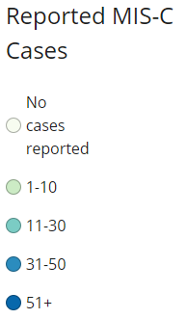
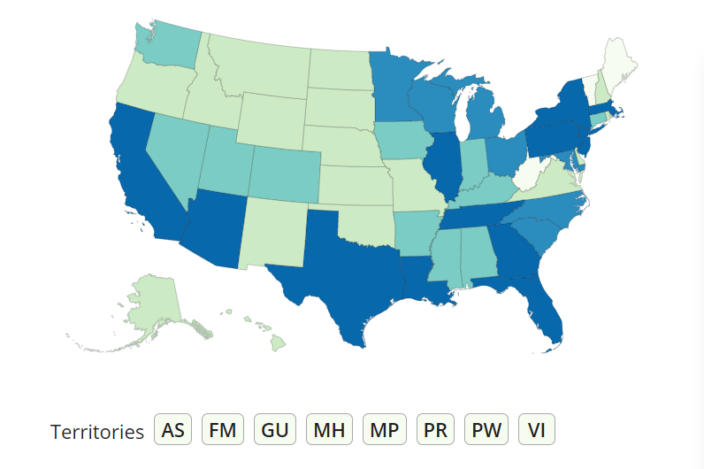
Health Department-Reported Cases of Multisystem Inflammatory Syndrome in Children (MIS-C)
1,659 cases
26 deaths
47 states, New York City, and Washington, DC, have reported >1 case
Average age 8 years
57% male
33% Hispanic/Latino; 30% Black, non-Hispanic
February 19 – December 29, 2020
28
https://www.cdc.gov/mis-c/cases/index.html; last updated January 8, 2021
Notes:
The CDC MIS-C website shows the health department-reported cases. The most recent January update shows 1659 cases reported and 26 deaths from 47 states, New York City, and Washington, DC. Average age is 8 years, 57% are male; with 33% Hispanic/Latino and 30% Black, non-Hispanic persons.

Slide 38




Vaccine clinical development: Children
Platform/ Design | mRNA: encodes stabilized spike; lipid NP | mRNA: encodes 2P-stabilized spike; lipid NP | Replication incompetent Ad26; stabilized spike | Replication incompetent ChAdOx1 chimp Ad; wild type spike
Dose/ Schedule Adults | IM 2 doses X 30 µg 21 days apart | IM 2 doses 100 µg 28 days apart | IM 1 dose at 5 x 10¹⁰ vp (also testing 2 doses (0, 56 days) | IM 2 doses at 5 × 10¹⁰ vp, (0, 28 days)
Current Status | EUA ages 16 and up | EUA ages 18 and up | Phase 3 adults | Phase 3 adults
Adolescents | Fully enrolled | TeenCOVE | Start 4-6wks after results from adult trials | Begin Early 2021
Younger Children | Planning early 2021 | Planning early 2021 | Planning early 2021 | Planning early 2021
Comments |  |  | Platform used widely in teens, infants, children
Others supported by USG: Novavax (Ph3 enrolling), Sanofi
Notes:
Bloomberg article, Jan. 19, 2021: https://www.bloomberg.com/news/articles/2021-01-19/kids-sign-up-for-vaccine-trials-in-next-step-to-conquer-covid
The University of Oxford, which developed a vaccine with AstraZeneca Plc, is planning initial tests in 12- to 18-year-olds next month.”
“[Johnson and Johnson estimates [they] will start trials for children four to six weeks after receiving results from its adult studies, which are expected by early February.”
CNBC article, Jan. 22, 2021:
https://www.cnbc.com/2021/01/22/pfizer-says-its-covid-vaccine-trial-for-kids-ages-12-to-15-is-fully-enrolled.html
“AstraZeneca, whose Oxford University-developed vaccine is in late-stage trials in the U.S. and authorized in the U.K., told CNBC Friday it plans to continue U.K. trials in a new protocol for kids between ages 5 and 18 “beginning in the coming months.”
“Johnson & Johnson, whose phase three results in adults are expected imminently, said it’s in discussions with regulators about including pediatric populations in its development plan. It noted the same technology it’s using for the Covid-19 vaccine has been used in vaccines given to more than 200,000 people, including people over 65, infants, children, HIV-positive adults and pregnant women.”

Slide 39
Vaccine Effectiveness Studies
Dr. K Flemming-Dutra https://www.cdc.gov/vaccines/acip/meetings/slides-2021-1-27-21.html

Slide 40
VE policy priorities: Results of internal and external input
Immediate First 2-4 months | Does vaccine protect against symptomatic disease as expected?
Subsequent | VE against key outcomes Severe disease Non-severe disease SARS-CoV-2 infection and transmission VE in key subpopulations Adults aged ≥65 years, including those in long-term care facilities (LTCF) People with key underlying conditions (e.g., immunocompromised, obesity, diabetes) Disproportionately affected racial/ethnic populations (Black, Latinx, Native American/ Alaska Native) VE for regimen-related questions Single dose and prolonged dosing intervals; Mixed dose schedules (>1 product)
Later stage | Viral evolution: Do genome changes threaten VE? Duration of protection Comparative VE: Is one product better than another?

Slide 41
Currently planned COVID-19 VE assessments
VE priority |  | Prospective data collection | Electronic health record (EHR) and claims analyses (coordination across US government)
Immediate priority
Does vaccine work as expected to prevent symptomatic disease? | Test-negative design case-control among healthcare personnel | Test-negative design case-control among healthcare personnel
Subsequent priorities
Older adults, including residents of long-term care facilities (LTCF) | Case-control among adults ≥65 years (COVID-NET linked to CMS); National Healthcare Safety Network | Case-control among adults 65+ years (COVID-NET linked to CMS); National Healthcare Safety Network | CMS cohort (FDA, CMS) EHR datasets (CDC, VA, FDA)
Infection and transmission | Prospective longitudinal cohorts, including among healthcare personnel & frontline workers; case-ascertained household cohorts for transmission | Prospective longitudinal cohorts, including among healthcare personnel & frontline workers; Case-ascertained household cohorts for transmission
Severe disease/hospitalization | Test-negative design (for adults and children); conventional case-control using hospitalized controls; screening method | Test-negative design (for adults and children); conventional case-control using hospitalized controls; screening method | EHR datasets (CDC, VA, FDA): Retrospective cohort or test-negative design
Non-severe disease | Test-negative design among outpatients | Test-negative design among outpatients | Potentially using EHR datasets
Those with key underlying conditions (e.g., immunocompromised) | Captured in above studies | Captured in above studies | CMS (FDA,CMS); EHR datasets (CDC, VA, FDA)
Disproportionately affected racial/ethnic groups | Captured in above studies; test-negative design in American Indian/Alaska Native population | Test-negative design in American Indian/Alaska Native population; Also captured in above studies | CMS (FDA, CMS); EHR datasets (CDC, VA, FDA); Exploring IHS EHR (IHS)
Vaccine impact | Ecologic analyses of disease incidence/seroprevalence and vaccine coverage; comparisons of expected vaccine impact from models with observed impact

Slide 42
Safety Monitoring
Dr. G Lee
Dr. T Shimabukuro https://www.cdc.gov/vaccines/acip/meetings/slides-2021-1-27-21.html

Slide 43

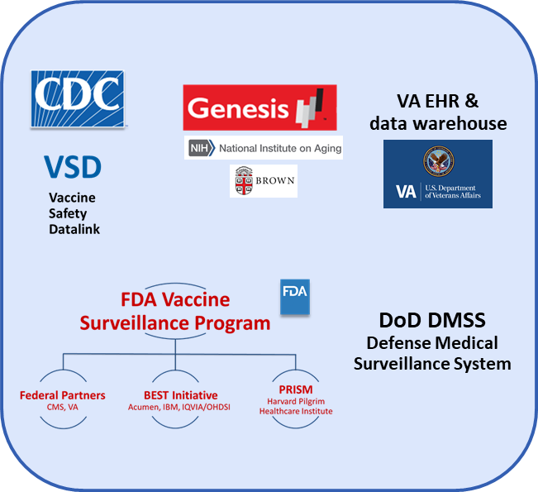

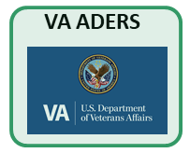

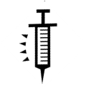

start of vax
active surveillance, passive surveillance, case consults
safety monitoring timeline

Slide 44
start of vax
active surveillance, passive surveillance, case consults
safety monitoring timeline

Slide 45
Summary of v-safe data
 | Pfizer-BioNTech | Moderna | All COVID-19 vaccines
People receiving 1 or more doses in the United States* | 12,153,536 | 9,689,497 | 21,843,033
Registrants completing at least 1 v-safe health check-in† | 997,042 | 1,083,174 | 2,080,216
Pregnancies reported to v-safe | 8,633 | 6,498 | 15,131
* COVID Data Tracker data as of 1/24/2021
† v-safe data as of 1/20/2021, 5:00 AM ET

Slide 46
Reactogenicity reported to v-safe
Local and systemic reactions, day 0-7*,† | All vaccines % | Pfizer-BioNTech dose 1 % | Pfizer-BioNtech dose 2 % | Moderna dose 1 %
Pain | 70.7 | 67.7 | 74.8 | 70.1
Fatigue | 33.4 | 28.6 | 50.0 | 29.7
Headache | 29.4 | 25.6 | 41.9 | 26.0
Myalgia | 22.8 | 17.2 | 41.6 | 19.6
Chills | 11.5 | 7.0 | 26.7 | 9.3
Fever | 11.4 | 7.4 | 25.2 | 9.1
Swelling | 11.0 | 6.8 | 26.7 | 13.4
Joint pain | 10.4 | 7.1 | 21.2 | 8.6
Nausea | 8.9 | 7.0 | 13.9 | 7.7
* v-safe data lock point 1/14/2021, 5 AM ET
† Reported on at least one health check-in completed on days 0-7 after receipt of vaccine

Slide 47
VSD RCA outcomes for COVID-19 vaccines | Concurrent comparator | Risk interval | Events in vaccinated | Events in unvaccinated | Signal (Y/N)
Acute disseminated encephalomyelitis | Unvaccinated | 1-21 days | 0 | 0 | N
Acute myocardial infarction | Unvaccinated | 1-21 days | 1 | 179 | N
Acute respiratory distress syndrome | Unvaccinated | 1-21 days | 0 | 4 | N
Anaphylaxis | Unvaccinated | 0-1 days | 0 | 8 | N
Appendicitis | Unvaccinated | 1-21 days | 5 | 267 | N
Bell’s palsy | Unvaccinated | 1-21 days | 4 | 358 | N
Convulsions / seizures | Unvaccinated | 1-21 days | 0 | 39 | N
Disseminated intravascular coagulation | Unvaccinated | 1-21 days | 0 | 14 | N
Encephalitis / myelitis / encephalomyelitis | Unvaccinated | 1-21 days | 0 | 6 | N
Guillain-Barré syndrome | Unvaccinated | 1-21 days | 0 | 4 | N
Thrombotic thrombocytopenic purpura | Unvaccinated | 1-21 days | 0 | 4 | N
Immune thrombocytopenia | Unvaccinated | 1-21 days | 0 | 21 | N
Kawasaki disease | Unvaccinated | 1-21 days | 0 | 1 | N
MIS-C and MIS-A | Unvaccinated | NA | 0 | NA | N
Myocarditis / pericarditis | Unvaccinated | 1-21 days | 0 | 12 | N
Narcolepsy and cataplexy | Unvaccinated | N/A | 0 | 8 | N
Stroke, hemorrhagic | Unvaccinated | 1-21 days | 1 | 85 | N
Stroke, ischemic | Unvaccinated | 1-21 days | 0 | 197 | N
Transverse myelitis | Unvaccinated | 1-21 days | 0 | 0 | N
Venous thromboembolism | Unvaccinated | 1-21 days | 3 | 408 | N
Pulmonary embolism (subset of VTE) | Unvaccinated | 1-21 days | 0 | 132 | N
Vaccine Safety Datalink
Preliminary results of VSD unvaccinated concurrent comparator analyses for COVID-19 vaccine safety
No signals as of January 16

Slide 48
Background
Genesis Healthcare is the largest nursing home company in the United States, spanning 24 states
  Analysis included Skilled Nursing Facilities (284 Facilities with about 25,000 residents)
COVID-19 vaccination began on December 18, 2021
  By December 31, first dose of vaccine was administered in 118 facilities among 7,006 residents (61.4% in those facilities)
Assessed 7-day mortality rates among the vaccinated and unvaccinated residents in 118 facilities as well as 17,076 residents in the 166 facilities that started vaccinating after January 1, 2021

Slide 49
Results
After excluding residents with a positive SARS-CoV-2 diagnostic test within 20 days prior to their 7-day observation window
  Mortality was lower among vaccinated versus unvaccinated residents within the same facilities and compared to residents in not-yet-vaccinated facilities, with overlapping 95% confidence intervals

Slide 50
Estimated anaphylaxis reporting rates following COVID-19 vaccines based on VAERS reports and reported doses administered*
Reported vaccine doses administered | Anaphylaxis cases | Reporting rate (analytic period Dec 14-Jan 18)
Pfizer-BioNTech: 9,943,247 | 50 | 5.0 per million doses admin.
Moderna: 7,581,429 | 21 | 2.8 per million doses admin.
Total COVID-19 vaccine doses administered thru Jan 18 by sex: Female 61%, Male 36%, Unk 3%
Previously reported rate for Pfizer-BioNTech vaccine: 11.1 per million doses admin (Dec 14-Dec 23) https://www.cdc.gov/mmwr/volumes/70/wr/mm7002e1.htm
Previously reported rate for Moderna vaccine: 2.5 per million doses admin (Dec 21-Jan 10) https://www.cdc.gov/mmwr/volumes/70/wr/mm7004e1.htm
* Data through January 18, 2021

Slide 51
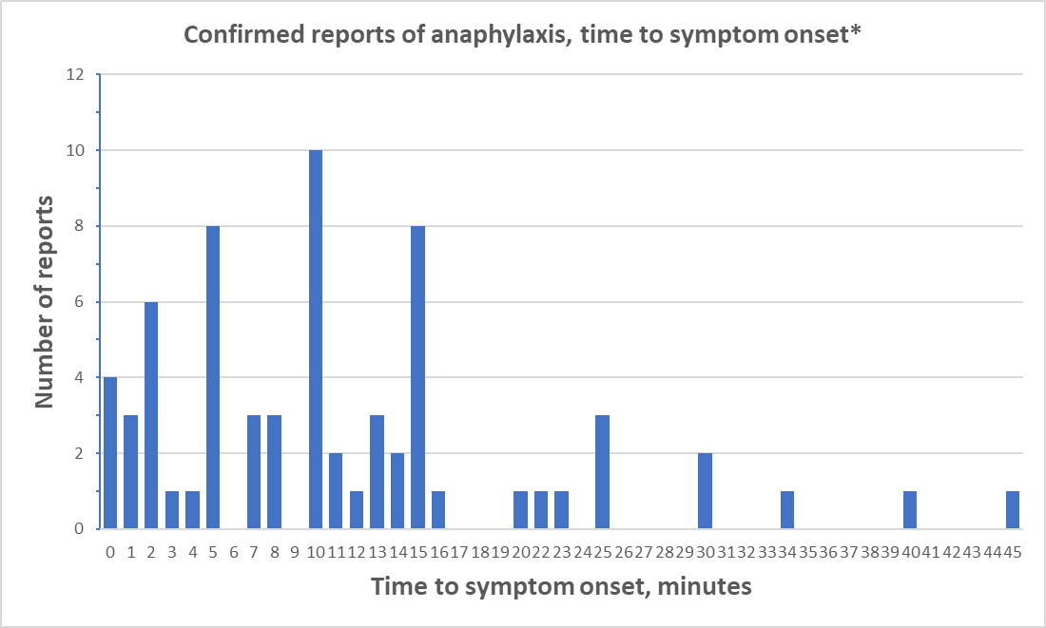

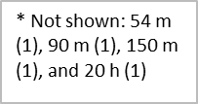
Data through January 18, 2021

Slide 52
COVID-19 Vaccination Implementation
Dr. A Cohn https://www.cdc.gov/vaccines/acip/meetings/slides-2021-1-27-21.html

Slide 53
Summary of State Priority Populations/Phases
As of January 25, 2021
Current reported phases of vaccine distribution:
  Phase 1a: 11 states Phase 1b: 38 states Phase 1c: 2 states
ACIP prioritization recommendations intended as a framework to support equitable and efficient administration of COVID-19 and jurisdictional flexibility
  1. Not necessary to complete one phase to expand into the next group
  2. When demand starts to decrease in persons aged ≥75 years, jurisdictions can consider lowering age group to ≥65 years
  3. Use all available doses and minimize waste
  4. Continue to offer vaccine in persons in earlier phases
  Available: https://www.kff.org/other/state-indicator/state-covid-19-vaccine-priority-populations/
Notes:
CpFrom Nancy: Include language that you did not get to use in MMWR about priorities <- Not sure what this means
Here we provide four points of clarification of the ACIP prioritizationNo recommendations to support equitable and efficient administration of COVID-19 vaccine and allow for jurisdictional flexibility in program implementation. First, within each jurisdiction, it is not necessary to completely or fully administer vaccine to all eligible persons in one phase before expanding to the next phase; it is expected that phases will overlap. Second, as soon as demand for COVID-19 vaccine starts to slow among persons aged ≥75 years in Phase 1b, jurisdictions should expand vaccination to persons aged 65–74 years, who are currently included in Phase 1c. Third, in light of the limited vaccine supply, vaccinators should attempt to use all available doses and minimize wastage; if there are extra doses that would otherwise expire imminently, it is permissible to administer them to persons assigned to a later phase. Fourth, persons who were eligible in earlier phases but did not receive the vaccine should continue to be educated and offered vaccine.

Slide 54
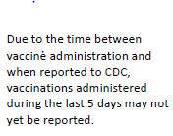
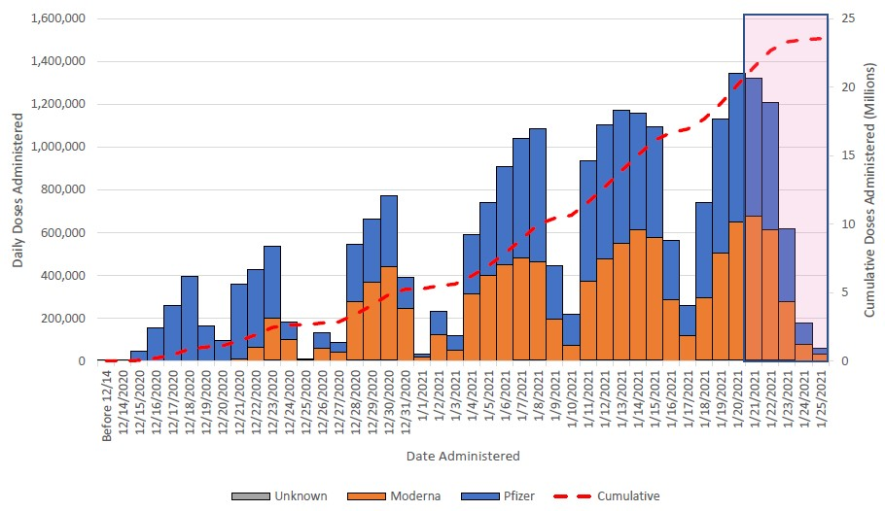
Total Doses Administered, by Date of Administration and Vaccine Manufacturer
As of January 26, 2021
Data Source: IIS, Federal Pharmacy Program,
Federal Entities Program
Notes:
CDC is posting the latest numbers of doses distributed and administered on its COVID-19 vaccines landing page.
“Doses distributed” refers to the number of doses that have been received by jurisdictions.
“Doses administered” refers to the number of vaccine doses that have gotten into arms.

Slide 55
COVID-19 vaccine administration
& variants
Dr. S Oliver https://www.cdc.gov/vaccines/acip/meetings/slides-2021-1-27-21.html

Slide 56
Dosing and administration
mRNA vaccines are recommended for a two-dose series administered intramuscularly
  Pfizer-BioNTech: Three weeks apart
  Moderna: Four weeks apart
Persons should not be scheduled to receive the second dose earlier than the recommended intervals
  However, doses administered earlier should not be repeated
The second dose should be administered as close to the recommended interval as possible. However, if it is not feasible to adhere to the recommended interval, the second dose of Pfizer-BioNTech and Moderna COVID-19 vaccines may be scheduled for administration up to 6 weeks (42 days) after the first dose.
https://www.cdc.gov/vaccines/covid-19/info-by-product/clinical-considerations.html
Notes:
Pfizer-BioNTech is authorized in persons aged >=16 years, while the Moderna vaccine is authorized for those age 18 years or older.
Both vaccine series consists of two doses administered intramuscularly, with the Pfizer-BioNTech vaccine series administered three weeks apart, and the Moderna vaccine four weeks apart.
Either vaccine series may be used; ACIP does not state a product preference
However, mRNA COVID-19 vaccines are not interchangeable with each other or with other COVID-19 vaccine products so the same vaccine product must be used for both doses
mRNA vaccines should be administered alone, with a minimum interval of 14 days before or after administration with any other vaccines

Slide 57
Dosing and administration
mRNA vaccines are not interchangeable with each other or other COVID-19 vaccines
  Either vaccine series may be used; ACIP does not state a product preference
  Every effort should be made to determine which vaccine product was received as the first dose
  In exceptional situations in which the first-dose vaccine product cannot be determined or is no longer available, any available mRNA COVID-19 vaccine may be administered at a minimum interval of 28 days between doses
https://www.cdc.gov/vaccines/covid-19/info-by-product/clinical-considerations.html
Notes:
Pfizer-BioNTech is authorized in persons aged >=16 years, while the Moderna vaccine is authorized for those age 18 years or older.
Both vaccine series consists of two doses administered intramuscularly, with the Pfizer-BioNTech vaccine series administered three weeks apart, and the Moderna vaccine four weeks apart.
Either vaccine series may be used; ACIP does not state a product preference
However, mRNA COVID-19 vaccines are not interchangeable with each other or with other COVID-19 vaccine products so the same vaccine product must be used for both doses
mRNA vaccines should be administered alone, with a minimum interval of 14 days before or after administration with any other vaccines

Slide 58
Dosing and administration
mRNA vaccines should be administered alone, with a minimum interval of 14 days before or after administration with any other vaccines
  However, mRNA COVID-19 vaccines and other vaccines may be administered within a shorter period in situations where benefits of vaccination are deemed to outweigh the potential unknown risks of vaccine coadministration
  If mRNA COVID-19 vaccines are administered within 14 days of another vaccine, doses do not need to be repeated for either vaccine
https://www.cdc.gov/vaccines/covid-19/info-by-product/clinical-considerations.html
Notes:
Pfizer-BioNTech is authorized in persons aged >=16 years, while the Moderna vaccine is authorized for those age 18 years or older.
Both vaccine series consists of two doses administered intramuscularly, with the Pfizer-BioNTech vaccine series administered three weeks apart, and the Moderna vaccine four weeks apart.
Either vaccine series may be used; ACIP does not state a product preference
However, mRNA COVID-19 vaccines are not interchangeable with each other or with other COVID-19 vaccine products so the same vaccine product must be used for both doses
mRNA vaccines should be administered alone, with a minimum interval of 14 days before or after administration with any other vaccines

Slide 59
SARS-CoV-2 variants

Slide 60

SARS-CoV-2 Variants
In fall of 2020, several SARS-CoV-2 variants emerged, with changes in receptor-binding domain of spike protein – confer increased transmissibility
Amino acid change in spike protein | United Kingdom (B.1.1.7) | South Africa (20H/501Y.V2 or B.1.351) | Brazil (P.1)
No. of spike changes | 8 | 10 | 12
N501Y
E484K
K417T/N
Does the variant have the ability to evade vaccine-induced immunity?
Emerging SARS-CoV-2 Variants | CDC

Slide 61
Variants: in vitro
In most of the studies reviewed, minimal to moderate reduction (1.3–6-fold) in neutralization activity for vaccine-immune sera
  Implications for ‘real world’ effectiveness unclear- sera from mRNA vaccine recipients had higher neutralization activity than COVID-19 convalescent human sera in early phase clinical trials
  Most studies are using pseudoviruses, which are more sensitive to neutralization
  Limited studies, small numbers
Evidence quickly evolving, so continued review of data critical
  Studies evaluating the full sets of mutation from variants likely more informative than studies of single mutations
  Studies of vaccine breakthrough cases are planned and may serve as an early waring
Moderna has announced they are developing a vaccine against B.1.351 (South African) variant

Slide 62
Variants: What can we learn from Phase III studies?
Janssen COVID-19 vaccine candidate¹
VE overall= 66%
  U.S.=72%
  Latin America=66%
  South Africa=57%
  against severe disease= 85%
Noted that 95% of all cases in South Africa were B.1.351 lineage.
Novavax COVID-19 vaccine candidate²
VE U.K=89%
  >50% of sequenced cases are UK variant
VE South Africa=60%
  In HIV negative persons
  90% of sequenced cases are South Africa variant
https://www.jnj.com/johnson-johnson-announces-single-shot-janssen-covid-19-vaccine-candidate-met-primary-endpoints-in-interim-analysis-of-its-phase-3-ensemble-trial
https://ir.novavax.com/news-releases/news-release-details/novavax-covid-19-vaccine-demonstrates-893-efficacy-uk-phase-3

Slide 63
Thank you
Notes:
Thank you

Slide 64
Now Available: COVID-19 Vaccine FAQs
Go to www.COVID19LearningNetwork.org and click on “Vaccines FAQ”

Slide 65


Continue the conversation on Twitter
@RealTimeCOVID19
#RealTimeCOVID19
We want to hear from you! Please complete the post-call survey.
Next Call: Saturday, February 6th
A recording of this call will be posted at www.idsociety.org/cliniciancalls
-- library of all past calls now available --
Contact Us:
Dana Wollins (dwollins@idsociety.org)
Deirdre Lewis (dlewis@idsociety.org)

