Slide 1

CDC/IDSA COVID-19 Clinician Call
April 9, 2022
87th in a series of calls, initiated by CDC as a forum for information sharing among frontline clinicians caring for patients with COVID-19. This call is not intended for the media.
The views and opinions expressed here are those of the presenters and do not necessarily reflect the official policy or position of the CDC or IDSA. Involvement of CDC and IDSA should not be viewed as endorsement of any entity or individual involved.
This webinar is being recorded and can be found online at www.idsociety.org/cliniciancalls.
Welcome & Introductions
  Sue Visser, DrPH, MS
  U.S. Centers for Disease Control and Prevention

Slide 2
All About Paxlovid; Plus Update on Sotrovimab
Variants Update
Carolyn Gould, MD, MSCR
CAPT, U.S. Public Health Service and Chief Medical Officer, CDC COVID-19 Response
U.S. Centers for Disease Control and Prevention
All About Paxlovid
Introduction & Background
Derek Eisnor, MD
Medical Officer, Division of Clinical Development, Biomedical Advanced Research and Development Authority
COVID-19 Allocation and Distribution Lead, U.S. Department of Health and Human Services
Clinical Case Scenarios
George A. Diaz, MD- Infectious Diseases, Providence Regional Medical Center
Benjamin A. Miko, MD- Assistant Professor of Medicine, Columbia University Medical Center
Kimberly Scarsi, PharmD, MS, FCCP, BCPS- Department of Pharmacy Practice and Science, College of Pharmacy,
University of Nebraska Medical Center
Lessons Learned from the HIV/Ritonavir Experience
Melanie A. Thompson, MD
Co-Chair, HIVMA/IDSA HIV Primary Care Guidance Panel; AIDS Research Consortium of Atlanta
Additional Considerations
Derek Eisnor, MD
Q&A and Discussion
All Presenters Plus:
Cristina Miglis, PharmD, MSc, BCPS- Clinical Pharmacologist, U.S. Food and Drug Administration
Mario Sampson, PharmD- Clinical Pharmacology Reviewer, U.S. Food and Drug Administration

Slide 3
Additional Clinical Experts Responding to Q&A
Michael Chary, MD, PhD
NY Presbyterian Weill Cornell University Hospital
Paul Wax, MD, FACMT
Executive Director, American College of Medical Toxicology

Slide 4

Question?
Use the “Q&A” Button
Comment?
Use the “Chat” Button

Slide 5
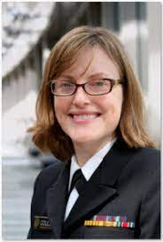
Update on the Omicron Variant
and its Sub-lineages
Carolyn Gould, MD, MSCR
CAPT, USPHS

Slide 6
Update on the Omicron variant
and its sub-lineages
Carolyn Gould, MD, MSCR
Chief Medical Officer
CDC COVID-19 Response
April 9, 2022

Slide 7
Nothing to disclose

Slide 8
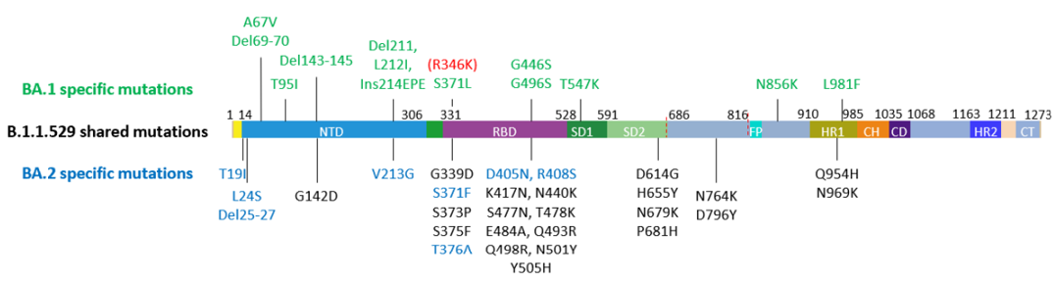
Most common Omicron sublineages currently in circulation are BA.1, BA1.1, and BA.2
Iketani S. et al. Antibody evasion properties of SARS-CoV-2 Omicron sublineages. https://www.biorxiv.org/content/10.1101/2022.02.07.479306v1

Slide 9
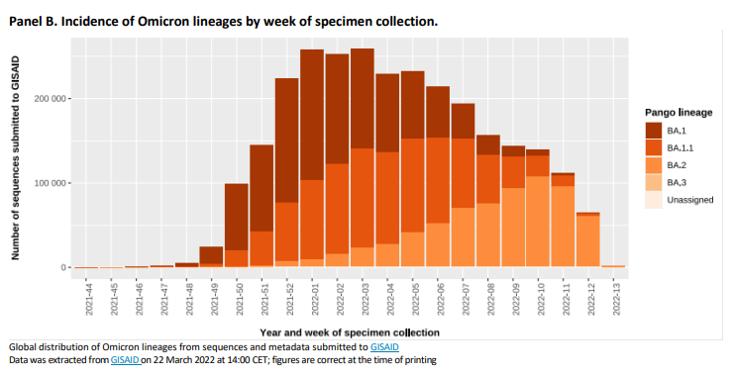
BA.2 now the predominant sublineage worldwide
WHO weekly epidemiological update on COVID-19 – 5 April 2022. Edition 86. https://www.who.int/publications/m/item/weekly-epidemiological-update-on-covid-19---5-april-2022
Notes:
SARS-CoV-2 (hCoV-19) sequencing is not a random sample of mutations. As a result, this report does not indicate the true prevalence of the undefined but rather our best estimate now.

Slide 10
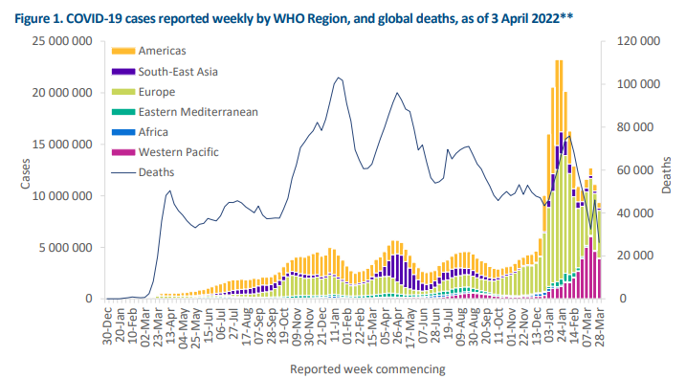
Case counts and deaths decreasing in all WHO regions
WHO weekly epidemiological update on COVID-19 – 5 April 2022. Edition 86. https://www.who.int/publications/m/item/weekly-epidemiological-update-on-covid-19---5-april-2022

Slide 11
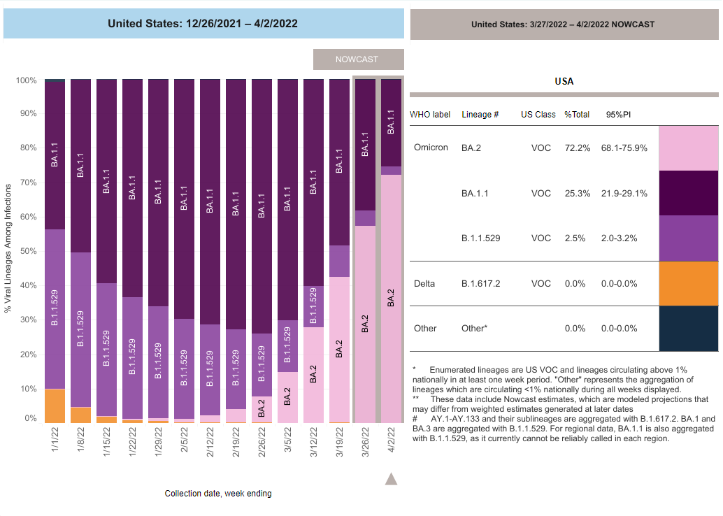
BA2 now the predominant sublineage in U.S.
https://covid.cdc.gov/covid-data-tracker/#variant-proportions

Slide 12
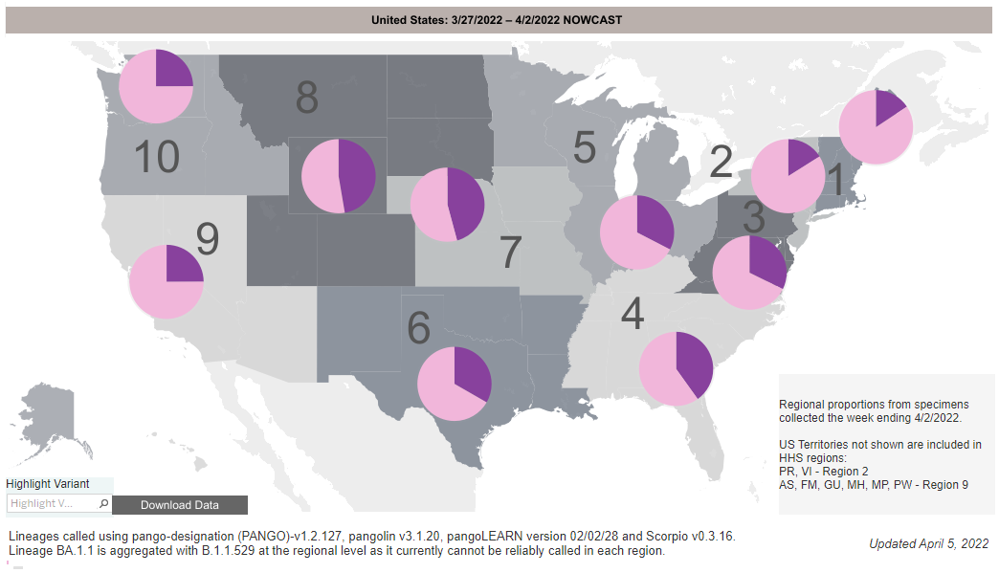
BA.2 now the predominant sublineage in U.S.
https://covid.cdc.gov/covid-data-tracker/#variant-proportions

Slide 13
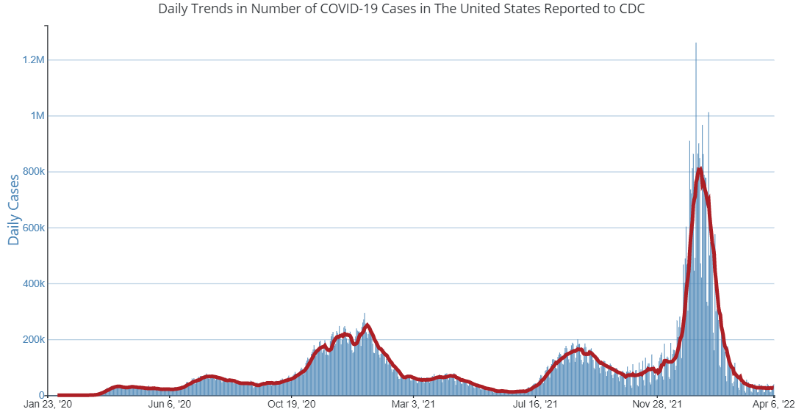
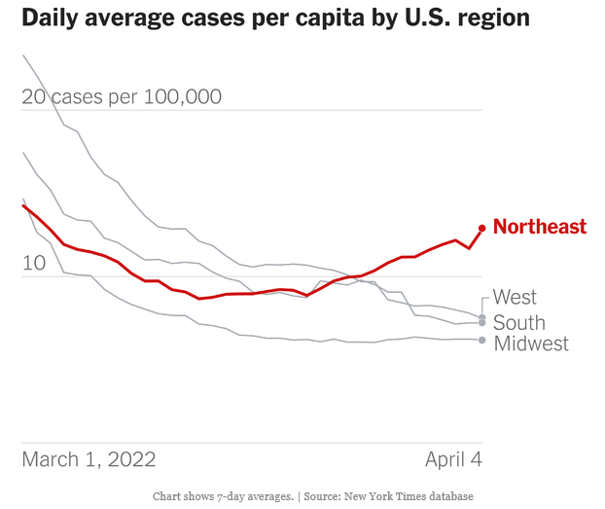
U.S. COVID-19 cases declined but have now plateaued
New cases (7-day moving average)
https://covid.cdc.gov/covid-data-tracker/#trends
https://www.nytimes.com/interactive/2021/us/covid-cases.html

Slide 14
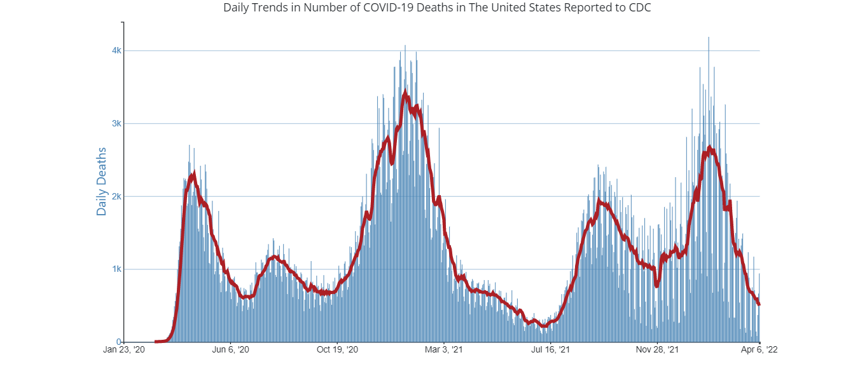
U.S. COVID-19 deaths decreasing but still high
Daily deaths (7-day moving average)
https://covid.cdc.gov/covid-data-tracker/#trends

Slide 15
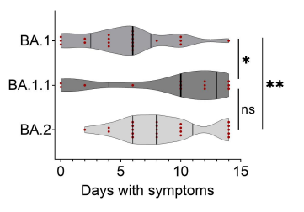
Disease severity with BA.2 appears to be similar to BA.1 sublineages
South Africa and UK
  No differences in hospitalization or severe disease
Boosted HCP in Sweden with Omicron breakthrough infections (n=71)
*p ≤ 0.05
**p ≤ 0.01
Marking U et al. High rate of BA.1, BA.1.1 and BA.2 infection in triple vaccinated. https://www.medrxiv.org/content/10.1101/2022.04.02.22273333v1
Wolter N et al. Clinical severity of Omicron sub-lineage BA.2 compared to BA.1 in South Africa. https://www.medrxiv.org/content/10.1101/2022.02.17.22271030v1
UK Health Security Agency. SARS-CoV-2 variants of concern and variants under investigation in England. Technical briefing 39. 25 March 2022. https://assets.publishing.service.gov.uk/government/uploads/system/uploads/attachment_data/file/1063424/Tech-Briefing-39-25March2022_FINAL.pdf

Slide 16
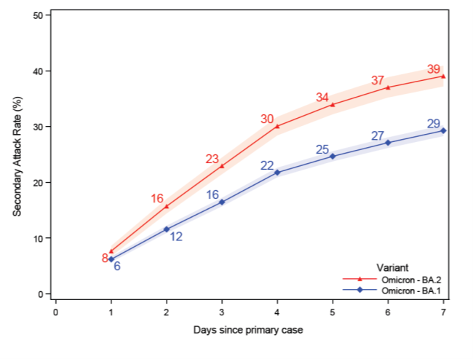
Evidence suggests BA.2 more transmissible than BA.1
Secondary attack rates higher for BA.2 compared with BA.1
  Danish household transmission study
  UK household and non-household contacts
Difference still smaller than between BA.1 and Delta
Lyngse FP et al. Transmission of SARS-CoV-2 Omicron VOC subvariants BA.1 and BA.2: evidence from Danish households. https://www.medrxiv.org/content/10.1101/2022.01.28.22270044v1.full
UK Health Security Agency. SARS-CoV-2 variants of concern and variants under investigation in England. Technical briefing 38. 11 March 2022. https://assets.publishing.service.gov.uk/government/uploads/system/uploads/attachment_data/file/1060337/Technical-Briefing-38-11March2022.pdf

Slide 17
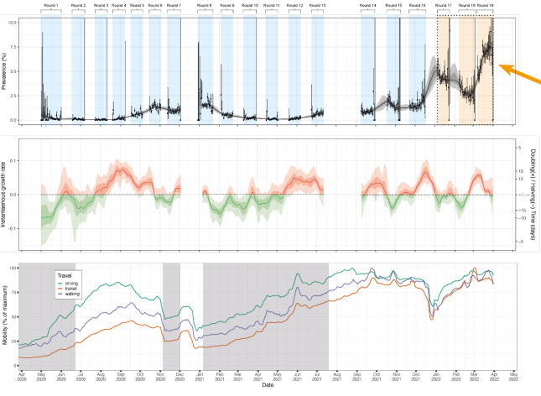
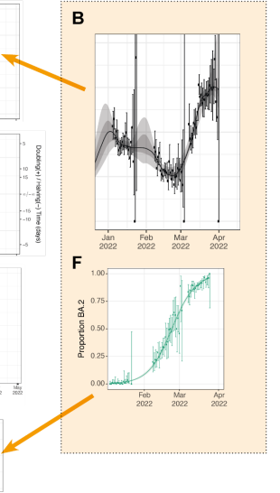
Rapid increase in SARS-CoV-2 prevalence as BA.2 displaced other subvariants in England, March 2022
Prevalence (%)
Proportion of BA.2
“Twin peaks”
Elliott P. et al. Twin peaks: the Omicron SARS-CoV-2 BA.1 and BA.2 epidemics in England. https://spiral.imperial.ac.uk/bitstream/10044/1/96170/8/REACT-1_R19_Final.pdf

Slide 18
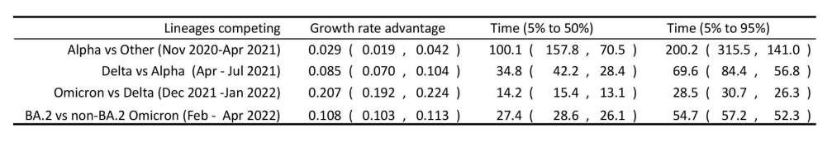
Transmission advantage of each successive variant during epidemic in England
Elliott P. et al. Twin peaks: the Omicron SARS-CoV-2 BA.1 and BA.2 epidemics in England. https://spiral.imperial.ac.uk/bitstream/10044/1/96170/8/REACT-1_R19_Final.pdf

Slide 19
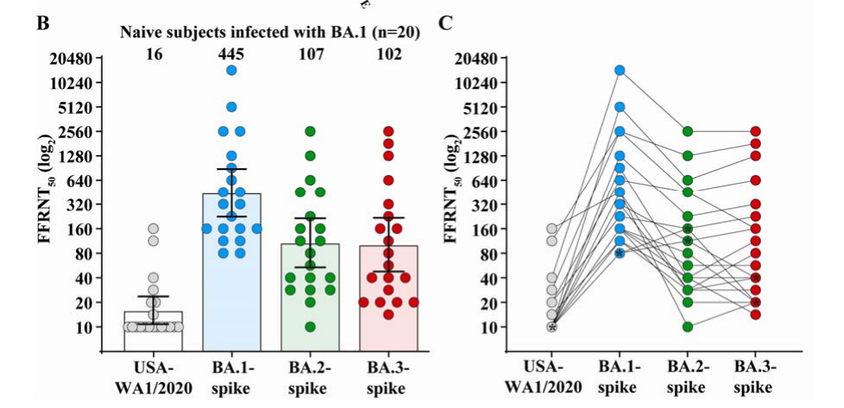
Early data suggest infection with BA.1 provides protection against reinfection with BA.2
Zou J et al. Cross-neutralization of Omicron BA.1 against BA.2 and BA.3 SARS-CoV-2. https://www.biorxiv.org/content/10.1101/2022.03.30.486409v1
Stegger M et al. Occurrence and significance of Omicron BA.1 infection followed by BA.2 reinfection. https://www.medrxiv.org/content/10.1101/2022.02.19.22271112v1

Slide 20
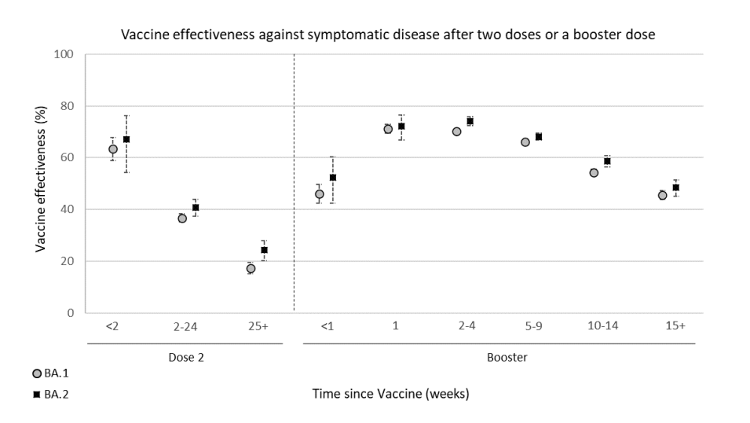
Vaccine effectiveness for symptomatic infection does not appear to be reduced against BA.2 compared to BA.1
Kirsebom FCM et al. COVID-19 vaccine effectiveness against the Omicron BA.2 variant in England. https://doi.org/10.1101/2022.03.22.22272691

Slide 21
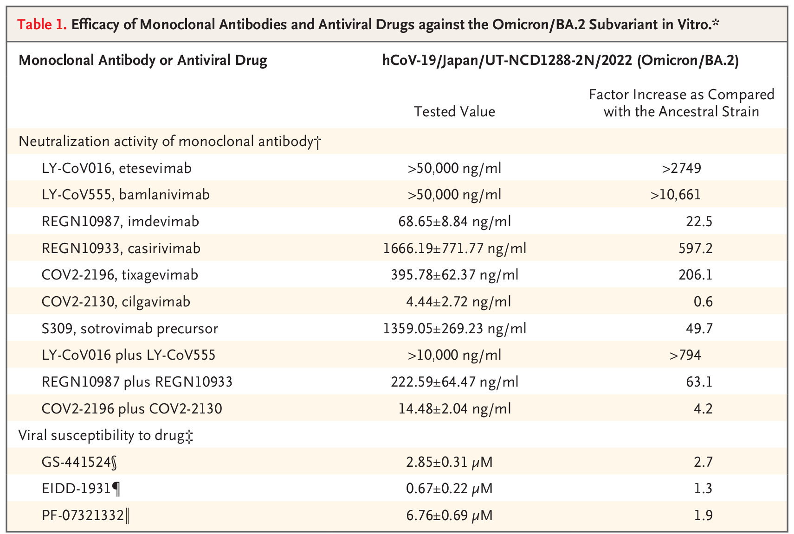
Reduced activity of sotrovimab against BA.2
tixagevimab + cilgavimab (Evusheld)
main metabolite of remdesivir
active form of molnupiravir
nirmatrelvir
Takashita E. Efficacy of antiviral agents against the SARS-CoV-2 Omicron subvariant BA.2. https://www.nejm.org/doi/full/10.1056/NEJMc2201933
Iketani S. Antibody evasion properties of SARS-CoV-2 Omicron sublineages. https://www.biorxiv.org/content/10.1101/2022.02.07.479306v1

Slide 22
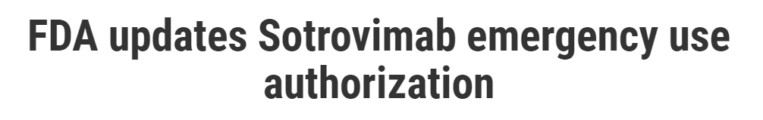
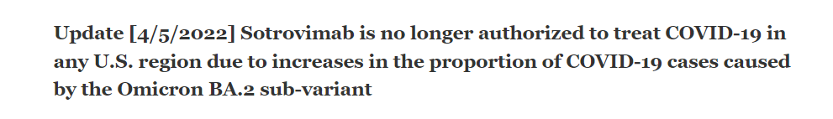
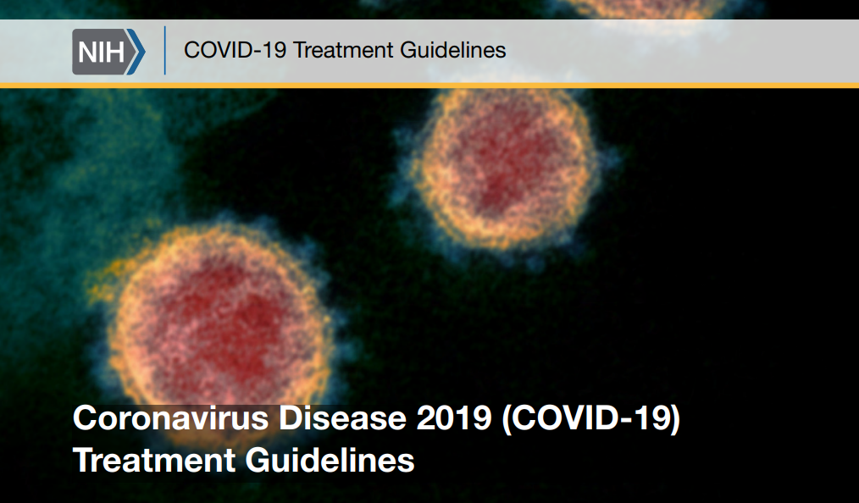
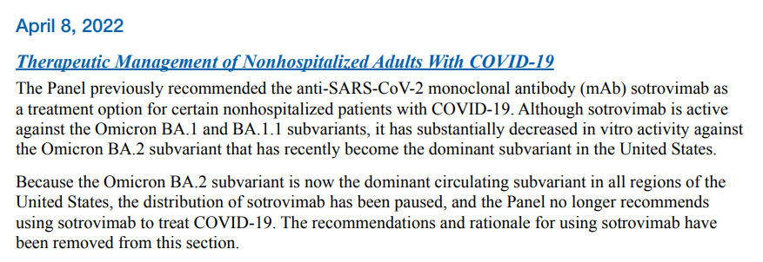
https://www.fda.gov/drugs/drug-safety-and-availability/fda-updates-sotrovimab-emergency-use-authorization
https://www.covid19treatmentguidelines.nih.gov/

Slide 23
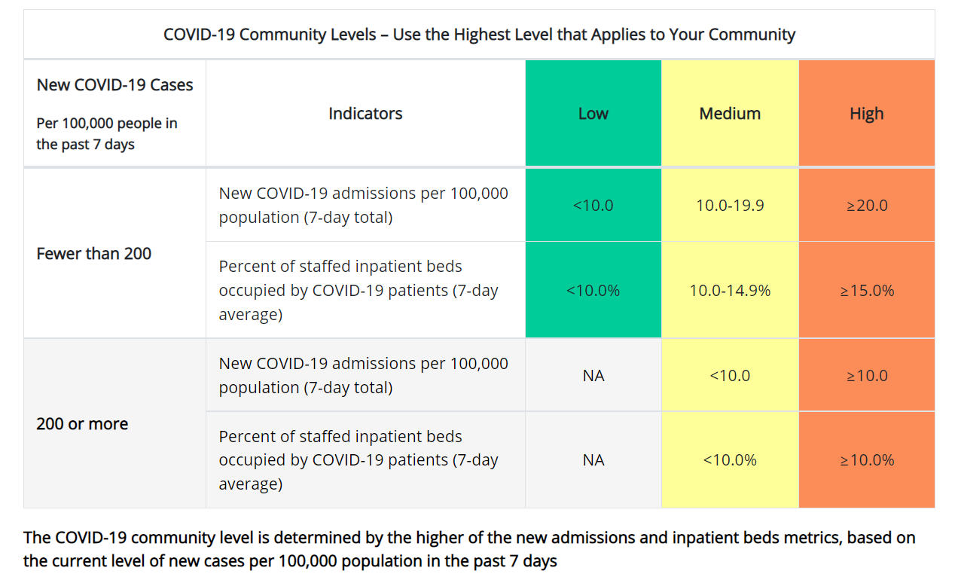
COVID-19 Community Levels
https://www.cdc.gov/coronavirus/2019-ncov/science/community-levels.html
https://www.cdc.gov/coronavirus/2019-ncov/science/science-briefs/indicators-monitoring-community-levels.html

Slide 24
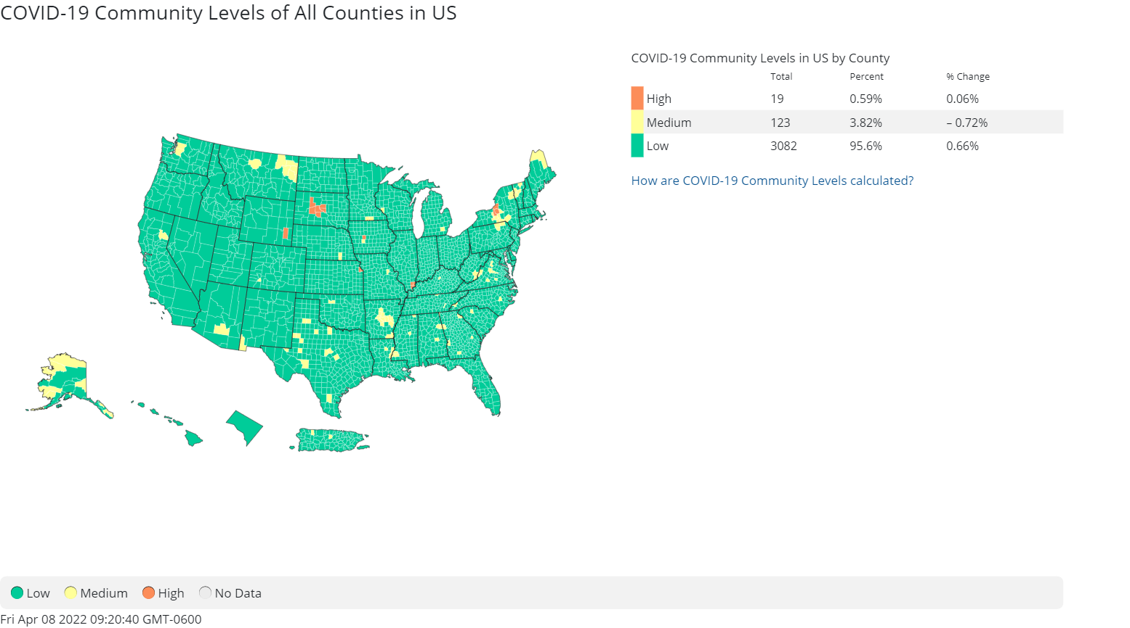
COVID-19 Community Levels in all counties in United States (updated 4/7/2022)
https://www.cdc.gov/coronavirus/2019-ncov/science/community-levels.html

Slide 25
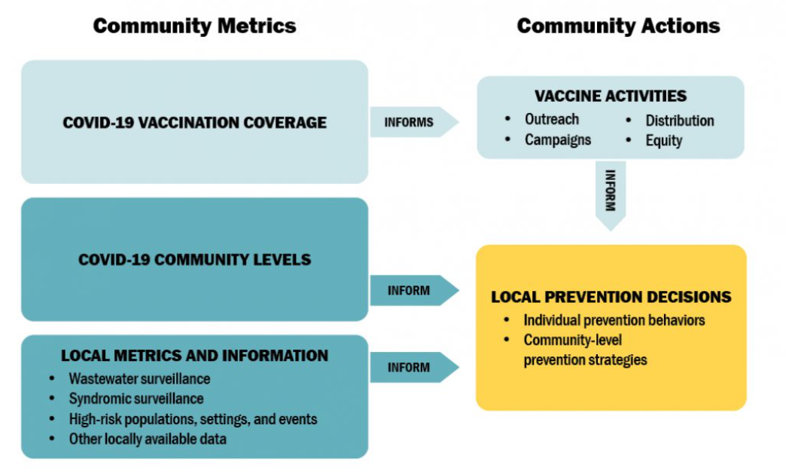
How community metrics and actions should inform prevention decisions of local authorities
https://www.cdc.gov/coronavirus/2019-ncov/science/science-briefs/indicators-monitoring-community-levels.html

Slide 27

Introduction & Background
Derek Eisnor, MD

Slide 28
Avoiding Paxlovid Potholes & Drug-drug Interactions (DDIs)
Guide for Front line Providers
Derek Eisnor, MD Medical Toxicology, Emergency Medicine
Therapeutics Team Lead, HCORE/HHS
April 9, 2022

Slide 29
Disclosures
Federal employee
I have nothing to disclose
My opinions are my own
Notes:
I would like to take this opportunity to thank my colleagues from ACMT and clin pharm experts from FDA to join our panel member discussions today.

Slide 30
Update:
Sotrovimab Distribution Paused to all Regions
March 25: FDA announced Sotrovimab not authorized for use in regions where infection is likely to have been caused by a non-susceptible SARS-CoV-2 variant; updated Fact Sheet
  March 25 – FDA announced Sotrovimab use not authorized in regions 1 and 2
  March 30 – FDA updated announcement to include regions 5, 9, 10
  April 5 – FDA announced Sotrovimab not authorized in any U.S. state or territory
Results from in vitro assays used to assess susceptibility of viral variants to particular monoclonal antibodies suggest that Sotrovimab is not fully active against BA.2 variant. The FDA Sotrovimab Fact Sheet was updated to reflect new data using authentic live BA.2 virus.
April 5: Centers for Disease Control and Prevention (CDC) identified that BA.2 variant is now circulating with a frequency exceeding 50% in all HHS regions
Distribution of Sotrovimab now paused to all U.S. states and territories
Currently authorized alternative treatments: Paxlovid, Lagevrio, Bebtelovimab
Additional details can be found here.

Slide 31
Outpatient Therapeutic Portfolio – Jurisdiction Allocations
For Planning Purposes Only – Subject to Change
 | Drug Class | Allocation Cadence | Sweep Schedule* | Allocation Mar 21 | Planned Allocation Mar 28 | Planned Allocation Apr 4 | Planned Allocation Apr 11 | Planned Allocation Apr 18 | Planned Allocation Apr 25
Paxlovid Pfizer | Oral antiviral for treatment | Weekly | Weekly; Saturday | 125,000 | 125,000 | 125,000 | 125,000 | 125,000 | 125,000
Lagevrio (molnupiravir) Merck | Oral antiviral for treatment | Weekly | Weekly; Saturday | 50,000 | 50,000 | 50,000 | 50,000 | 50,000 | 50,000
Sotrovimab¹ GSK/Vir | Monoclonal for treatment | Weekly | Weekly; Saturday | 35,000 | 35,000³ | 35,000³ | Distribution pause³ | Distribution pause³ | Distribution pause³
Bebtelovimab¹ Lilly | Monoclonal for treatment | Weekly | Weekly; Saturday | 30,000 | 30,000 | 30,000 | 30,000 | 30,000 | 30,000
Evusheld AstraZeneca | Monoclonal for prevention | Monthly | Monthly; end of month | N/A (order against monthly) | N/A (order against monthly) | 200,000 (monthly) | N/A (order against monthly) | N/A (order against monthly) | N/A (order against monthly)
Bam/Ete Lilly | Monoclonal; omicron resistance | Weekly | Weekly; Saturday | Distribution pause² | Distribution pause² | Distribution pause² | Distribution pause² | Distribution pause² | Distribution pause²
REGEN-COV Regeneron | Monoclonal, omicron resistance | Weekly | Weekly; Saturday | Distribution pause² | Distribution pause² | Distribution pause² | Distribution pause² | Distribution pause² | Distribution pause²
Remdesivir Gilead | IV antiviral for treatment | Commercial Market | N/A | N/A | N/A | N/A | N/A | N/A | N/A
At current allocation rates, allocations of sotrovimab and bebtelovimab are expected to stop in June. No funding is currently available to procure additional supply.
In accordance with the FDA EUA update on 1/24/2022, bam/ete and REGEN-COV distribution is paused nationally due to the high prevalence of the omicron variant. Resumption of allocation will be considered based on variant prevalence data and/or availability of patient level variant diagnostic testing.
In accordance with the FDA EUA update on 3/25/2022, sotrovimab distribution is paused in certain regions due to high prevalence of the BA.2 variant. Total allocated will be something less than 35,000 due to lack of distribution in regions where sotrovimab is no longer authorized for use. Those doses will be available for distribution through requests..
* Weekly sweeps will occur each Saturday at 8am ET (Paxlovid, Lagevrio, sotrovimab, bebtelovimab). Swept doses will be put back into federal inventory for redistribution as needed.
Evusheld doses will be swept at the end of each month starting Thursday, March 31 at midnight ET. April sweep for Evusheld will occur on Saturday, April 30 at 8am ET.

Slide 32
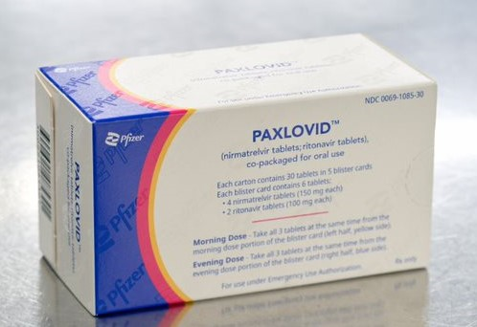
Paxlovid (nirmatrelvir and ritonavir) – Pfizer
Oral Antiviral
Paxlovid Product Information
https://www.pfizer.com/products/product-detail/paxlovidtm

Slide 33
Paxlovid (nirmatrelvir and ritonavir) Authorization
  FDA has issued an EUA for the treatment of mild-to-moderate coronavirus disease (COVID-19) in adults (12 years of age and older weighing more than 40 kg) who are at high risk for progression to severe COVID-19, including hospitalization and death, as soon as possible after diagnosis of COVID-19 and within 5 days of symptom onset.
  Paxlovid includes: nirmatrelvir (a SARS-CoV-2 main proteases inhibitor) and ritonavir (a CYP34A inhibitor)
  Limitations of authorized use:
    Not authorized for initiation of treatment in patients requiring hospitalization due to severe or critical COVID-19
    Paxlovid is not authorized for pre-exposure or post-exposure prophylaxis for prevention of COVID-19
    Not authorized for use longer than 5 consecutive days
  Paxlovid (nirmatrelvir and ritonavir) may only be prescribed for an individual patient by physicians, advanced practice registered nurses, and physician assistants that are licensed or authorized under state law to prescribe drugs in the therapeutic class to which Paxlovid (nirmatrelvir and ritonavir) belongs (i.e., anti-infectives).
For more information, Fact Sheet for Healthcare Providers for Paxlovid (nirmatrelvir and ritonavir) (https://www.fda.gov/media/155050/download)
Notes:
Nirmatrelvir is a SARS-CoV-2 main protease inhibitor, preventing polyprotein precursor formation and viral replication.
Ritonavir and nirmatrelvir are both CYP3A4 substrates.
Ritonavir results in near complete CYP 3A4 inhibition within 24 hours and 3 days* after last dose.

Slide 34
Paxlovid (nirmatrelvir and ritonavir)
  Dosage and Administration
eGFR 60 or greater: 300 mg nirmatrelvir (two 150 mg tablets) with 100 mg ritonavir (one 100 mg tablet) taken together twice daily for 5 days​.
eGFR > 30 mL/min to < 60 mL/min: 150 mg nirmatrelvir (one 150 mg tablet) with 100 mg ritonavir (one 100 mg tablet) taken together twice daily for 5 days.
eGFR <30 mL/min: currently not recommended
Severe hepatic impairment (Child-Pugh Class C): currently not recommended
  Contraindications and Precautions
History of clinically significant hypersensitivity reactions to the active ingredients or any other components.
Hepatic transaminase elevations, clinical hepatitis, and jaundice have occurred in patients receiving ritonavir.
Paxlovid (nirmatrelvir and ritonavir) use may lead to a risk of HIV-1 developing resistance to HIV protease inhibitors in individuals with uncontrolled or undiagnosed HIV-1 infection.
Co-administration with drugs highly dependent on CYP3A for clearance may result in life-threatening reactions¹.
Co-administration with potent CYP3A inducers may result in reduced nirmatrelvir plasma concentrations and potential loss of virologic response.
¹Liverpool Covid-19 interaction checker https://covid19-druginteractions.org/
For more information, Fact Sheet for Healthcare Providers for Paxlovid (nirmatrelvir and ritonavir) (https://www.fda.gov/media/155050/download)
Notes:
I do want to point out that the GFR and Pugh Class C criteria should not imply that prospective patients need routine bloodwork prior to treatment. Providers should only make these determinations if there is suspicion of recent changes in renal and/or liver function based on a thorough H&P.

Slide 35
Why Paxlovid and Who to Treat?
The EPIC-HR trial demonstrated that starting ritonavir-boosted nirmatrelvir treatment in non-hospitalized adults with mild to moderate COVID-19 within 5 days of symptom onset reduced the risk of hospitalization or death through Day 28 by 89% compared to placebo.
Are there other equally effective and feasible alternatives with less risk? No
Include patients at higher risk based on 4 key elements: age, vaccination status, immune status, and the presence of risk factors for clinical progression to severe disease.^{1,2}
Ritonavir has been used extensively during pregnancy and HIV, suggesting an acceptable safety profile in higher risk pregnant individuals.
1. CDC webpage Underlying Medical Conditions Associated With Higher Risk for Severe COVID-19.
2. NIH COVID-19 Treatment Guidelines.
Notes:
1. The EPIC HR trial demonstrated nearly 90% reduction in hosp for adults with one or more risk factors for progression to severe dz. +1000 rec’d Paxlovid, Event rates were 6.3 and 0.8%. This was also supported by lower viral loads at day 5 v placebo.
1. Concerning Omicron specific activity, cell cx studies show similar results to legacy VOCs with <3-fold reduction in antiviral activity.
4. We have human 1st and 2nd trimester exposure outcomes on ~7K live births with no increase in birth defect rates versus background. Animal EFD and fertility studies are negative at 3 times the HED.

Slide 36
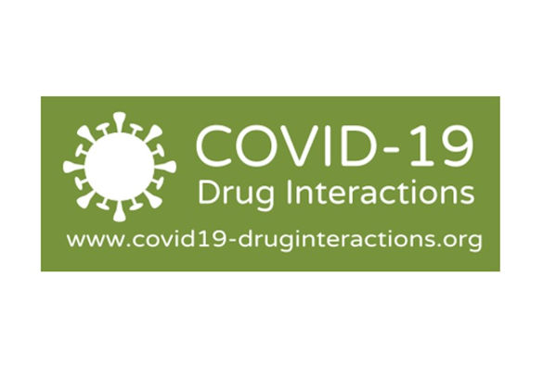
Cytochrome P450 (CYP) 3A4
CYP 1A2, 2C9, 2C19, 2D6, 2E1, 3A4 account for ~90% drug/substrate metabolism
Present in gut (first pass metabolism), kidney, lung
CYP 3A4 represents ~50% of total liver enterocyte mass of CYP enzymes
CYP 3A4 represents ~70% of enterocyte CYPs
Focus on concurrent meds heavily dependent on or impact to CYP 3A4 activity
4-25% individuals with concurrent medications with major/severe DDIs
CYP inducers (e.g., carbamazepine)
CYP inhibitors (e.g., ritonavir, ketoconazole)
* reference
Notes:
Cytochrome p450 enzymes are a group of hemoproteins who catalyze reactions through transfer of electrons. They perform the majority of drug P1 biotransformation reactions, as well as a number of homeostatic synthesis reactions involving chol/FAs/steroids, etc.
These enzymes are organized into families & subfamilies. Most drug metabolism is done by families 1,2,3.
CYP 3A4 function represent more than half of total hepatic CYP activity and the majority of enterocyte CYP activity, significantly impacting first pass metabolism of affected drugs.

Slide 37
CYP inhibition
Most common cause of harm from DDIs
  Terfenadine or astemizole & ketoconazole resulting TdP
  Simvastatin & itraconazole resulting in rhabdomyolysis
Can increase bioavailability of drug or decrease activity of prodrug (e.g, clopidogrel)
Concurrent medications increase with age and comorbidities
Increasing rate and mortality of adverse drug events in the elderly from toxic or supratherapeutic exposures
Cannot predict CYP activity based on drug class:
  HMG-CoA Reductase Inhibitors
  Lovastatin, simvastatin, atorvastatin: 3A4
  Fluvastatin: 2C9 (<2 fold)
  Pravastatin: nil CYP dependence
Notes:
Keto & Itrac are well known for near complete 3A4 inhibition, similar to ritonavir

Slide 38
Membrane transporters and P-gp
Ritonavir is also a potent inhibitor of P-gp
Phase III metabolism, uptake and efflux transporters
Can facilitate or prevent movement of xenobiotics across cell membranes
Most part of ABC (ATP Binding Cassette) family & includes P-gp family
Small intestine, hepatocyte/bile, BBB
Increased Bioavailability:
  Digoxin with clarithromycin or atorvastatin
  Loperamide with quinidine
Notes:
Also transport of sugars, lipids, amino acids and hormones.

Slide 39
Thank You

Slide 40


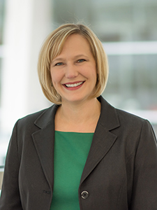
Real-World Case Scenarios
George A. Diaz, M.D
Benjamin A. Miko, MD
Kimberly Scarsi, PharmD, MS, FCCP

Slide 41
Use of Paxlovid in patients with cardiovascular disease
George Diaz, MD, FIDSA
Chief of Medicine
Providence Regional Medical Center Everett
Kimberly Scarsi, PharmD, MS, FCCP
Professor of Pharmacy Practice and Science
University of Nebraska Medical Center
Dr. Diaz reports clinical trial research grants from Gilead, Roche, Regeneron, Edesa, and NeuroBo, and sits on the Scientific Advisory Board for Safeology.

Slide 42
History of Present Illness
The patient is a 75 year old male from Whidbey Island, WA.
He is unvaccinated.
He developed cough, fever, fatigue, and generalized malaise 3 days prior to presentation.
He has not previously been infected with COVID-19.

Slide 43
Past Medical History
Heart failure, last ejection fraction was 30%.
Coronary artery disease, with coronary artery bypass grafting and coronary stenting 3 months ago.
Atrial fibrillation, status post ablation, completion of amiodarone one month ago.
Hypertension, which has been difficult to control.
Cardioembolic stroke in the past 3 months.
Hypercholesterolemia.

Slide 44
Medications
Amiodarone (completed one month prior)
Amlodipine 5mg PO daily
Sacubitril/Valsartan 97/103 mg PO twice daily
Atorvastatin 80mg PO daily
Prasugrel 10mg PO daily
Warfarin 5mg PO daily

Slide 45
Physical Exam
BP 150/90 HR 70 RR 14 Temp 37.9 O2 Room Air Saturation 97% BMI 35
General: well nourished, well developed
HEENT: no conjunctivitis, oropharynx clear
Chest: Clear bilaterally
CV: Regular rate and rhythm no murmurs rubs or gallops
Abdomen: Soft, non-tender, no hepatosplenomegaly
Ext: no clubbing, cyanosis or edema
Neuro: mild left sided arm weakness
Skin: well healed sternotomy and saphenous vein harvesting site scars

Slide 46
Chest X-ray
Sternotomy wires and cardiac stents noted
Lungs are clear
Mildly enlarged cardiac silhouette
No pleural effusions

Slide 47
Labs
CBC reveals WBC 4.5, absolute lymphocytes are decreased, hematocrit is normal, platelets normal
Chemistries reveal a creatinine of 1.1, AST and ALT are elevated
INR 2.5
Influenza PCR is negative
SARS-CoV-2 PCR is positive, no prior positives in the electronic health record

Slide 48
Assessment for treatment with Paxlovid
Patient is in NIH Tier 1 as an unvaccinated patient aged 75 years at greatest risk for severe COVID-19
Additional risk factors include:
  Heart conditions (HF, CAD)
  Cerebrovascular disease (CVA)
  Obesity
Symptom duration is 3 days
Patient is not hypoxemic and does not require hospitalization
Patient appears to meet clinical criteria for treatment with Paxlovid

Slide 49
Review of medication list for drug-drug interactions
Amiodarone (completed one month ago): If he had still been taking, would be a contraindication to Paxlovid
Sacrubitril/Valsartan: No dose adjustment, but BP monitoring is recommended
Amlodipine: Reduce dose by 50% during treatment with Paxlovid + 3 days
Atorvastatin: Hold during treatment with Paxlovid + 3 days
Prasugrel: No adjustment
Warfarin: No empiric dose adjustment, consider if additional monitoring is needed

Slide 50



Assessing drug interactions
Consider:
Full medication list: Rx, OTC, herbal, recreational
Will Paxlovid influence the co-administered drug metabolism?
Will the co-administered drug influence Paxlovid metabolism?
What is the therapeutic window of the drug?
Contraindication
Dose adjustment or Increased monitoring
No clinically significant interactions

Slide 51

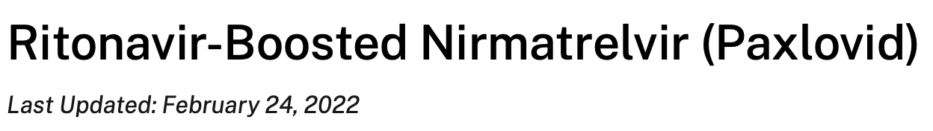
Drug interaction resources
Table A. Drug-Drug Interactions Between Ritonavir-Boosted Nirmatrelvir (Paxlovid) and Concomitant Outpatient Medications
Prescribe an Alternative COVID-19 Therapy For cases where drug-drug interaction management strategies are not possible or feasible, or the potential risks of such strategies outweigh the potential benefits.
Temporarily Withhold Concomitant Medication, If Clinically Appropriate For guidance on restarting the concomitant medication, consult the Liverpool COVID-19 Drug Interactions website. If withholding is not clinically appropriate, use an alternative concomitant medication or COVID-19 therapy.
Adjust Concomitant Medication Dose and Monitor for Adverse Effects Consult the Liverpool COVID-19 Drug Interactions website^{b} for guidance. If the dose of the concomitant medication cannot be adjusted, withhold the medication (if clinically appropriate) or use an alternative concomitant medication or COVID-19 therapy
https://www.covid19treatmentguidelines.nih.gov/therapies/antiviral-therapy/ritonavir-boosted-nirmatrelvir--paxlovid-/

Slide 52

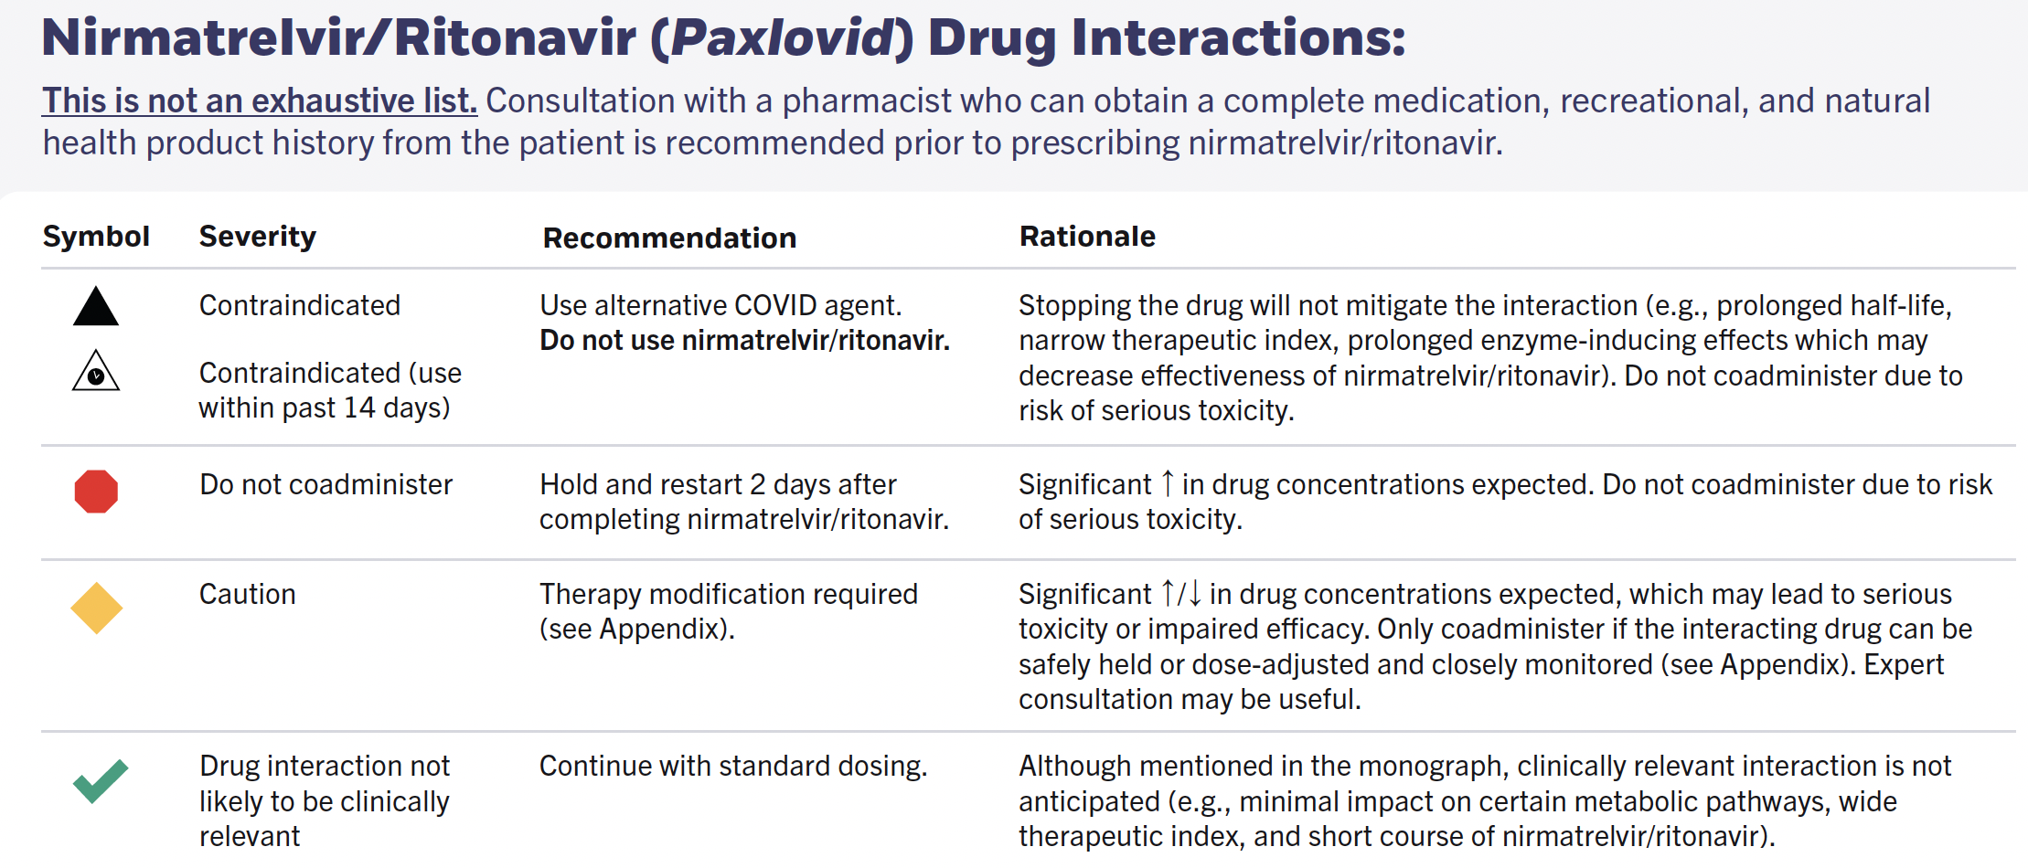
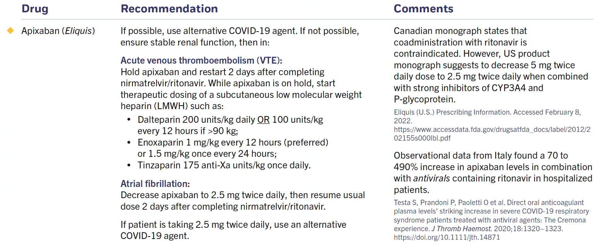
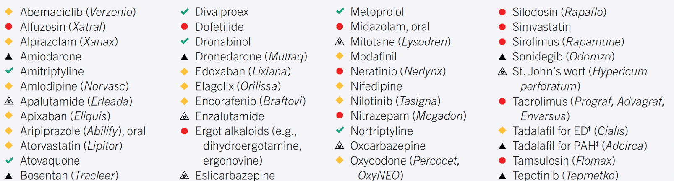
https://covid19-sciencetable.ca/sciencebrief/nirmatrelvir-ritonavir-paxlovid-what-prescribers-and-pharmacists-need-to-know-2-0/

Slide 53

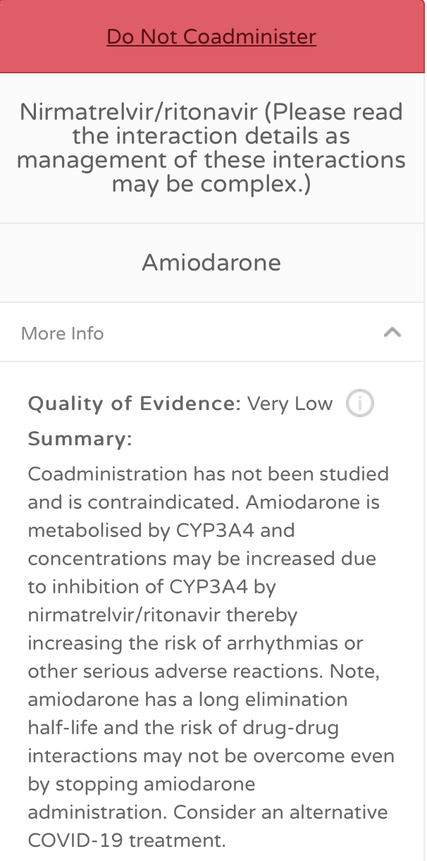
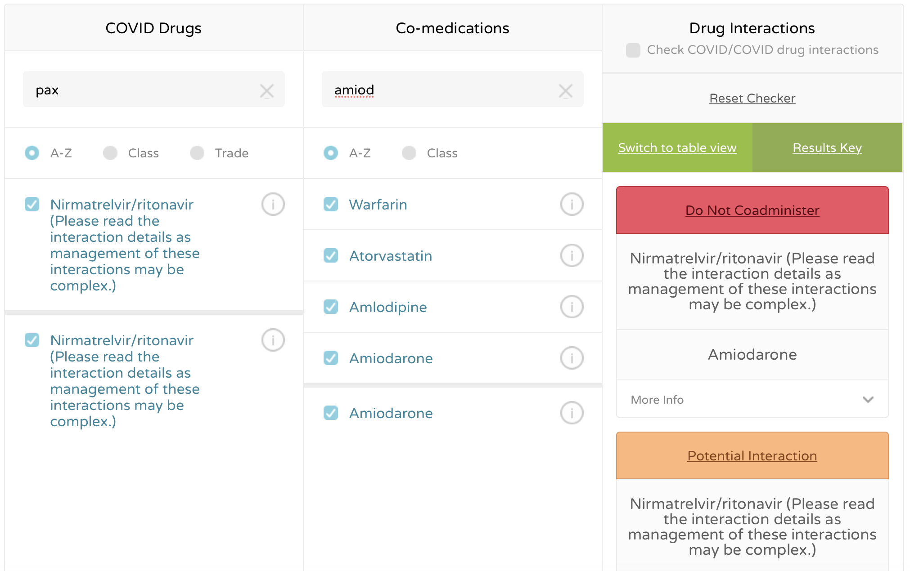
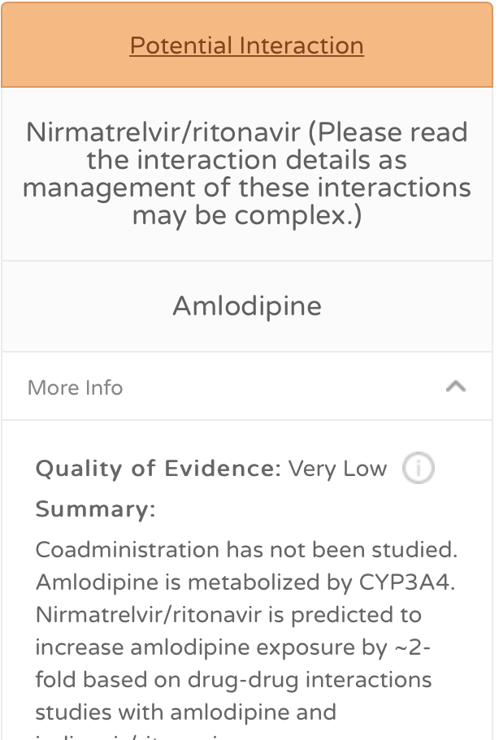
https://www.covid19-druginteractions.org/checker

Slide 54
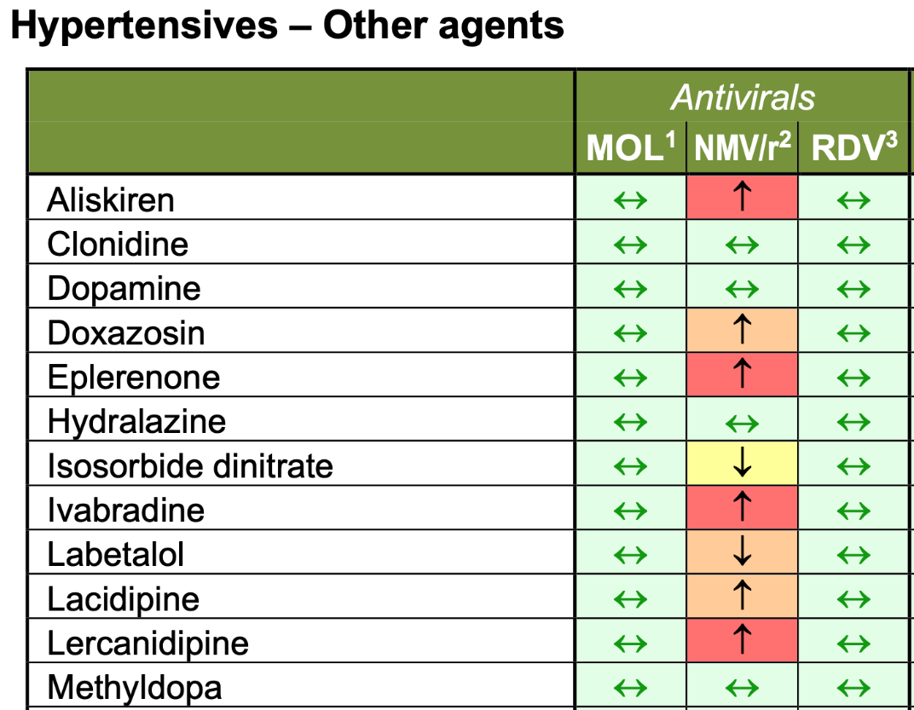
Cardiovascular Drug Interaction considerations
Antihypertensives: Common classes
ACE inhibitors
Angiotensin agonists (most) | Except valsartan, monitor BP
Beta Blockers
Calcium Channel Blockers Amlodipine 50% dose reduction Others, monitor BP
Diuretics (most) | Except indapamide, monitor BP
Contraindication
Dose adjustment or Increased monitoring
No clinically significant interactions
Prescribing resources available that summarize by class at COVID-19 DDI site:
This is not a comprehensive list of medications and recommendations. Refer to a drug interaction resource for additional Information.

Slide 55
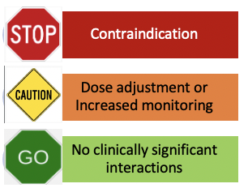
Cardiovascular Drug Interaction considerations
Common indications
Antiarrhythmics: most contraindicated | Except digoxin, lidocaine, mexiletine: Consider dose adjustment and monitoring
Lipid Lowering Agents:
Evolocumab
Ezetimibe
Fibrates
Fish oil
Gemfibrozil
Statins: Pitavastatin, Pravastatin
Statins: Atorvastatin, rosuvastatin, simvastatin, lovastatin: hold statin dose during Paxlovid therapy +3 days
This is not a comprehensive list of medications and recommendations. Refer to a drug interaction resource for additional Information.

Slide 56
Cardiovascular Drug Interaction considerations
Common Antiplatelet and anticoagulants
Antiplatelet agents:
Aspirin, dipyridamole, prasugrel, ticagrelor
Clopidogrel: conversion from prodrug to active drug via CYP required; management based on indication and time since stent placement
Anticoagulants:
DOACs – nuanced interpretation based on indication and renal function
Apixaban: Dose adjustment required; if dose adjustment is not possible, contraindicated
Betrixaban: Dose adjustment suggested
Dabigatran: Caution in patients with renal function < 50ml/min Edoxaban: No dose adjustment recommended in US labeling
Rivaroxaban: If appropriate, hold dose during Paxlovid therapy + 3 days after. If not clinically appropriate to hold dose, contraindicated
Low molecular weight heparins
Warfarin: Consider additional monitoring of INR
This is not a comprehensive list of medications and recommendations. Refer to a drug interaction resource for additional Information.

Slide 57
Assessing if patient can take Paxlovid with concomitant drug interactions
Do you have an accurate medication list and can you verify which medications are being taken as prescribed?
Can alternative therapies or dosages be accessed by the patient?
Is the patient or patient’s caregiver able to follow the directions for medication adjustments reliably?
Can increased monitoring at home or at a clinical site be accomplished (ie blood pressure, INR)?

Slide 58
Nirmatrelvir/Ritonavir in Immunosuppressed Patients
Benjamin A Miko, MD
Columbia University Medical Center
Kimberly Scarsi, PharmD, MS, FCCP
University of Nebraska Medical Center
We have no relevant financial disclosures.

Slide 59
Background
Compared to the general population, immunosuppressed individuals are at significantly elevated risk of morbidity and mortality from COVID-19
Immunosuppressed individuals have decreased response rates to vaccination and may derive particular benefit from novel therapies for SARS-CoV-2 exposure/infection
The emergence of the Omicron variant and its subvariant BA.2 has limited the utility of certain monoclonal antibody therapies
Although remdesivir remains a compelling option, serial infusions of an intravenous medication may be logistically complicated in the outpatient setting
Oral nirmatrelvir-ritonavir has been shown to reduce hospitalization and death by 89% in 2,246 unvaccinated patients infected with SARS-CoV-2
The application of this agent to immunosuppressed patients, particularly solid organ transplant recipients (SOTRs), is complicated by drug-drug interactions
Pereira MR et al. Am J Transplant 2020
Hammond J et al. NEJM 2022

Slide 60
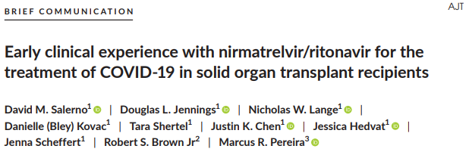
American Journal of Transplantation, 2022
Retrospective study of all CUMC adult SOTRs on calcineurin inhibitor or mTOR inhibitor therapy who were prescribed NR between 12/28/2021 and 1/6/2022
A total of 25 adult SOTR were included in the analysis: 21 on tacrolimus, 4 on cyclosporine, 3 on everolimus, and 1 on sirolimus
All were instructed to follow a standardized protocol during treatment with the 5 day course of NR: completely hold tacrolimus/mTOR inhibitors or reduce cyclosporine to 20% of baseline doses
Four patients (16%) were hospitalized by day 30; no patients died within 30 days of NR treatment
Median tacrolimus level pre- and post-NR were 7.5 and 5.2, respectively
Four patients experienced a supratherapeutic tacrolimus level post-NR

Slide 61
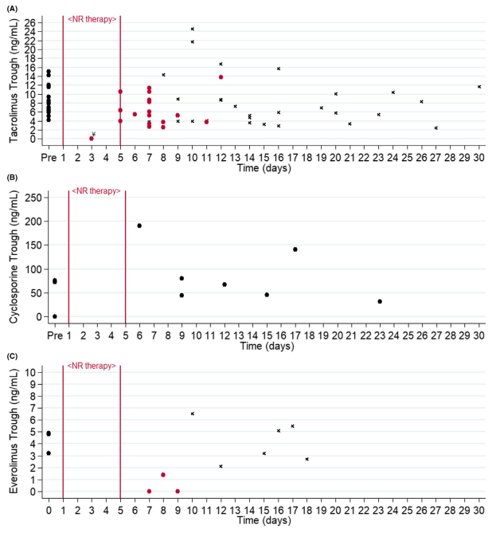
Salerno DM et al. Am J Transplant 2022

Slide 62
Immunosuppressant-Paxlovid DDI considerations
Immunosuppressants
Adalimumab
Anti-thymocyte globulin
Azathioprine
Basiliximab
Belatacept
Cyclosporin: ↓ dose 80% with additional monitoring
Everolimus
Methotrexate
Mycophenolate
Pirfenidone
Prednisone
Sirolimus
Tacrolimus: Hold dosing during therapy, frequent monitoring
Contraindication
Dose adjustment or Increased monitoring
No clinically significant interactions

Slide 63
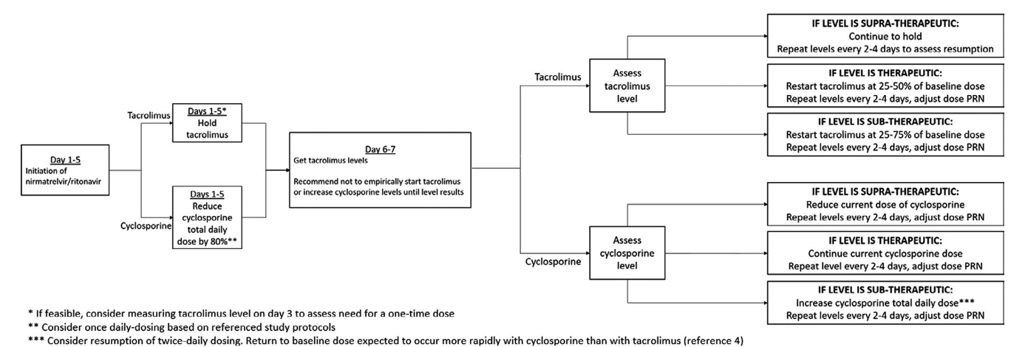
Lange NW et al. Am J Transplant 2022

Slide 64
Patient 1 - LG
54 year old woman with a PMH of hypertension, GERD, and sarcoidosis s/p double lung transplant on 8/6/2020 who developed fevers, dry cough, and dyspnea on exertion on 12/21/2021
Patient seen at urgent care for these symptoms on 12/27/2021
VS: Temp 38.1C, BP 123/76, HR 98, RR 18, Sat 94% RA
Physical exam: NAD, scattered bilateral crackles in all lung fields, tachycardia, normal abdominal exam, normal extremity exam
Labs: WBC 3.5, hgb 12.2, plt 199, Cr 1.4, normal LFTs
CXR: Increased interstitial opacities bilaterally
SARS-CoV-2 testing obtained (pending) and patient discharged on oral azithromycin
  This returned positive the following day (12/28/2021)

Slide 65
Patient 1 - LG, continued
Transplant background (8/6/2020): thymoglobulin induction, initially complicated by primary graft dysfunction necessitating V-V ECMO x 5 days. Later complicated by wound dehiscence & infection with Enterobacter chloacae treated with ertapenem. No episodes of rejection. One episode of CMV reactivation in summer 2021
Transplant immunosuppression: tacrolimus 2mg PO q12h (goal 8-12), mycophenolate 1500mg PO q12h, prednisone 5mg PO q24h
Antimicrobial prophylaxis: nystatin oral suspension, TMP-SMX, valganciclovir
Other medications: acetaminophen, alendronate, calcium/vitamin D, furosemide, gabapentin, magnesium oxide, omeprazole, ondansetron, senna
No known drug allergies
No clinically significant DDIs expected between Paxlovid and other co-medications

Slide 66
Patient 1 - LG, continued
Patient prescribed five-day course of NR on 12/29/2021; advised to hold tacrolimus at that time
Most recent tacrolimus level (pre-NR) 14.2 (75 days prior)
First post-NR tacrolimus level (7 days after NR initiation) 11.4
Patient advised to restart tacrolimus at 50% previous dosage
Second post-NR tacrolimus dose (29 days after NR initiation) 11.7
No sub- or supratherapeutic levels, no episodes of rejection
Patient recovered from COVID-19 symptoms

Slide 67
Patient 2 - RR
60 year old woman with a PMH of dyslipidemia, anxiety/depression, colon cancer, and giant cell myocarditis s/p heart transplant on 8/5/2021 who developed nasal congestion, cough, and nausea/vomiting on 12/30/2021
Patient seen at local ED for those symptoms 12/31/2021
VS: Temp 37.1C, BP 109/66, HR 85, RR 17, Sat 95% RA
Physical exam: NAD, faint expiratory wheezing in all lung fields, 2/6 systolic murmur at R upper sternal border, abdomen softly distended, normal extremity exam without edema
Labs: WBC 4.1, hgb 10.2, plt 145, Cr 1.2, normal LFTs
CXR: Small bilateral pleural effusions, otherwise clear
SARS-CoV-2 testing obtained (pending) and patient discharged on oral levofloxacin
  This returned positive the following day (1/1/2022)

Slide 68
Patient 2 - RR, continued
Transplant background (8/5/2021): thymoglobulin induction, index admission c/b groin infection necessitating wound vac. Antibody-mediated rejection (9/23/2021) treated with steroids and IVIG further complicated by steroid-induced psychosis
Transplant immunosuppression: tacrolimus 7.5mg PO q12h, mycophenolate 1500mg PO q12h, prednisone 7.5mg PO q24h
Antimicrobial prophylaxis: nystatin oral suspension
Other medications: alendronate, aspirin, atorvastatin, calcium/vitamin D, citalopram, docusate, famotidine, ferrous gluconate, magnesium oxide, quetiapine
Allergies: Benzocaine, bacitracin
Quetiapine: Reduce dose to 1/6 of current dose during Paxlovid + 3 days after therapy
Atorvastatin: Hold during Paxlovid + 3 days
No clinically significant DDIs expected between Paxlovid and other co-medications

Slide 69
Patient 2 - RR, continued
Patient prescribed five-day course of NR on 1/1/2022; advised to hold tacrolimus at that time
Most recent tacrolimus level (pre-NR) 15.0 (13 days prior)
First post-NR tacrolimus level (3 days after NR initiation) <0.2
Patient advised to restart tacrolimus at 67% previous dosage
Second post-NR tacrolimus dose (8 days after NR initiation) 8.9
Patient underwent right heart catheterization 1/10/2022 – negative for rejection
Third post-NR tacrolimus (25 days after NR initiation) 10.4
In late January, patient developed worsening sinus pain and congestion, prescribed amoxicillin-clavulanate for sinusitis

Slide 70
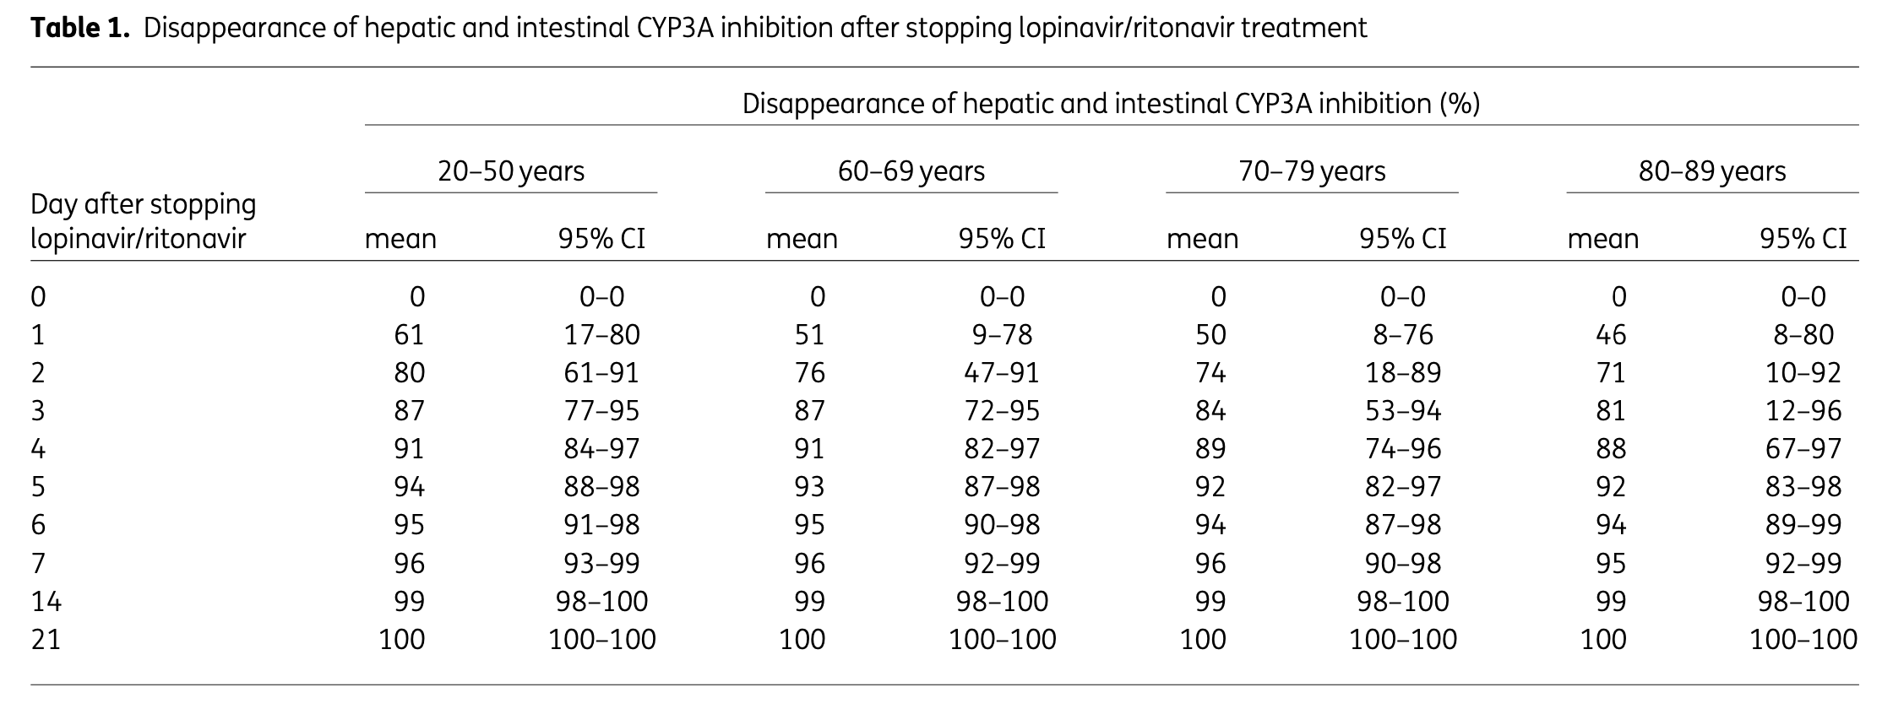
Timeline of nirmatrelvir/ritonavir DDIs
Ritonavir is a mechanism-based, irreversible inhibitor of CPY3A4, CYP2D6, p-glycoprotein
One study modeled the time to resolution of enzyme inhibition based on lopinavir/ritonavir
Support guideline advice to resume contraindicated medications 3 days after completion of Paxlovid therapy
Residual inhibition may be observed in some individuals through 21 days based on Stader et al.’s model.
Note: chronic ritonavir also induces several other CYP enzymes and glucuronidation, but this is unlikely to be clinically significant due slower time to maximal enzyme induction.
Stader et al. JAC 2020; 75:3084-86

Slide 71
Discussion
While NR can be safely used in SOTRs, drug-drug interactions are complex and require close monitoring
Holding CNIs and mTOR inhibitors at the time of NR initiation can prevent supratherapeutic levels
An important aspect of managing these drug-drug interaction is determining when and how to restart CNI/mTOR inhibitors
For the majority of stable SOTRs, slight transient reductions in immunosuppression are unlikely to result in adverse outcomes
For patients with high immunological risk factors (recent transplant or rejection), more intensive monitoring may be needed
To effectively do this, transplant centers must have the ability to test COVID-positive individuals on-site or remotely and communicate recommendations to patients
PCPs, emergency/urgent care providers, transplant teams, and PharmDs must to partner together to care for these vulnerable individuals

Slide 72

Lessons Learned from the HIV/
Ritonavir Experience
Melanie A. Thompson, MD

Slide 73

Ritonavir:
The Drug HIV Providers
Love to Hate
Melanie Thompson, MD
Principal Investigator Emeritus, AIDS Research Consortium of Atlanta
Co-Chair, HIVMA/IDSA HIV Primary Care Guidance

Slide 74
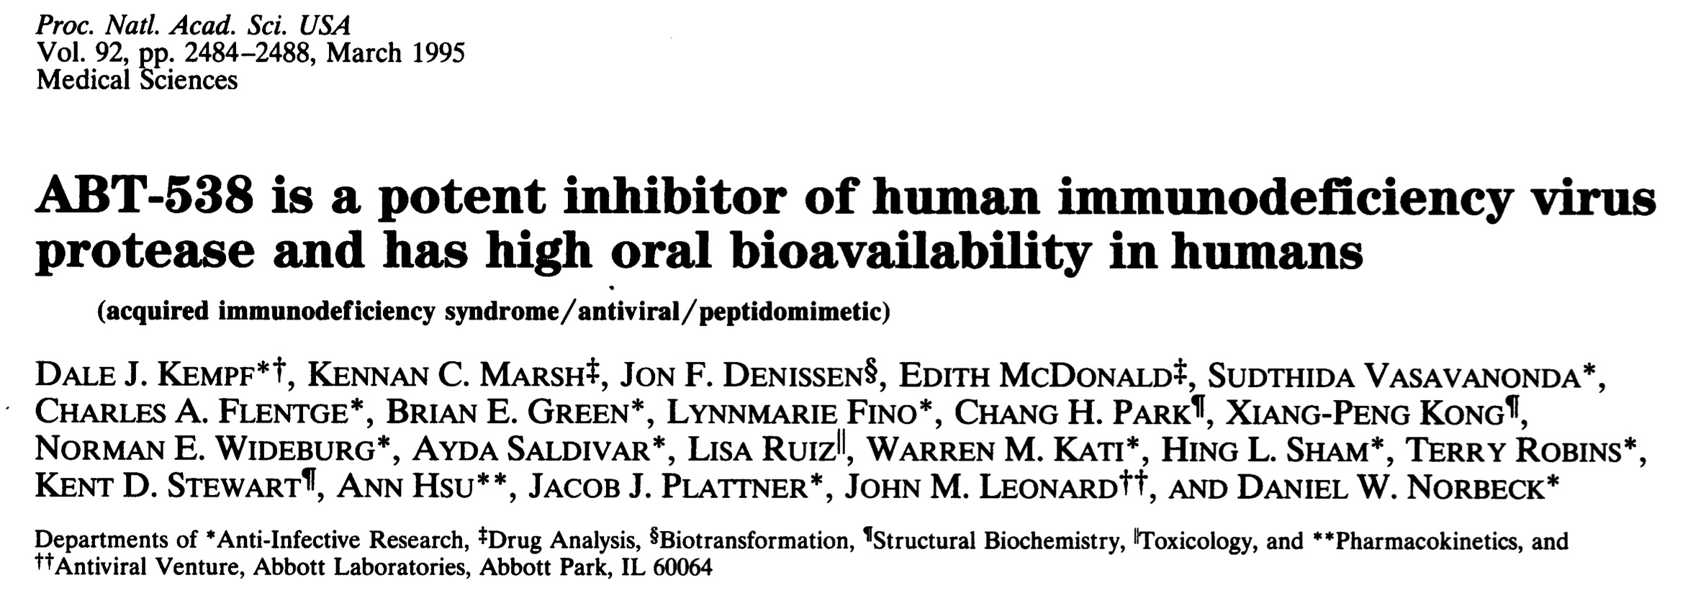
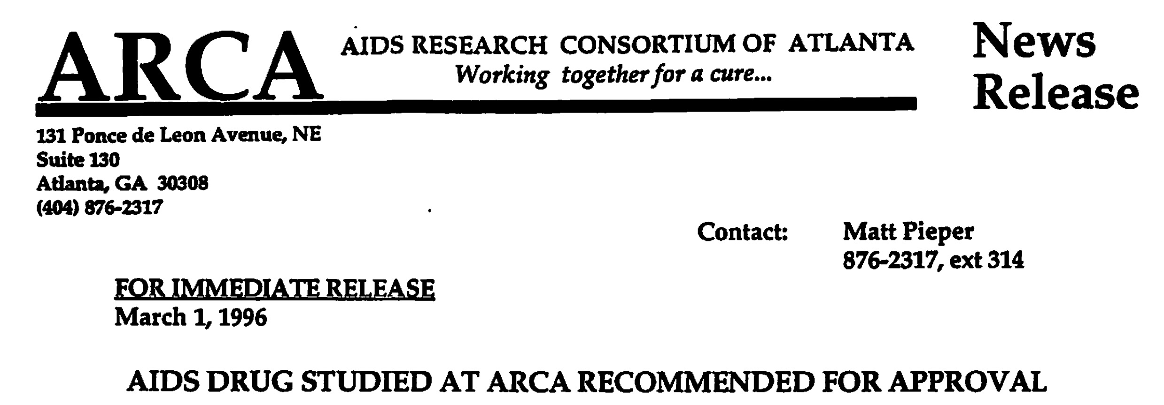

Slide 75
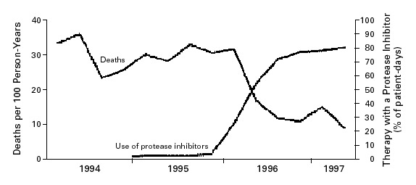

Mortality and Frequency of Use of Combination Antiretroviral Therapy Including a Protease Inhibitor
People with HIV and <100 CD4/mm3, January 1994 - June 1997
Palella FJ Jr et al. N Engl J Med 1998;338:853-860.
Notes:
Figure 1. Mortality and Frequency of Use of Combination Antiretroviral Therapy Including a Protease Inhibitor among HIV-Infected Patients with Fewer than 100 CD4+ Cells per Cubic Millimeter, According to Calendar Quarter, from January 1994 through June 1997.

Slide 76
Evolution of PK Boosting in HIV Treatment
Protease inhibitors (PIs) + 2 NRTIs
Lower dose RTV as a pharmacokinetic booster for PIs
Cobicistat = non-antiviral PK booster for coformulation
    Integrase inhibitor elvitegravir
    Protease inhibitors darunavir, atazanavir
  RTV still used at 100mg BID with darunavir for MDR virus

Slide 77


Challenges of Prescribing Ritonavir
High dose, lots of pills: initially 600mg twice daily, as 100mg pill
Lots of side effects
  Diarrhea, nausea, vomiting, abdominal pain
  Elevated liver enzymes; hepatotoxicity
  Perioral tingling (50%)
  “Taste perversion”
    Spencer Cox: “an inexplicable desire to wear plaid.”
AND – those pesky drug interactions!

Slide 78
What’s Different? Ritonavir for HIV vs COVID-19
HIV requires lifetime treatment: cumulative toxicities; interactions with newly added meds; adherence
Clinicians prescribing ritonavir for HIV are familiar with its toxicities and drug-drug interactions
5 days of PaxlovidTM treatment mitigates some – but not all - potential ritonavir complications
  Some interacting medications can be stopped temporarily
  Concern mainly for acute adverse effects
PaxlovidTM must be started rapidly to be effective

Slide 79
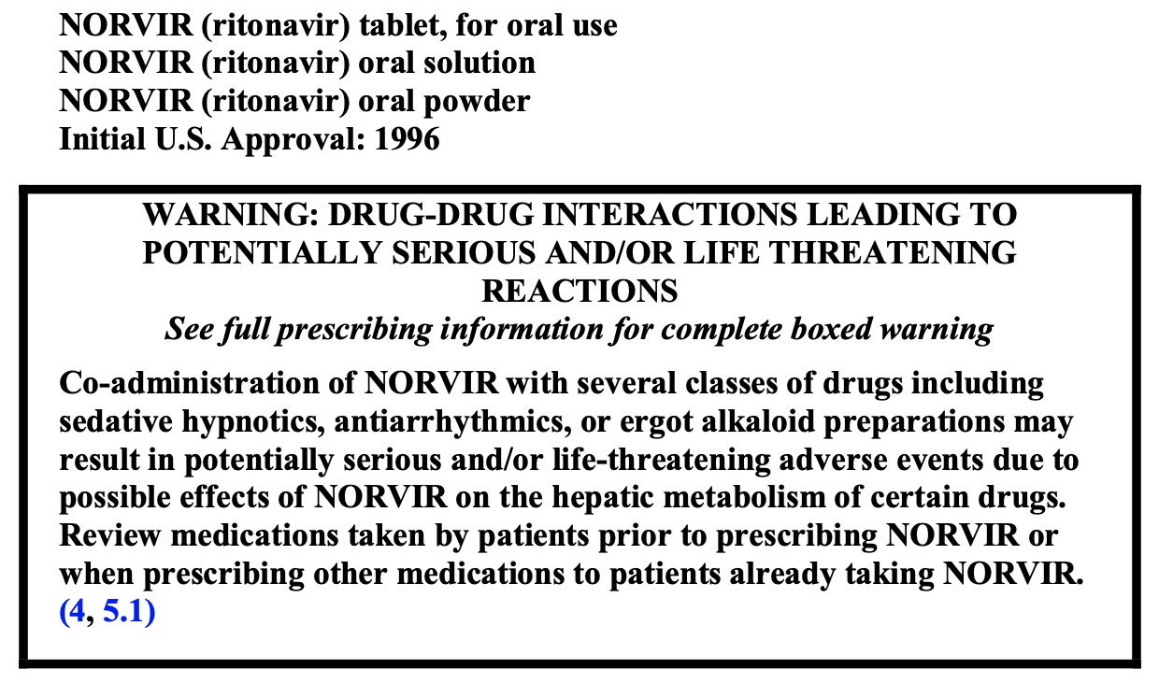
BEWARE:
Sedative hypnotics
Antiarrhythmics
Ergot alkaloids
Plus 7 pages of drug-drug interactions
😱
Norvir Package Insert: Revised 2019

Slide 80
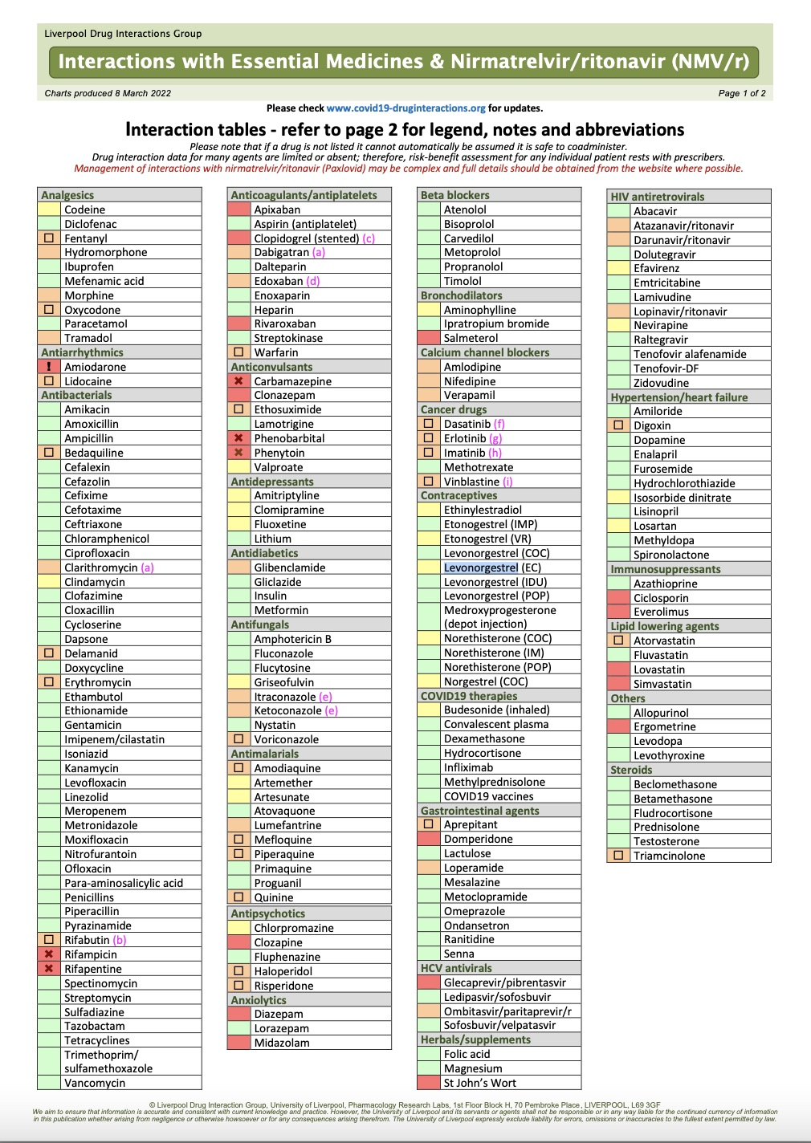
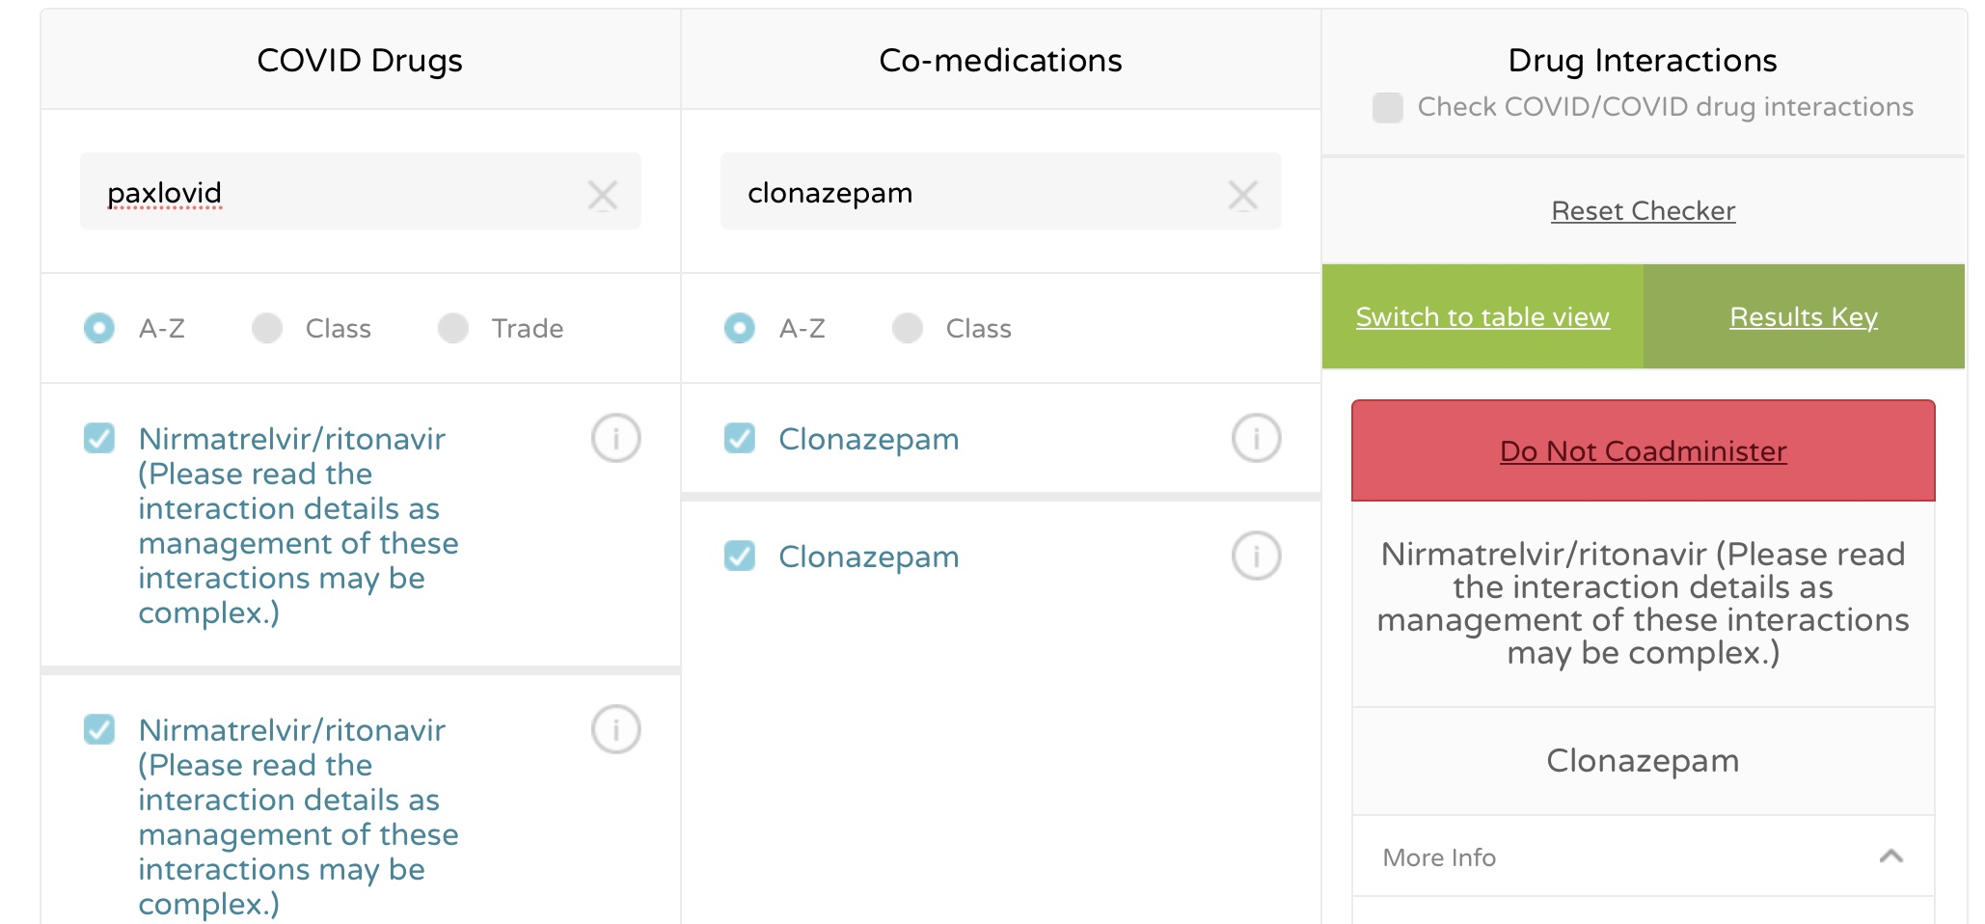
University of Liverpool hiv-druginteractions.org covid19-druginteractions.org
Indispensable tool for finding drug interactions

Slide 81

Lesson 1
Polypharmacy requires
medicine reconciliation & management of interactions
Patients may not know the names of their meds
Patients may not have a consistent primary care provider
OTC meds, supplements, vitamins, recreational drugs often overlooked during reconciliations
Who will do this for PaxlovidTM?

Slide 82
Lesson 2
Someone must teach patients (and caregivers) about their meds
Discuss drugs that need to be changed, stopped, dose adjusted
Counsel on adverse effects
Ask patients not to take other meds without discussing
Rapid clinician access for patients if issues develop
Who will do this for PaxlovidTM?

Slide 83
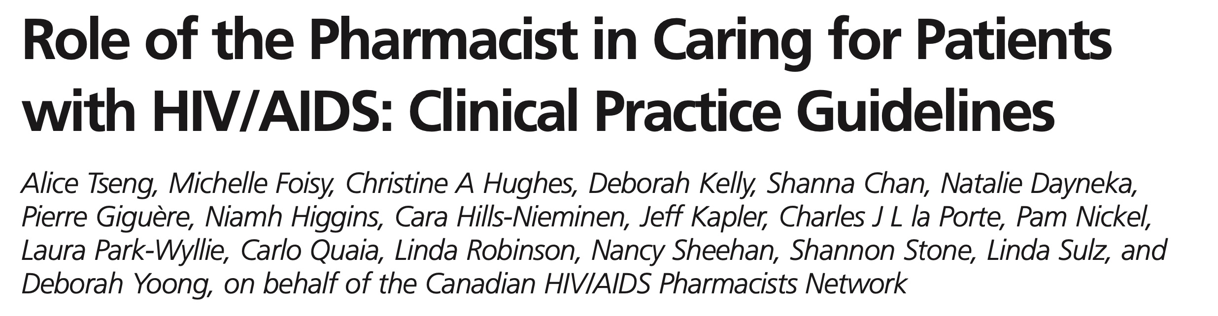
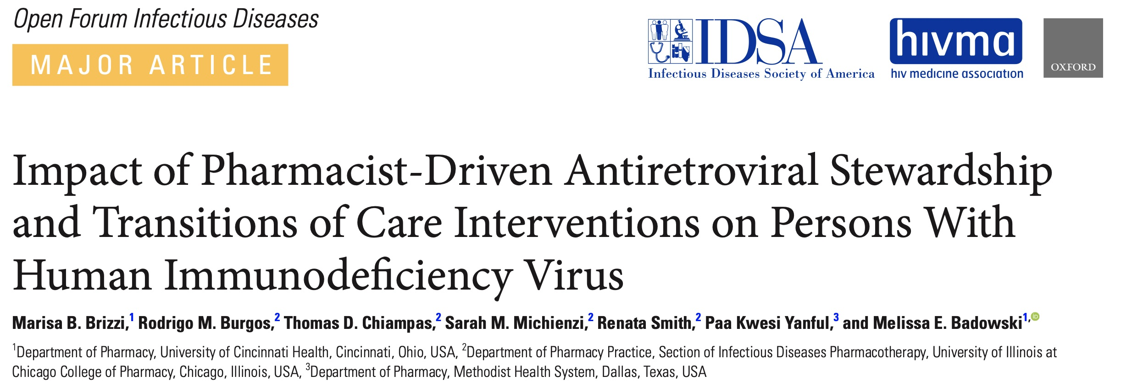
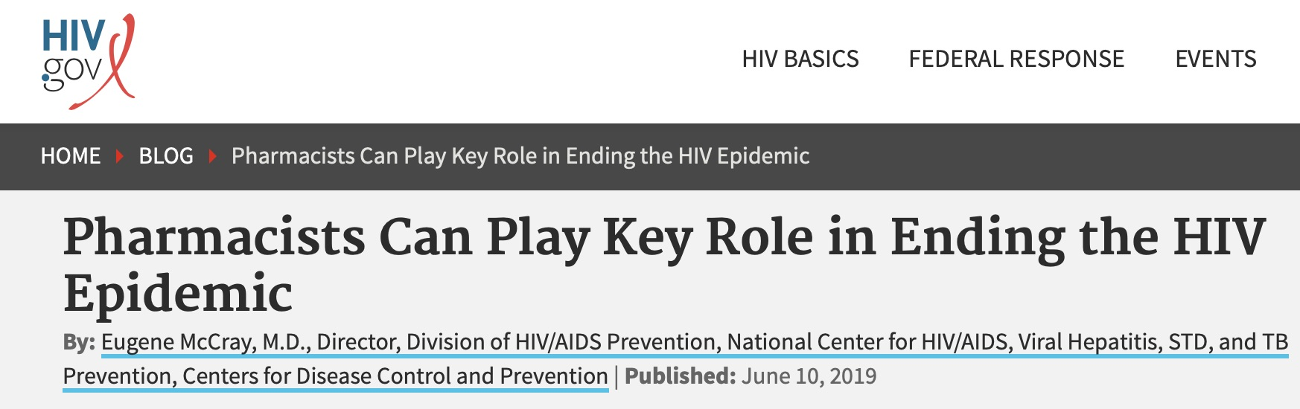
Canadian Journal of Hospital Pharmacy, Mar-Apr 2012
Notable roles of the pharmacist
Counseling on side effects and adherence
Medication reconciliation
Managing drug Interactions
Decreasing medication errors

Slide 84
Lesson 3: Workforce
Pharmacists & nurses play primary roles in HIV care
Pharmacists have expertise in drug interactions, counseling on adverse effects, but many may not be familiar with ritonavir
Nurses often have the most direct contact with patients through phone, e-messages
Pharmacists & nurses have been overwhelmed by COVID-19
What role will pharmacists & nurses play for PaxlovidTM education and counseling and how do we train them?

Slide 85
Early Days: Few Providers Treated People with HIV
Stigma and discrimination in healthcare was fierce (still is!)
People with AIDS: desperately ill, likely to die (pre-1995)
AIDS was complex: specialized knowledge required
  Multiple concurrent opportunistic infections/malignancies
  Polypharmacy: ART, OI prevention & treatment, drug & disease side effects
  Rapidly changing ART landscape
  “Cocktail therapy”: drug interactions – especially with ritonavir

Slide 86
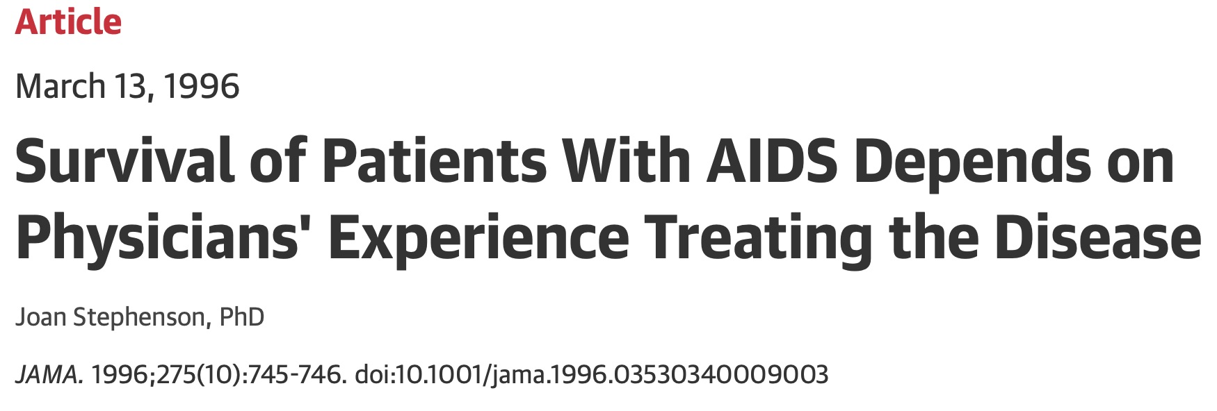
… people with AIDS whose therapy was managed by primary care physicians with no previous experience in treating such patients died more than a year sooner than those whose physicians had previously treated at least five patients…

Slide 87


Training for low volume clinicians
Web based, interactive training (HIV-ASSIST)
Curriculum development for residency and APP training programs
Expert networks for expert help; warmlines
Project ECHO telemedicine

Slide 88
Lesson 4: Workforce
Very few clinicians have expertise with ritonavir
Assume that most clinicians do not know ritonavir
Best practices for expanding the HIV workforce and training low-volume providers may be relevant
How will we train clinicians to prescribe and manage PaxlovidTM?

Slide 89
Lesson 5:
Equity
Health disparities do not resolve by themselves.
Equity does not occur spontaneously.
We have NOT solved this for HIV or COVID-19.
How will we ensure that PaxlovidTM gets to people who need it most?

Slide 90
Ideas for consideration
Package simple patient education materials with PaxlovidTM, focusing on acute adverse effects and most dangerous drug-drug interactions
Implement online training modules for prescribers, pharmacists, nurses; also use Project ECHO model for clinician training
Incorporate training modules in curricula for physicians, APPs, pharmacists, nurses in training
Implement PaxlovidTM hotlines for prescribers (USCF National Clinician Consultation Center for HIV) and for patients
Provide HIPAA-compliant access to cross-pharmacy databases to assist in medication reconciliation by pharmacists/prescribers
Make sure PaxlovidTM is available at neighborhood pharmacies in underserved communities

Slide 91
Disclosures
In the past 24 months the following provided funding to the AIDS Research Consortium of Atlanta for HIV clinical trials:
  Cepheid, Inc.
  Cytodyn, Inc.
  Frontier Biotechnologies
  Gilead Sciences
  GlaxoSmithKline
  Merck, Sharp, Dohme
  ViiV Healthcare
Dr. Thompson currently chairs the IDMC for Excision Biotherapeutics EBT-101

Slide 92
Additional Considerations
Derek Eisnor, MD

Slide 93


Major DDIs – Hold or Consider Alternative to Paxlovid versus
Dose Adjustments
Notes:
I would like to review Hold/contraindicated drugs with severe DDIs versus those to consider dose adjustments. Also keep in mind whether you are holding a concurrent med or making a dose adjustment, that period should include the 3 day washout period beyond the 5 day drug dosing interval for a total of 8 days.
I would also add that there are several excellent resources for exploring potential Paxlovid DDIs, including FDA’s FS, the COVID-19 Liverpool website and phone app, and Pfizer’s DDI toolkit. FDA is also working on a more proscriptive 3-page checklist for PCPs. The Liverpool group through the Scotland NHS also has an excellent primer covering best approach to Paxlovid prescribing. All these links are included in the end of this slide deck.

Slide 94
Prescribing of Paxlovid for the treatment of COVID-19 in non-hospitalized Patients, 3rd February 2022, NHS Education for Scotland
Notes:
This is from the Liverpool group showing the top 10 concurrent medications for patients prescribed Paxlovid. Going through the following lists, I tried to focus on the top 250 most prescribed US drugs (minus some of the chemotherapeutics).

Slide 95
Cardiovascular / Pulmonary
Anti-arrhythmics:
  Amiodarone (NTI), active metabolites & long elimination half-life
  Bepridil, disopyramide, dofetilide, flecanide, propafenone, quinidine, dronedarone
  Ranolazine
  Ivabradine (Corlanor)
  Digoxin, lidocaine, mexiletine
Bronchodilators:
  Salmeterol
Anti-hypertensives
  CCBs - Hold or at least %50 dose reduction
PDE5 Inhibitors:
  Sildenafil, tadalafil, vardenafil
Notes:
Ranolazine is an antianginal with NA & K channel inhibition and prolongation of QT interval.
Ivabradine is a new CHF drug which decreases SA node activity without decreasing contractility but may result in symptomatic bradycardia.
Salmeterol may cause enhanced adrenergic symptoms, including palp/ST and prolonged QT. It is LAB2A lasting 12 hours and more with ritonavir.
CCBs recommend dose reduction of at least 50% and caution for hypotension, weakness or syncope. Some drugs like nifedipine (10-15 fold incr AUC) may require a larger dose reduction or hold.
PDE5I used for PAH are CI for concern for excessive hypotension, syncope & possible priapism.

Slide 96
Cardiovascular / Pulmonary
Alpha Antagonists:
  Alfuzosin
  Terazosin
Lipid Lowering Agents:
  Simvastatin, lovastatin
  Rosuvastatin, atorvastatin
Anti-coagulants:
  Rivaroxaban
  Apixaban*, edoxaban
  Ticagrelor, clopidogrel
Notes:
Alfuzosin is CI due to potential for severe hypotension. A1B for BPH like or Tamsulosin caution on possible hypotension.
HMG COA red agents above hold for 8 days prior to resuming. If possible, space out first dose of Paxlovid from last dose of LLA by 8-12 hours.
FXaI Apixaban if concurrent use, recommend dose reduction. A limited number of PWH on ritonavir and a reduced apixaban dose did not show adverse bleeding events.
Increase in ticagrelor exposure, consider substitution with prasugrel. Clopidogrel may be inefficacious, consider prasugrel addition or ASA.

Slide 97
Sedative/hypnotic & pain
Meperidine, dextropropoxyphene
Fentanyl
Consider dose/frequency reduction:
  Hydrocodone, hydromorphone, morphine, oxycodone, tramadol
Midazolam (oral), triazolam
Chlorazepate, clonazepam, diazepam, flurazepam
50% dose reduction:
  Alprazolam, Chlordiazepoxide, Zolpidem, Zopliclone
https://clincalc.com/Benzodiazepine/
https://www.cdc.gov/opioids/providers/prescribing/guideline.html
Notes:
For benzodiazepines, consider using Lorazepam, Oxazepam or temazepam equivalent doses.
Zaleplon (Sonata) does not need adjustment.

Slide 98
Immunosuppressants*
Changes to immunosuppressants should be in conjunction with patient’s Oncologist*
Many chemotherapeutics have a narrow therapeutic index
Apalutamide
Encorafenib, Ivosidenib
Neratinib, venetoclax, ibrutinib
Abemaciclib, Ceritinib, Dasatinib, Nilotinib: possible dose reduction with Oncologist
Notes:
Apalutamide is a strong 3A4 inducer and thus CI.
Avoid concurrent use of Encorafenib or Ivosidenib due to Potential QT prolong.
Neratinib mainly metab by 3A4 and has a long t1/2. Not recommended due to concerns for severe hepatotoxicity. Recommend waiting 24 hr post DC before starting Paxlovid if possible.
Ibrutinib for CLL possible dangers of interrupting Tx in those with high volume leukemia. Increased conc from 3A4 inhibition may lead to TLS.

Slide 99
Immunosuppressants*
Cyclosporine
  prolonged half-life in PWH, possible dose reduction ~75% with enhanced cyclosporine level monitoring
Everolimus, sirolimus
  +10-fold increase exposure following ketoconazole coadministration
Tacrolimus
  hold or single dose on day 3 along with enhanced monitoring of tacrolimus levels (day 3 and every 2-4 days through 2 weeks)
Stomatitis, diarrhea, rash, fatigue, anemia, nephrotoxicity
Notes:
In general, concurrent use with these drugs to be avoided but may use dose reduction with enhanced drug level monitoring if necessary.

Slide 100
Others
Colchicine
Ergotamine, dihydro- & methyl ergotamine
Antipsychotics:
  Pimozide, lurasidone, clozapine
  Quetiapine
Trazadone
HCV DAAs:
  Elbasvir/Grazoprevir, Glecaprevir/Pibrentasvir – ALT elevations
Anti HIV protease regimens containing ritonavir or cobicistat – no change
Anti retroviral therapy, some potential increase in drug concentrations but no major DDI concerns
Notes:
Concurrent use of ergots CI due to increased risk of vasospasm included ischemia and/or stroke
Most due to possible prolonged QT and TdP, clozapine & possible increased myocarditis
Trazadone dose adjustment with caution on hypotension and QT prolong
Some HCV DAA concern for increasing risk of ALT elevations. However, those on ritonavir containing HCV regimens should continue treatment as indicated.
Possible dose reduction of maraviroc. Possible enhanced liver enzyme monitoring with efavirenz.

Slide 101
3A4 Inducers
Coadministration Contraindicated due to potential loss of virologic activity due to decrease in nirmatrelvir concentrations:
  Phenytoin
  Primidone, Phenobarbital
  Carbamazepine
  Rifampicin
  St John’s Wort
  Enzalutamide, Apalutamide
Notes:
Enzalutamide for prostate CA

Slide 103
Summary Recommendations
Paxlovid is the most effective pill option for risk patients with mild to moderate COVID-19
Current best use Guidance – Be Familiar with one or many:
  Health Care Provider Fact Sheet for PAXLOVID
  NIH COVID-19 Treatment Guidelines
  IDSA Guidelines on the Treatment and Management of Patients with COVID-19
  University of Liverpool COVID-19 Drug Interactions
Liberal use of DDI cross reference tools, have a plan!
Known Risk v benefits of holding concurrent med(s)
  Contraindicated – Can concurrent med be stopped safely for +1 week?
  Feasibility of concurrent med dose adjustment?
  Educate patient to early signs of potential medication toxicity
Inclusion of specialist consultation(s) when appropriate

Slide 104
Thank You

Slide 105

Paxlovid Prescribing Resources
https://covid19-druginteractions.org/checker
https://www.fda.gov/media/155050/download
https://www.covid19treatmentguidelines.nih.gov/therapies/statement-on-paxlovid-drug-drug-interactions/
https://www.idsociety.org/covid-19-real-time-learning-network/therapeutics-and-interventions/antivirals/
https://covid19-sciencetable.ca/sciencebrief/nirmatrelvir-ritonavir-paxlovid-what-prescribers-and-pharmacists-need-to-know-2-0/
https://www.pfizermedicalinformation.com/en-us/drug-interaction-checker?product=PAXLOVID%E2%84%A2+%7C+nirmatrelvir+tablets%3B+ritonavir+tablets&product2=Alfuzosin
https://www.glasgowlmc.co.uk/download/Links/test/2022/25_feb/Prescribing-of-Paxlovid-for-COVID-19.pdf

Slide 106
References
Paxlovid HCP FS 03182022: https://www.fda.gov/media/155050/download
Quality and Bioequivalence Standards for Narrow Therapeutic Index Drugs, FDA 2011: https://www.fda.gov/files/drugs/published/Quality-and-Bioequivalence-Standards-for-Narrow-Therapeutic-Index-Drugs.pdf
A Proposed Approach for the Determination of the Bioequivalence Acceptance Range for Narrow Therapeutic Index Drugs in the European Union Paulo Paixão,Rita Bento Guerreiro,Nuno Silva,Kevin Blake,Milton Bonelli,Jose Augusto Guimarães Morais,Alfredo Garcia Arieta,Luis Filipe Gouveia
Narrow Therapeutic Index drugs: clinical pharmacology perspective Sam Habet Journal of Pharmacy and Pharmacology, Volume 73, Issue 10, October 2021, Pages 1285–1291, https://doi.org/10.1093/jpp/rgab102
Utilization of Direct Oral Anticoagulants in People Living with Human Immunodeficiency Virus: Observational Data from the District of Columbia Cohort ,Jomy M George, Safia S Kuriakose, Anne Monroe, Qingjiang Hou, Morgan Byrne, Alice K Pau, Henry Masur, Colleen Hadigan, Amanda D Castel, Michael A Horberg ... Clinical Infectious Diseases, Volume 71, Issue 10, 15 November 2020, Pages e604–e613, https://doi.org/10.1093/cid/ciaa284
Narrow therapeutic index drugs: a clinical pharmacological consideration to flecainide, Juan Tamargo, 1 Jean-Yves Le Heuzey,2 and Phillipe Mabo3
Goldfrank’s Toxicologic Emergencies, Nelson et al, 9th Ed.

Slide 107
References(2)
Guiding dose adjustment of amlodipine after co-administration with ritonavir containing regimens using a physiologically-based pharmacokinetic/pharmacodynamic model, Dwaipayan Mukherjee, Journal of Pharmacokinetics and Pharmacodynamics (2018) 45:443–456.
Effect of Saquinavir-Ritonavir on Cytochrome P450 3A4 Activity in Healthy Volunteers Using Midazolam as a Probe, Christophe Schmitt, Pharm.D., Carsten Hofmann, Ph.D., Myriam Riek, M.Sc.,Arpna Patel, B.Sc., and Elke Zwanziger, Ph.D., PHARMACOTHERAPY Volume 29, Number 10, 2009.
Mechanisms of Pharmacokinetic Enhancement Between Ritonavir and Saquinavir; Micro/Small Dosing Tests Using Midazolam (CYP3A4), Fexofenadine (p‐Glycoprotein), and Pravastatin (OATP1B1) as Probe Drugs Ichiro Ieiri, PhD, 2013 The Journal of Clinical Pharmacology 53(6) 654–661.
Investigating the interaction between nifedipine- and ritonavir-containing antiviral regimens: A physiologically based pharmacokinetic/pharmacodynamic analysis, Wanjie Niu, 2020, Br J Clin Pharmacol. 2021;87:2790–2806.
Pharmacokinetics of once-daily darunavir-ritonavir and atazanavir-ritonavir over 72 hours following drug cessation. Boffito M, Jackson A, Amara A, et al. Antimicrob Agents Chemother. 2011;55(9):4218-4223. doi:10.1128/AAC.01747-10

Slide 108
Paxlovid (nirmatrelvir and ritonavir) Product Information
  FDA Fact Sheets
    Paxlovid provider fact sheet: https://www.fda.gov/media/155050/download
    Paxlovid patient fact sheet: https://www.fda.gov/media/155051/download
    Paxlovid patient fact sheet (Spanish): https://www.fda.gov/media/155075/download
Manufacturer’s Resources:
  Website for Healthcare Providers: https://www.covid19oralrx-hcp.com/
  Website for Patients: https://www.covid19oralrx-patient.com/
  Pharmacist Instruction Sheet: https://www.covid19oralrx-hcp.com/files/Clean_EUA-105-mitigation-plan-for-moderate-renal-impairment-01-11-22.pdf
Additional Resources:
  NIH’s COVID-19 Treatment Guidelines Therapeutic Management of Nonhospitalized Adults With COVID-19 (https://www.covid19treatmentguidelines.nih.gov/therapies/statement-on-therapies-for-high-risk-nonhospitalized-patients/)
  COVID-19 Therapeutics Locator: https://covid-19-therapeutics-locator-dhhs.hub.arcgis.com/
  Test to Treat Locator: https://aspr.hhs.gov/TestToTreat/Pages/default.aspx
  FDA MedWatch: https://www.accessdata.fda.gov/scripts/medwatch/index.cfm
  Pfizer Safety Reporting: http://www.pfizersafetyreporting.com/
  Module 5 Oral Therapeutics Administration

Slide 109
Q&A/Discussion

Slide 110


Specialty Society Collaborators
American Academy of Family Physicians
American Academy of Pediatrics
American College of Emergency Physicians
American College of Obstetricians and Gynecologists
American College of Physicians
American Geriatrics Society
American Thoracic Society
Pediatric Infectious Diseases Society
Society for Critical Care Medicine
Society for Healthcare Epidemiology of America
Society of Hospital Medicine
Society of Infectious Diseases Pharmacists
An online community bringing together information and opportunities for discussion on latest research, guidelines, tools and resources from a variety of medical subspecialties around the world.
www.COVID19LearningNetwork.org
@RealTimeCOVID19
#RealTimeCOVID19

Slide 111


Nirmatrelvir/Ritonavir (Paxlovid™) Point-of-Care Reference
https://www.idsociety.org/globalassets/covid-19-real-time-learning-network/paxlovid-quick-point-of-care-reference-hs-v9.pdf

Slide 112

CDC-IDSA Partnership: Clinical Management Call Support
FOR WHOM?
Clinicians who have questions about the clinical management of COVID-19
WHAT?
Calls from clinicians will be triaged by CDC to a group of IDSA volunteer clinicians for peer-to-peer support
HOW?
Clinicians may call the main CDC information line at 800-CDC-INFO (800-232-4636)
To submit your question in writing, go to www.cdc.gov/cdc-info and click on Contact Form

Slide 113


Continue the conversation on Twitter
@RealTimeCOVID19
#RealTimeCOVID19
We want to hear from you!
Please complete the post-call survey.
Next Call
Saturday, May 7th
The Clinician Calls are moving to once a month at the same time, 3pm ET.
A recording of this call, slides and the answered Q&A will be posted at www.idsociety.org/cliniciancalls
-- library of all past calls now available --
Contact Us:
Dana Wollins (dwollins@idsociety.org)
Deirdre Lewis (dlewis@idsociety.org)
Jide Ehimika (jehimika@idsociety.org)

