Slide 1

CDC/IDSA COVID-19 Clinician Call December 4, 2021
80th in a series of weekly calls, initiated by CDC as a forum for information sharing among frontline clinicians caring for patients with COVID-19
The views and opinions expressed here are those of the presenters and do not necessarily reflect the official policy or position of the CDC or IDSA. Involvement of CDC and IDSA should not be viewed as endorsement of any entity or individual involved.
This webinar is being recorded and can be found online at www.idsociety.org/cliniciancalls.
Welcome & Introductions
Dana Wollins, DrPH, MGC
Vice President, Clinical Affairs & Guidelines IDSA

Slide 2

Question?
Use the “Q&A” Button
Comment?
Use the “Chat” Button

Slide 3




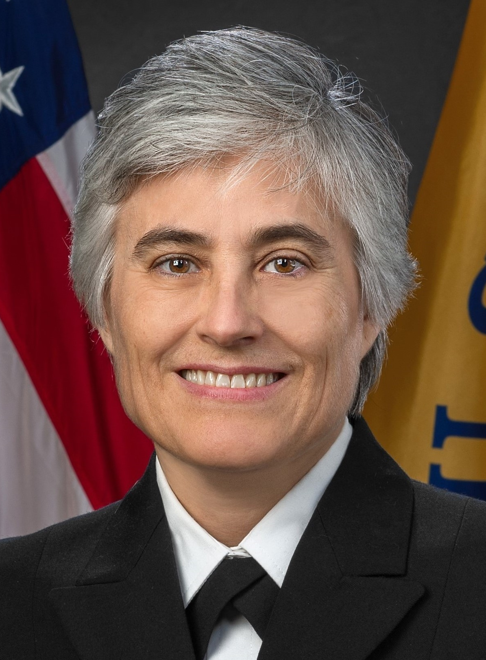

1. Molnupiravir Update |  | Amber Vasquez, MD, MPH Deputy Taskforce Lead, Healthcare Systems Worker Safety Taskforce U.S. Centers for Disease Control and Prevention
2. Omicron |  | B.1.1.529 – Omicron Variant Update John T. Brooks, MD Chief Medical Officer, COVID-19 Response U.S. Centers for Disease Control and Prevention
 |  | Viral Surveillance Update David E. Wentworth, PhD Lead, Surveillance & Emerging Variants Team, Laboratory and Testing Task Force, COVID-19 Emergency Response Chief, Virology Surveillance and Diagnosis Branch U.S. Centers for Disease Control and Prevention
 |  | Addressing Diagnostic Challenges Matthew J. Binnicker, PhD, D(ABMM) Professor of Laboratory Medicine and Pathology; Vice Chair of Practice, Department of Laboratory Medicine and Pathology; Medical Director, Clinical Virology Laboratory, Division of Clinical Microbiology Mayo Clinic, Rochester, Minnesota
3. Discussion/ Q&A |  | Kimberley Fox, MD, MPH Captain, U.S. Public Health Service Vaccine Task Force Co-Lead, COVID-19 Response U.S. Centers for Disease Control and Prevention |  | Sanjat Kanjilal, MD, MPH Instructor, Department of Population Medicine Harvard Pilgrim Healthcare Institute Harvard Medical School

Slide 4
Molnupiravir Update
Amber Vasquez, MD, MPH

Slide 5

B.1.1.529 – Omicron Variant Update
John T. Brooks, MD

Slide 6
B.1.1.529 – Omicron Variant Update
CDC COVID-19 Emergency Response
CDC All Hands
December 3, 2021

Slide 7
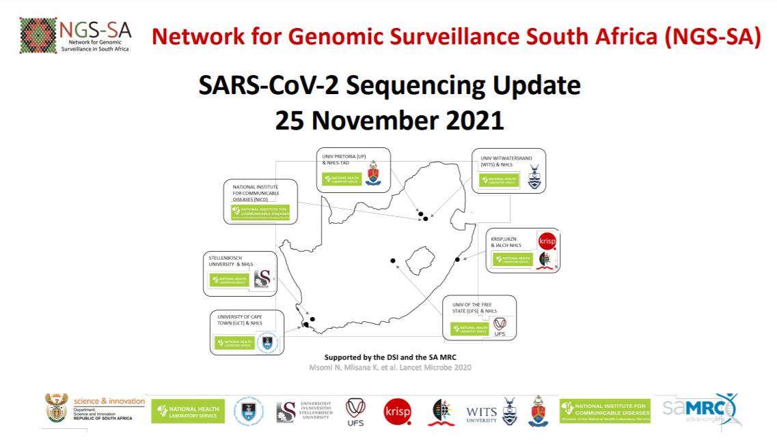
https://www.krisp.org.za/manuscripts/25Nov2021_B.1.1.529_Media.pdf

Slide 8
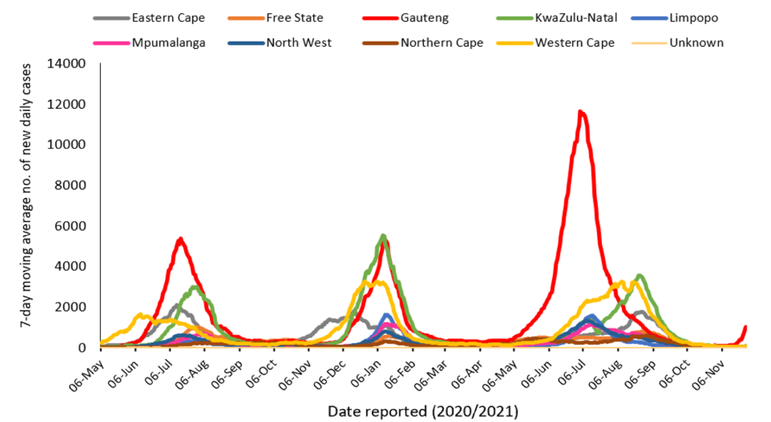

New cases by province – South Africa, 2020-2021
November 27, 2021
https://www.nicd.ac.za/latest-confirmed-cases-of-covid-19-in-south-africa-27-november-2021/

Slide 9
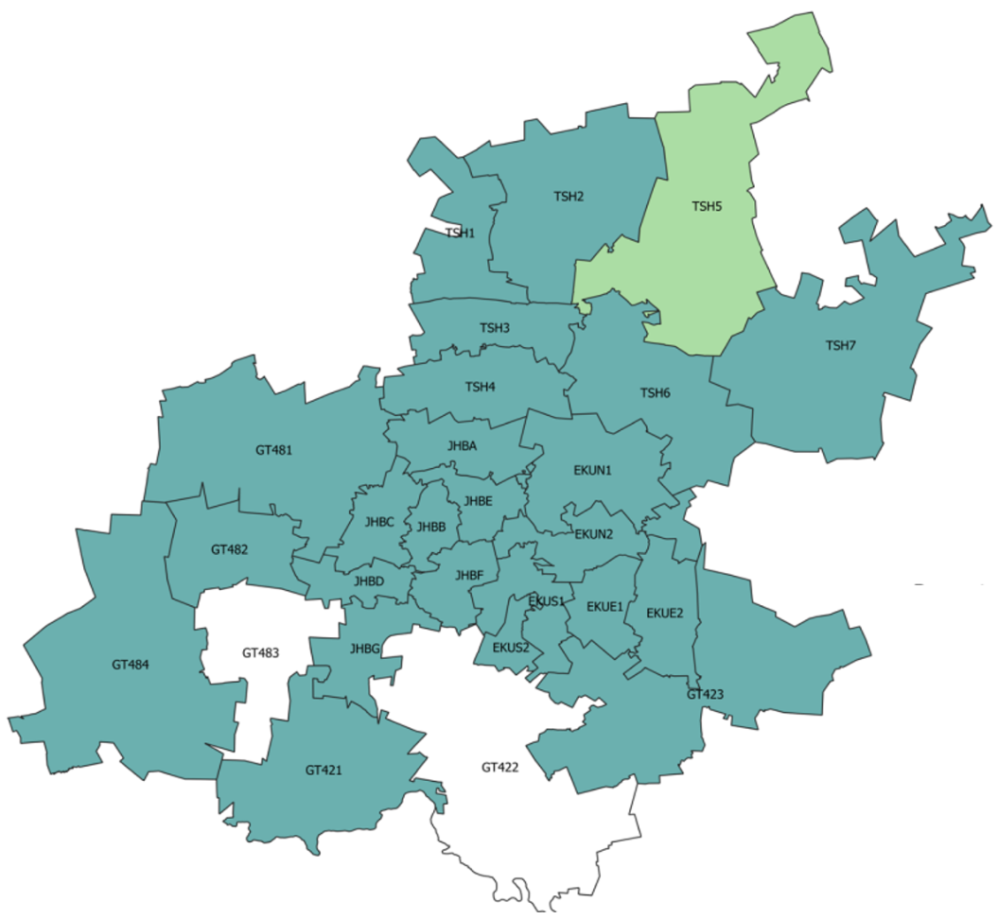
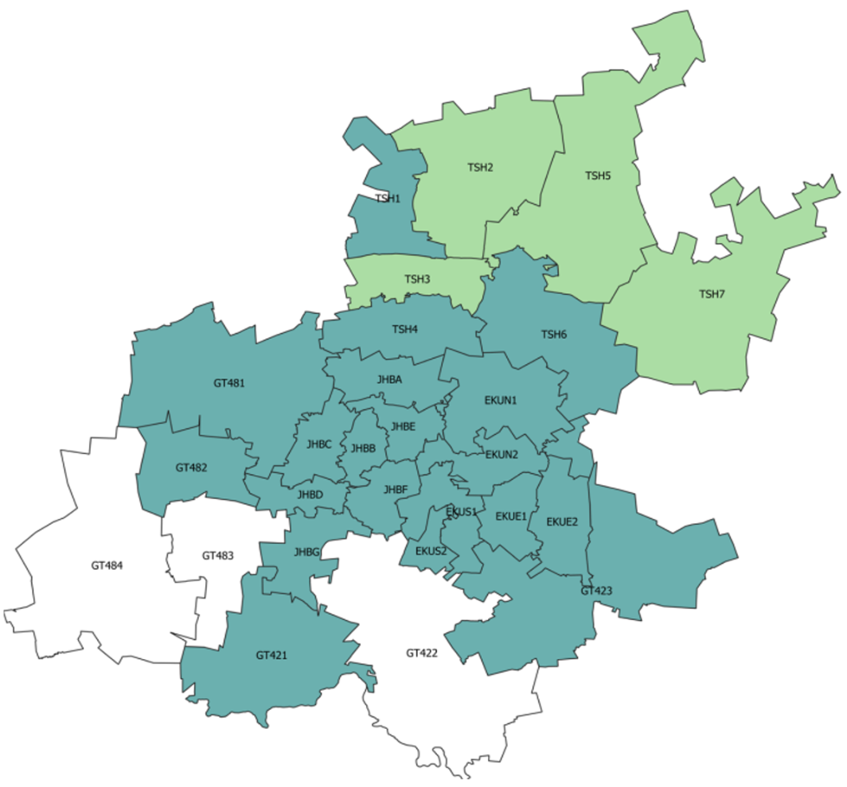
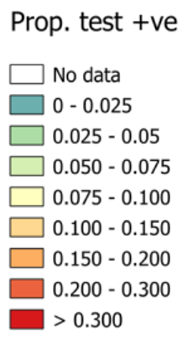
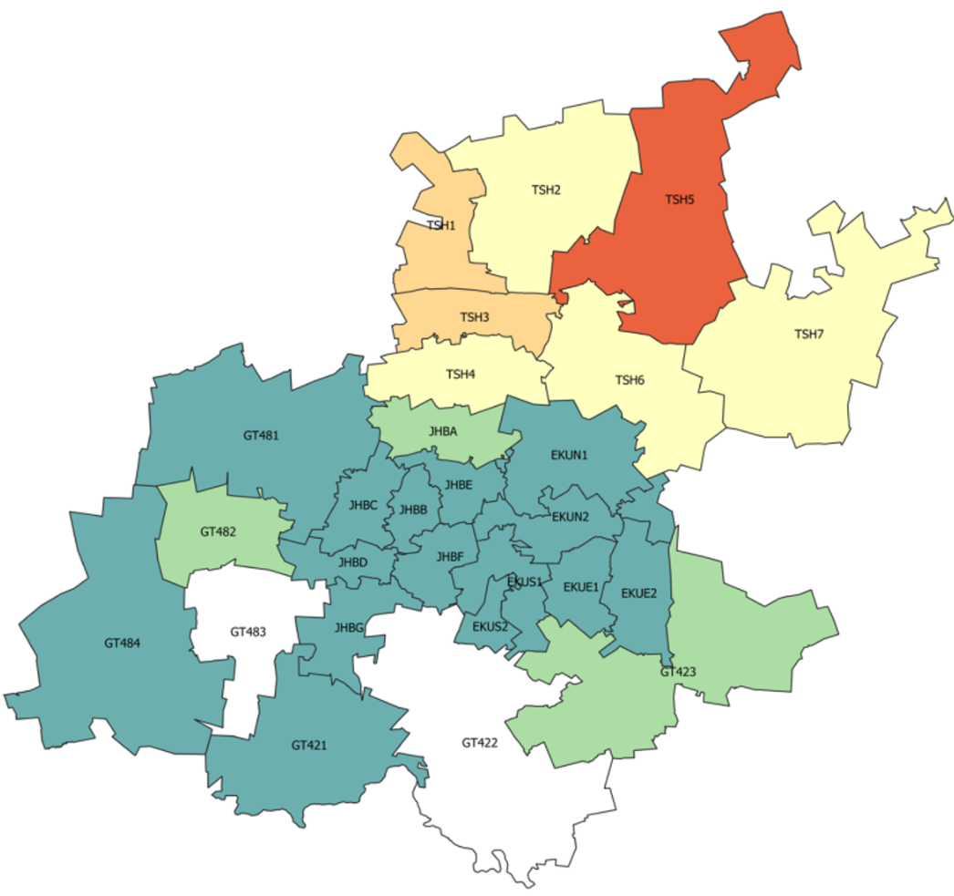

Test positivity rate – Gauteng Province
Week 44
(31 Oct – 6 Nov)
Week 45
(7 Nov – 13 Nov)
Week 46
(14 Nov – 20 Nov)
https://www.nicd.ac.za/diseases-a-z-index/disease-index-covid-19/surveillance-reports/weekly-testing-summary/

Slide 10
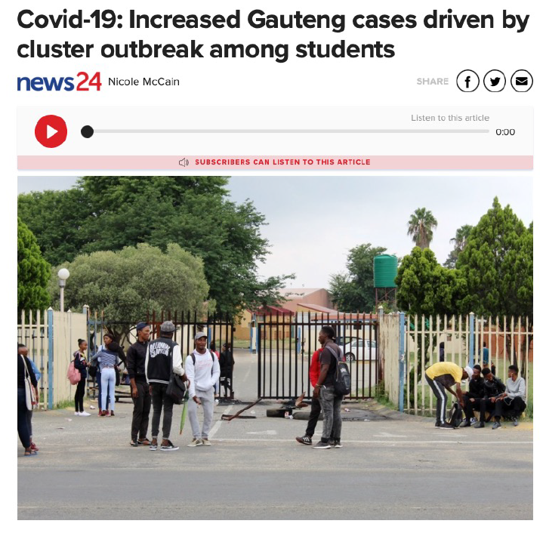
Increase in cases in Gauteng (Johannesburg) prompted investigation
Samples from 14-16 November
S-gene target failure (ThermoFisher TaqPath™ qPCR) from Δ69-70 deletion in spike sequence
23 November sequenced B.1.1.529
Is this a cluster outbreak?
Real resurgence (4th wave)?
November 23, 2021

Slide 11
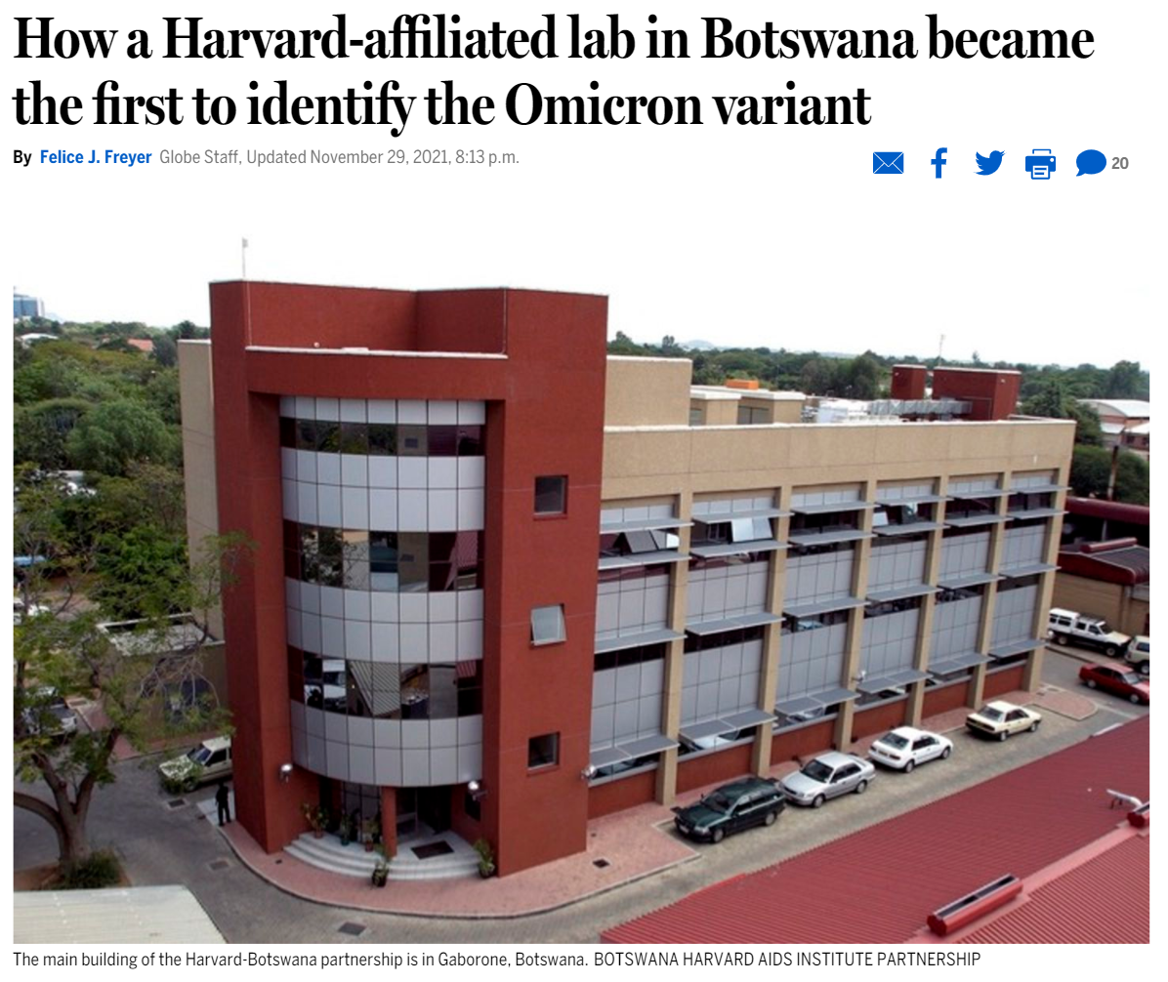
Lab in Botswana isolated B.1.1.529 in samples that had been collected on 11 November
Botswana, South Africa, and Hong Kong all uploaded the sequence to GISAID on 23 November
https://www.bostonglobe.com/2021/11/29/metro/how-harvard-affiliated-lab-botswana-became-first-identify-omicron-variant/

Slide 12
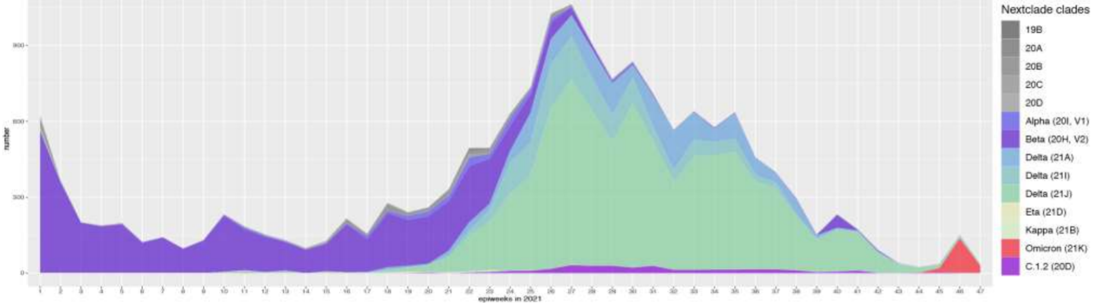
Number of variants by epiweek – South Africa, 2021
900
600
Number
Omicron (B.1.1.529)
300
Beta (B.1.351)
Delta (B.1.617.2)
0
Week in 2021
https://www.nicd.ac.za/wp-content/uploads/2021/12/Update-of-SA-sequencing-data-from-GISAID-1-Dec-Final.pdf

Slide 13
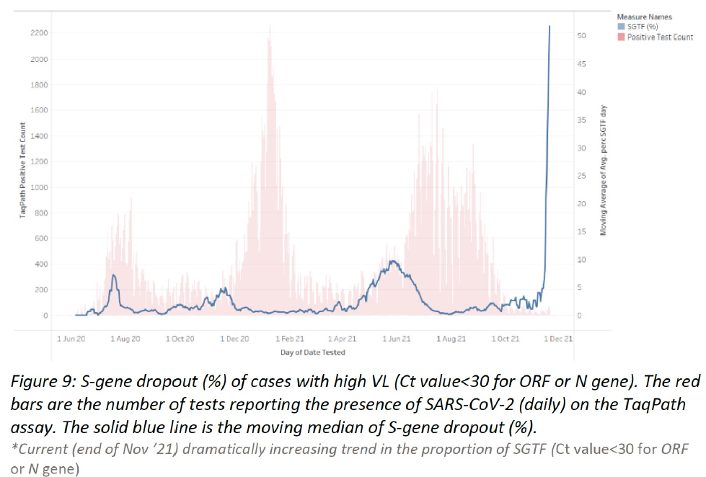
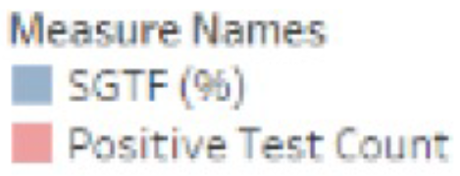

PCR proxy for new variant – S-gene target failure (SGTF)
New increase in S-gene target failure noted by NHLS and private labs very recently beginning in mid-November
TaqPath™ Positive Test County
Moving per day Average of Average Percent SGTF

Slide 14
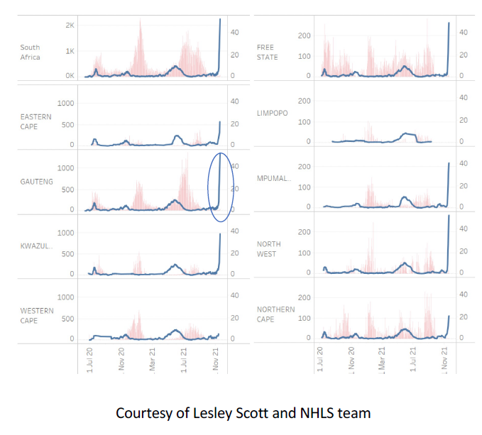
SGTF detected in multiple provinces
Rapid increase in proportion with SGTF noted across multiple provinces (caution low number of tests in most provinces)

Slide 15
New cases by province – South Africa, 2020-2021
November 27, 2021
https://www.nicd.ac.za/latest-confirmed-cases-of-covid-19-in-south-africa-27-november-2021/

Slide 16
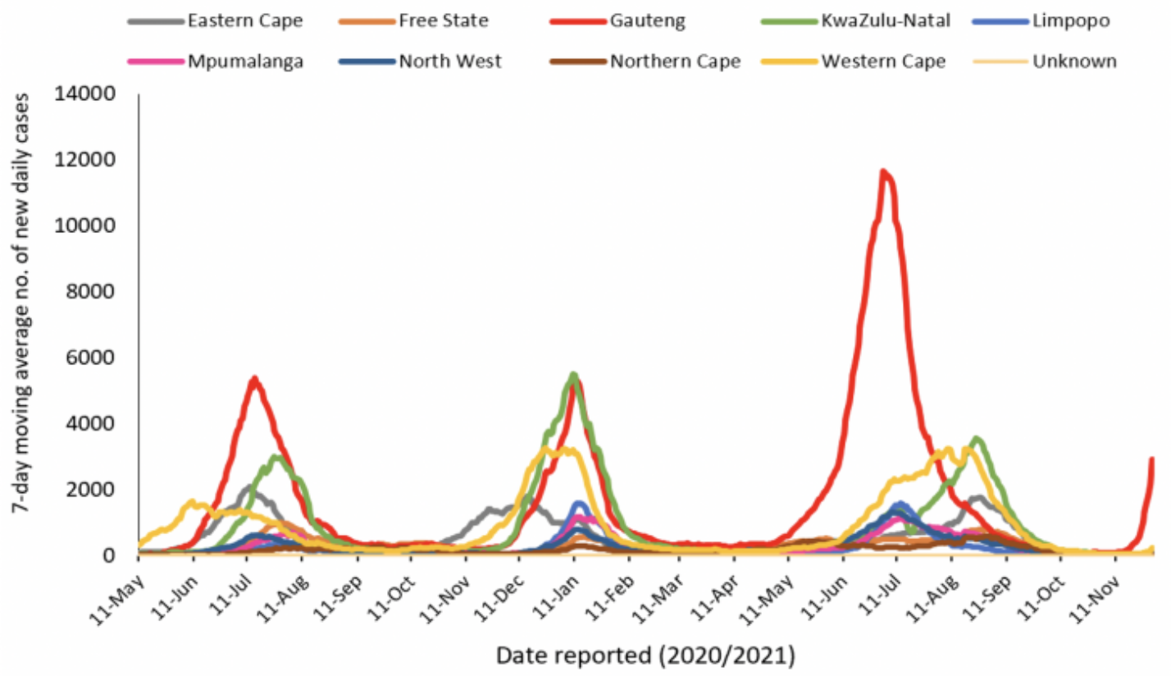
New cases by province – South Africa, 2020-2021
December 2, 2021
https://www.nicd.ac.za/latest-confirmed-cases-of-covid-19-in-south-africa-2-december-2021/

Slide 17
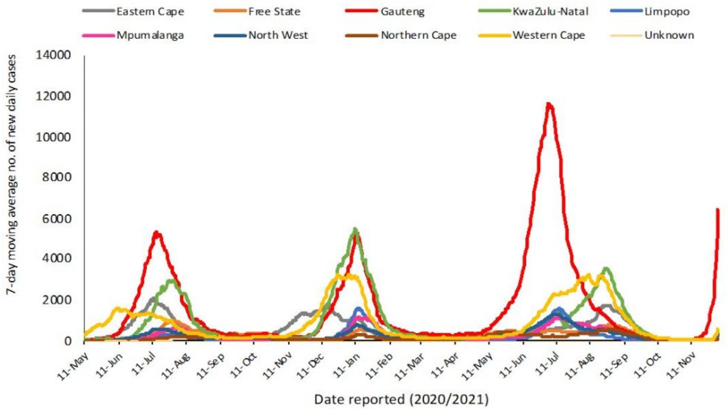
New cases by province – South Africa, 2020-2021
December 4, 2021
https://www.nicd.ac.za/latest-confirmed-cases-of-covid-19-in-south-africa-4-december-2021/

Slide 18
Test positivity rate – Gauteng Province
Week 44
(31 Oct – 6 Nov)
Week 45
(7 Nov – 13 Nov)
Week 46
(14 Nov – 20 Nov)
https://www.nicd.ac.za/diseases-a-z-index/disease-index-covid-19/surveillance-reports/weekly-testing-summary/

Slide 19
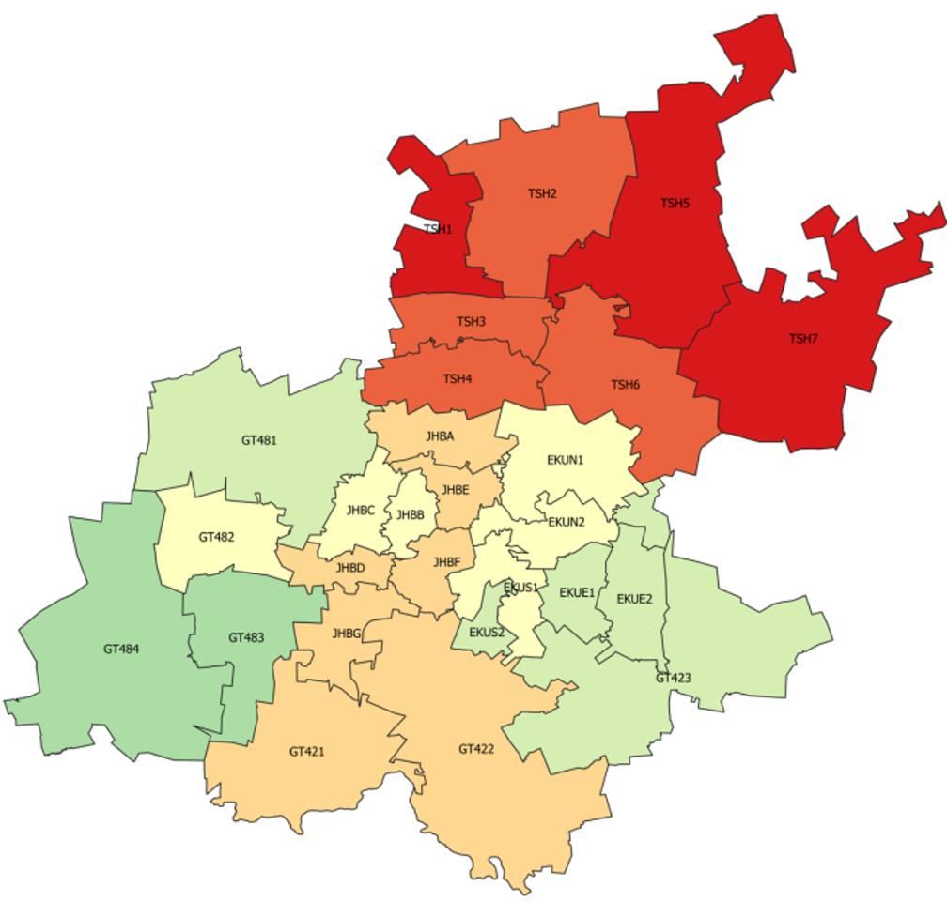
Test positivity rate – Gauteng Province
Week 45
(7 Nov – 13 Nov)
Week 47
(21 Nov – 27 Nov)
Week 46
(14 Nov – 20 Nov)
https://www.nicd.ac.za/diseases-a-z-index/disease-index-covid-19/surveillance-reports/weekly-testing-summary/

Slide 20
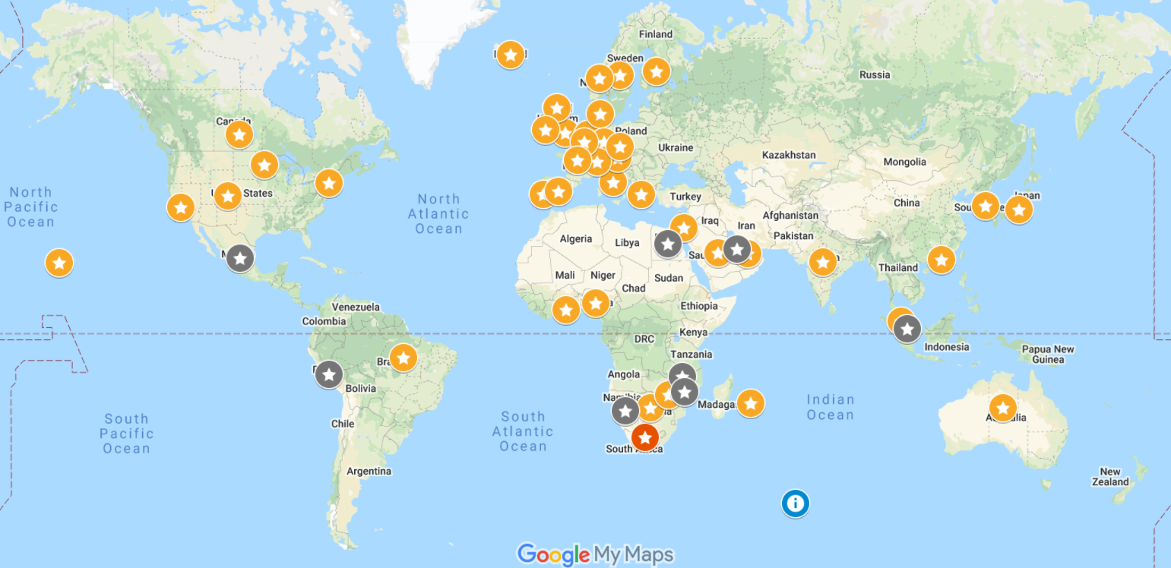





Confirmed and Presumptive B.1.1.529 Infections 03-Dec-2021 @10:00
Confirmed by
sequencing
Presumptive
by PCR SGTF
Courtesy of BNO News: https://newsnodes.com/nu_tracker

Slide 21
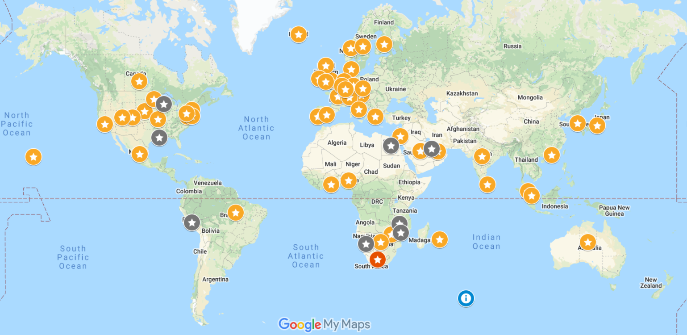
Confirmed and Presumptive B.1.1.529 Infections 04-Dec-2021 @13:00
Confirmed by
sequencing
Presumptive
by PCR SGTF
Courtesy of BNO News: https://newsnodes.com/nu_tracker

Slide 22
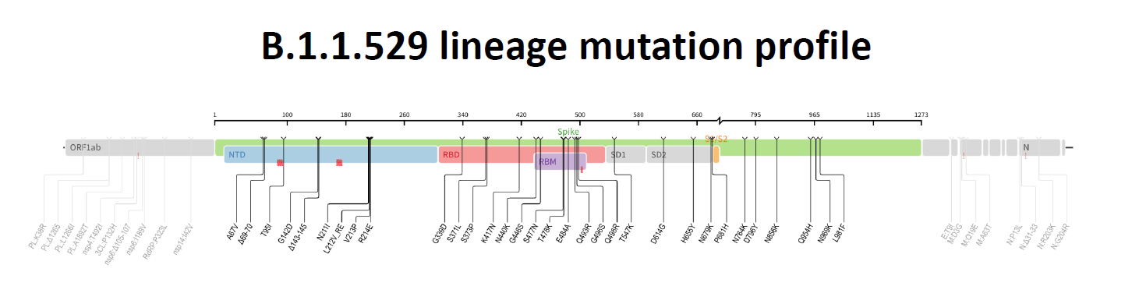
Unusually large number of mutations across the SARS-CoV-2 genome
45-52 amino acid changes, deletions, or insertions: 15 withing receptor binding domain
Some mutations well characterized with known phenotypic impact, but many others rarely observed until now and not well characterized
Known mutations have raised theoretical concerns that the Omicron variant might:
Be more infectious and transmissible than the Delta variant
Resist neutralization by vaccine- and infection-induced antibodies
Resist treatment with therapeutics
Evade innate immunity

Slide 23
Infection and clinical illness: Omicron variant
The variant has infected:
Fully vaccinated persons (unknown regarding boosted persons)
Persons recovered from Delta variant SARS-CoV-2 infection
No systematically collected data yet on:
Spectrum of signs, symptoms, and severity
South African public health authority has not officially reported any worrisome increase in hospitalizations, ICU admissions, or deaths signaling this variant is substantially more virulent, but these are early days
Many anecdotal report that illness is mild but also most cases thus far seem to be young adults, children, and travlers
https://www.telegraph.co.uk/global-health/science-and-disease/south-african-doctor-raised-alarm-omicron-variant-says-symptoms/

Slide 24
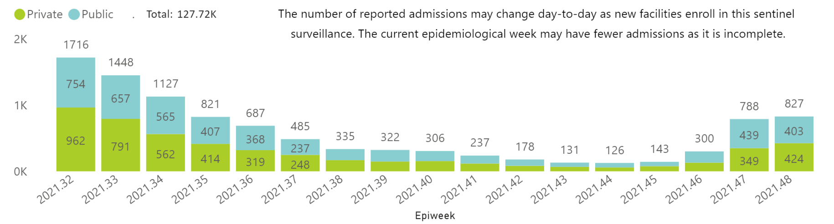

Hospital admissions of COVID-19 by epiweek and sector: Gauteng Province – 03-Dec-2021
Week Ending
6-NOV-2021
https://www.nicd.ac.za/diseases-a-z-index/disease-index-covid-19/surveillance-reports/daily-hospital-surveillance-datcov-report/

Slide 25
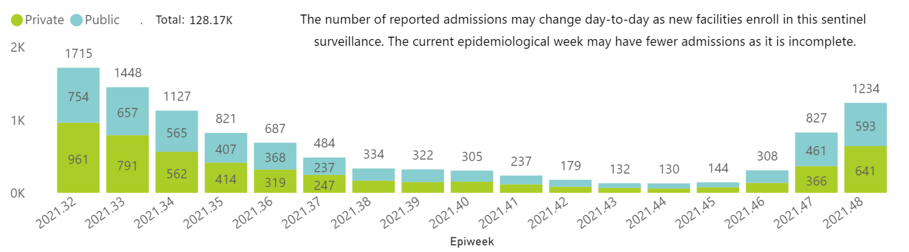
Hospital admissions of COVID-19 by epiweek and sector: Gauteng Province – 04-Dec-2021
Week Ending
6-NOV-2021
https://www.nicd.ac.za/diseases-a-z-index/disease-index-covid-19/surveillance-reports/daily-hospital-surveillance-datcov-report/

Slide 26
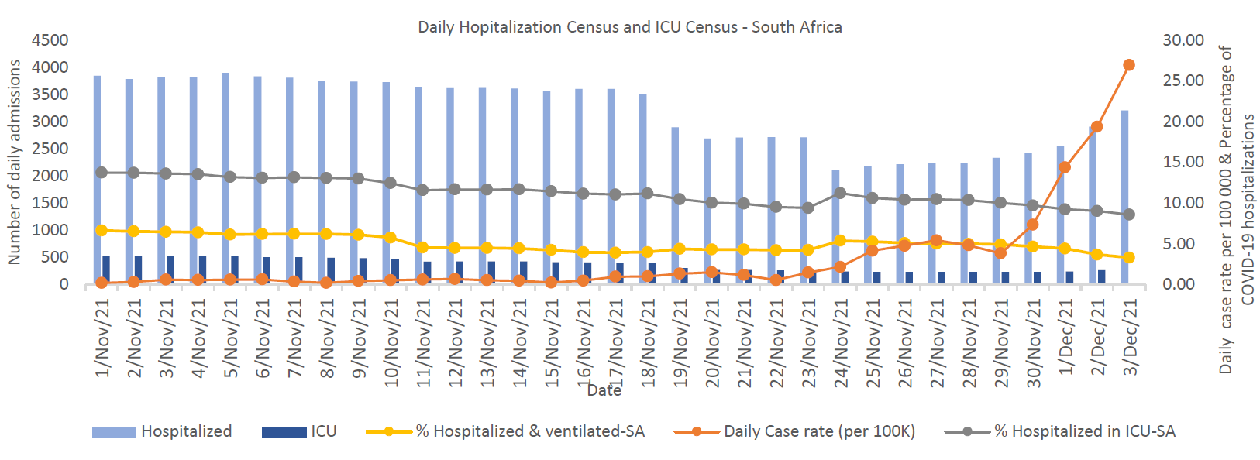
COVID-19 Daily Case Rates, Hospitalization Census and ICU Census - South Africa
https://www.nicd.ac.za/diseases-a-z-index/disease-index-covid-19/surveillance-reports/national-covid-19-daily-report/

Slide 27
Vaccines and therapeutics
Vaccines:
Expect decreased neutralization from vaccine and prior infection
Expect vaccines to remain effective against severe illness and death
Monoclonals:
No virus-specific data for FDA-authorized and available monoclonals
Antivirals:
No virus-specific data for remdesivir, molnupiravir, and PAXLOVID™

Slide 28
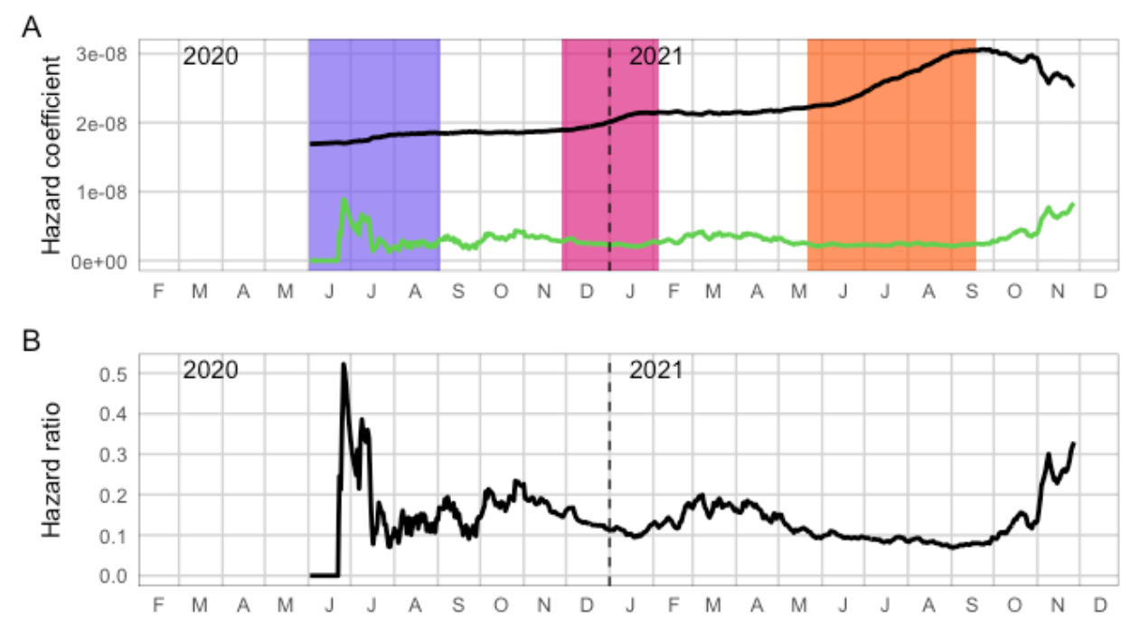
Empirical estimates of infection and reinfection hazards. A: Estimated time-varying hazard coefficients for primary infection and reinfections. Colored bands represent wave periods, defined as the period for which the 7-day moving average of cases was at least 15% of the corresponding wave peak. B: Ratio of the empirical hazard for reinfections to the empirical hazard for primary infections
Wave 1
Wave 2
Wave 3
primary infection (black)
reinfection (green)
For Wave 2 vs. Wave 1
relative hazard ratio:
0.75 (95%CI: 0.59–097)
For 01-Nov to 27-Nov vs. Wave 1
relative hazard ratio:
2.39 (95%CI: 1.88–3.11).
Source: Pulliam xet al. 2021, medRxiv; https://doi.org/10.1101/2021.11.11.21266068.

Slide 29
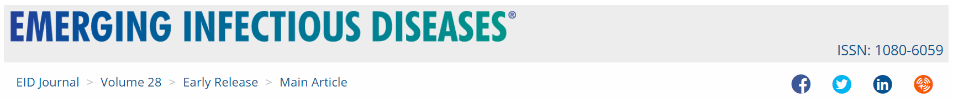

Two travelers arrive in Hong Kong and quarantine across the hall in same hotel
Arrived from A. South Africa (11-Nov) and B. Canada (10-Nov) one day apart
Confined to their rooms
No interaction, fully vaccinated (Pfizer), PCR negative <72 hours before arrival
A. PCR+ 13-Nov: asymptomatic
B. PCR+ 17-Nov: mild symptoms
Viral genomes differed by one nucleotide
Highly similar to South Africa and Botswana sequences
Source: https://wwwnc.cdc.gov/eid/article/28/2/21-2422_article

Slide 30
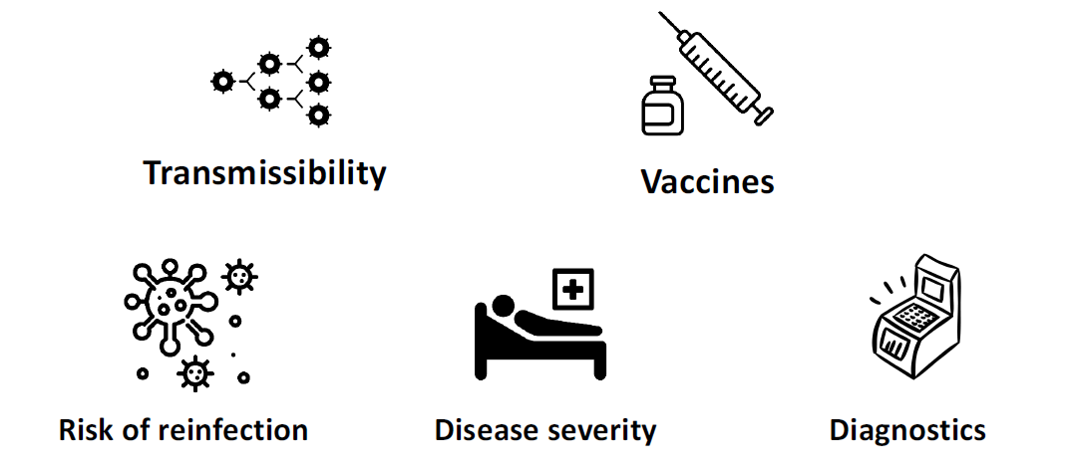
Work needed to understand phenotypic impact: “We know more about what we don’t know than what we do know” ….but we’re going to know more soon.

Slide 31
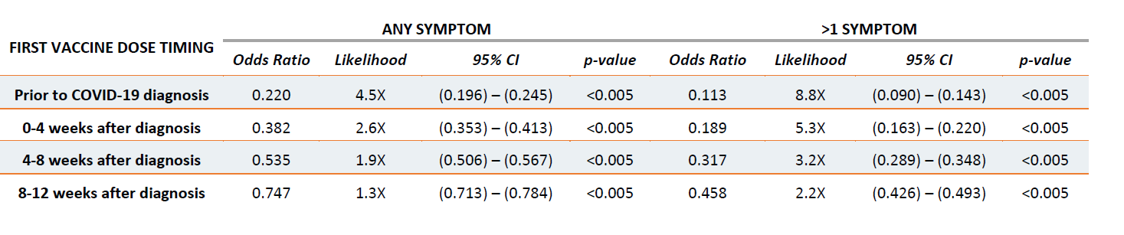
Vaccination before or after COVID-19 reduced ‘Long COVID’ risk
Retrospective analysis of the medical history of 240,648 COVID-19-infected persons
Long-COVID cases were classified as those where the patient presented one or more COVID-associated symptoms between 12 and 20 weeks after the initial COVID-19 diagnosis in the Arcadia Data Research dataset (Arcadia.io)
Source: Simon et al. 2020, medRix; https://doi.org/10.1101/2021.11.17.21263608

Slide 33
Viral Surveillance Update
David E. Wentworth, PhD

Slide 34
SARS-CoV-2 Surveillance and B.1.1.529/Omicron
David E. Wentworth , PhD
Lead, Strain Surveillance and Emerging Variants Team
Laboratory and Testing Task Force
CDC COVID-19 Emergency Response
Chief, Virology Surveillance and Diagnosis Branch
Director, WHO Collaborating Center for Surveillance, Epidemiology and Control of Influenza
Influenza Division, NCIRD, CDC
IDSA, 4 December 2021
The findings and conclusions in this report are those of the authors and do not necessarily represent the official position of the Centers for Disease Control and Prevention.

Slide 35
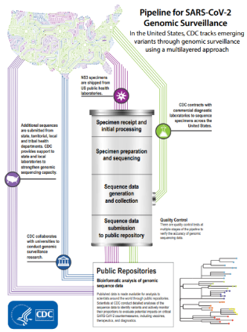
National SARS-CoV-2 Genomic Surveillance
In the United States, CDC tracks and analyzes emerging SARS-CoV-2 variants through multiple systems.
Leading the National SARS-CoV-2 Strain Surveillance (NS3) system
Partnering with commercial diagnostic laboratories
Supporting state, territorial, local and tribal health departments
Partnering with universities
Leading the SARS-CoV-2 Sequencing for Public Health Emergencies Response, Epidemiology, and Surveillance (SPHERES) Consortium
https://www.cdc.gov/coronavirus/2019-ncov/variants/cdc-role-surveillance.html

Slide 36
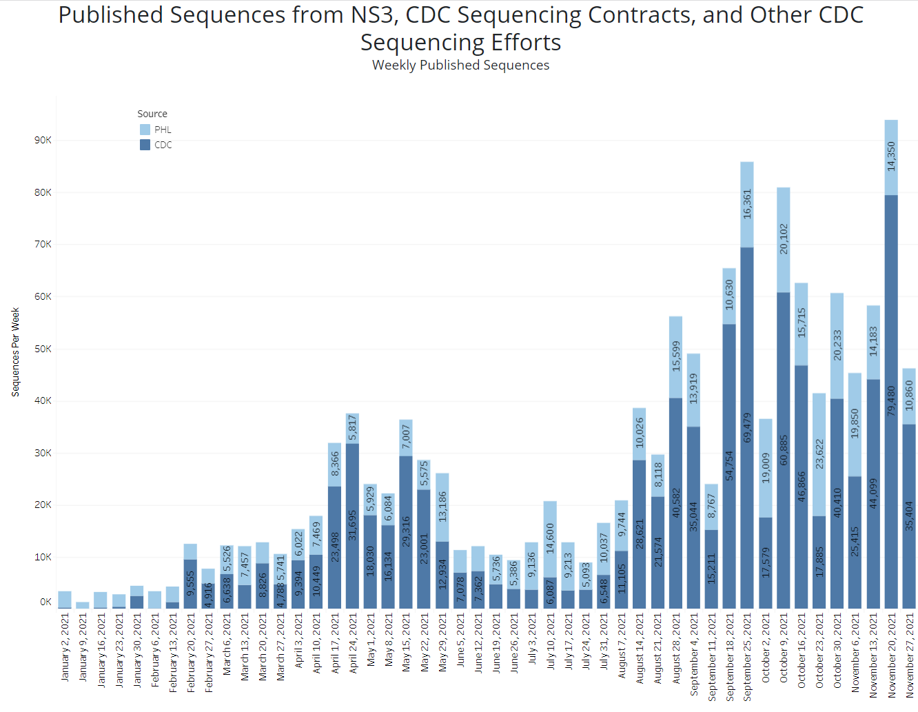
National SARS-CoV-2 Genomic Data Available
Omicron sequences available to date show
collection dates in mid November
Range from ~40-90 K sequences weekly in October and November
Omicron very rare, needed to target SGTF specimens for sequencing
https://covid.cdc.gov/covid-data-tracker/#published-sars-cov-2-sequences
Notes:
Alt text. Image shows sequences published from CDC efforts. Described in bullets.

Slide 37
National SARS-CoV-2 Strain Surveillance (NS3)
Enhanced Surveillance for SARS-CoV-2
Baseline virus surveillance
Request ~700 specimens/week
Population based
Representative specimens
Diverse specimens
Geographic location within jurisdiction
Patient demographics
Patient clinical information
Targeted surveillance
Additional interim specimens weekly
Address variants of interest
More narrow criteria
Dynamic - Variants of Interest
New variant lineage viruses (e.g., B.1.1.7)
https://www.cdc.gov/coronavirus/2019-ncov/variants/cdc-role-surveillance.html

Slide 38



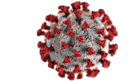
Initiated Enhanced Surveillance (ES) to Rapidly Identify and Obtain Putative Omicron Specimens
Goals
Provide mechanism for agile, targeted collection of novel/emerging variants and specimens harboring substitutions or mutations of interest
Isolation and phenotypic characterization of viruses
Revised guidance for Enhanced Surveillance announced 11/29/2021 *
ES21-01 – S gene target failure (SGTF)
Target potential Omicron (B.1.1.529) for identification and submission to CDC for verification (if needed) and for further characterization
Note there are other lineages circulating at low proportion that will yield SGTF with some assays
Resulted in first Omicron specimens detected on 12/01/2021
Additional detections on 12/02 and 12/03/2021
Clinical diagnostic labs and/or state public health labs sending in representative specimens
* https://www.aphl.org/programs/preparedness/Crisis-Management/Documents/NS3-Submission-Guidance.pdf

Slide 39
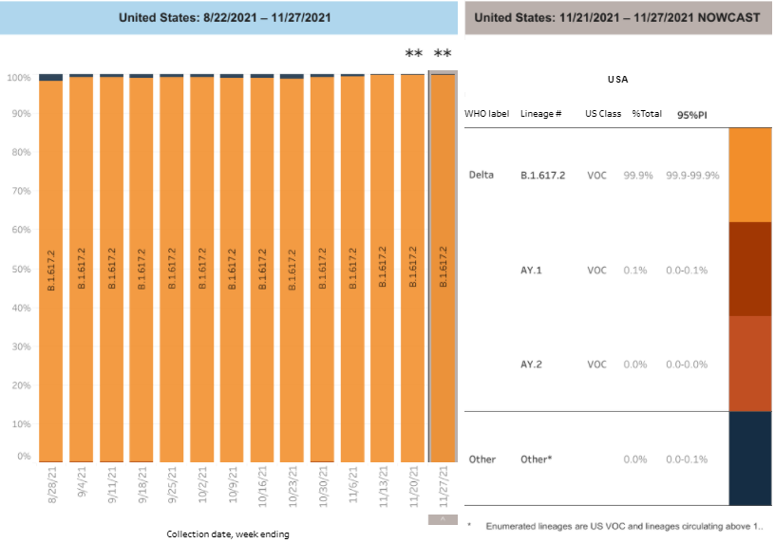
National Estimates of SARS-CoV-2 Lineages
Delta is estimated at 99.9%
Includes AY.3-AY.120 sublineages
AY.1 and AY.2
0.1% or less
Omicron detected in baseline surveillance
Period ending 12/3/2021
Nowcast Data updated 11/24/2021
https://covid.cdc.gov/covid-data-tracker/#variant-proportions
Notes:
Alt Text:
Bar Graph showing national proportions of variants Weighted estimates for >434,000 virus sequences collected 8/21/2021 – 11/13/2021, as of 11/24/2021. .
Illustrates predominance of Delta over all other lineages as described in bullets.
Embedded legend
* Other represents lineages circulating <1% nationally in the previous 12 weeks.
** These data include Nowcast estimates, which are modeled projections that may differ from weighted estimates generated at later dates.
# Sublineages of Delta AY.3-120 are aggregated with B.1.617.2, and AY.1, and AY.2 are segregated

Slide 41

Addressing Diagnostic
Challenges
Matthew J. Binnicker, PhD, D(ABMM)

Slide 42

The impact of Omicron on testing and future diagnostic considerations
Matthew J. Binnicker, Ph.D., D(ABMM)
Director of Clinical Virology
Vice Chair of Practice, Department of Laboratory Medicine and Pathology
Professor of Laboratory Medicine and Pathology
President, Pan American Society for Clinical Virology
@DrMattBinnicker

Slide 43
Disclosures
Advisory Board Member
DiaSorin Molecular
Mammoth Biosciences
Honoraria for Educational Presentations
DiaSorin Molecular
Roche Diagnostics
Medscape/WebMD

Slide 44
Objectives
Impact of Omicron on COVID-19 testing
Molecular (PCR) tests
Rapid, at-home tests (antigen)
Role of sequencing
Future diagnostic considerations
Expansion of at-home testing

Slide 45
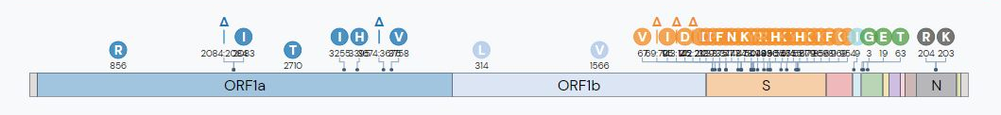
Impact of Omicron on COVID-19 molecular testing
Omicron has a high number of mutations, largely clustered in the gene encoding the spike (S) protein
Most commercially-available molecular tests target ≥2 SARS-CoV-2 genes
Omicron likely detected by molecular testing
However, routine tests unable to distinguish Omicron from other variants
Source: outbreak.info

Slide 46

Gene targets of major commercial COVID-19 molecular tests
 | Envelope | Nucleocapsid | Orf-1a/b | RdRp | Spike
Abbott
Cepheid
DiaSorin
Hologic
Roche
Thermo Fisher
*
*Targets 2 unique regions of Orf
“S drop out may serve as early indicator of Omicron infection; requires sequencing to confirm”

Slide 47
Impact of Omicron on COVID-19 antigen testing
Most commercially-available rapid antigen tests target the nucleocapsid (N) protein
Omicron should be detected by antigen tests
Negative result should not rule-out COVID-19 if high index of suspicion
Source: outbreak.info

Slide 48
Future Diagnostic Considerations
Likely to see an expansion of at-home testing options
Advantages:
Rapid (results in 15-20 minutes)
Ease-of-use
Limitations/Considerations:
Limited sensitivity (symptomatic [~80%]; asymptomatic [~40%])¹
¹Pray IW et al. 2021 MMWR 69(5152):1642-16477

Slide 49
Future Diagnostic Considerations
Limitations/Considerations:
Positive results should be confirmed by lab-based test in order to:
Track positive cases
Connect patients with healthcare team for appropriate management and follow-up

Slide 50
Summary
Omicron variant should be detected by majority of current COVID-19 tests (molecular and antigen)
Sequencing required to distinguish omicron from other variant strains (i.e., delta)
At-home testing will likely increase in the future
Negative test should not be considered a ‘free pass’
Positive result should be confirmed by lab-based test

Slide 51
Questions?

Slide 52
Q&A/Discussion

Slide 53
Today’s Links
Program Links:
This webinar is being recorded and can be found with the slides online at https://www.idsociety.org/cliniciancalls
RTLN Survey - https://www.surveymonkey.com/r/BFBJ5CK
COVID-19 Real-Time Learning Network: https://www.idsociety.org/covid-19-real-time-learning-network/
Vaccine FAQ: https://www.idsociety.org/covid-19-real-time-learning-network/vaccines/vaccines-information--faq/
Dr. Vasquez’s Links:
The FDA slides available here: https://www.fda.gov/media/154473/download
Dr. Brooks’ Links:
Slide 7 - https://www.krisp.org.za/manuscripts/25Nov2021_B.1.1.529_Media.pdf
Slide 8 - https://www.nicd.ac.za/latest-confirmed-cases-of-covid-19-in-south-africa-27-november-2021/
Slide 9 - https://www.nicd.ac.za/diseases-a-z-index/disease-index-covid-19/surveillance-reports/weekly-testing-summary/
Slide 11 - https://www.bostonglobe.com/2021/11/29/metro/how-harvard-affiliated-lab-botswana-became-first-identify-omicron-variant/
Slide 12 - https://www.nicd.ac.za/wp-content/uploads/2021/12/Update-of-SA-sequencing-data-from-GISAID-1-Dec-Final.pdf
Slide 17 - https://www.nicd.ac.za/latest-confirmed-cases-of-covid-19-in-south-africa-4-december-2021/
Slides 18/19 - https://www.nicd.ac.za/diseases-a-z-index/disease-index-covid-19/surveillance-reports/weekly-testing-summary/

Slide 54
Today’s Links Continued
Dr. Brooks’ Links Continued:
Slides 20/21 - https://newsnodes.com/nu_tracker
Slide 23 - https://www.telegraph.co.uk/global-health/science-and-disease/south-african-doctor-raised-alarm-omicron-variant-says-symptoms/
Slide 24/25 - https://www.nicd.ac.za/diseases-a-z-index/disease-index-covid-19/surveillance-reports/daily-hospital-surveillance-datcov-report/
Slide 26 - https://www.nicd.ac.za/diseases-a-z-index/disease-index-covid-19/surveillance-reports/national-covid-19-daily-report/
Slide 28 - ; https://doi.org/10.1101/2021.11.11.21266068
Slide 29 - https://wwwnc.cdc.gov/eid/article/28/2/21-2422_article
Slide 31 - ; https://doi.org/10.1101/2021.11.17.21263608
Dr. Wentworth’s Links:
Slides 35/37- https://www.cdc.gov/coronavirus/2019-ncov/variants/cdc-role-surveillance.html
Slide 36 - https://covid.cdc.gov/covid-data-tracker/#published-sars-cov-2-sequences
Slide 38 - https://www.aphl.org/programs/preparedness/Crisis-Management/Documents/NS3-Submission-Guidance.pdf
Slide 39 - https://covid.cdc.gov/covid-data-tracker/#variant-proportions

Slide 55


Real-Time Learning Network Needs your Feedback
Help shape future plans for the COVID-19 Real-Time Learning Network (RTLN).
Your responses to this short survey will ensure that the RTLN is useful for front-line clinicians.
https://www.surveymonkey.com/r/BFBJ5CK

Slide 56


Continue the conversation on Twitter @RealTimeCOVID19 #RealTimeCOVID19
We want to hear from you!
Please complete the post-call survey.
Next Call
Saturday, Dec. 18th
A recording of this call will be posted at www.idsociety.org/cliniciancalls
-- library of all past calls now available --
Contact Us:
Dana Wollins (dwollins@idsociety.org)
Deirdre Lewis (dlewis@idsociety.org)

